Slide 1
PAYMENTS BY AMBIENT OUTCOMES: HOW DOES TARGETING ARISE?
Presentation at:
Targeting BMPs Workshop
Fairfax, WV
November 12, 2019

Slide 2
Authors
Alan R. Collins, Professor in the Division of Resource Economics and Management, West Virginia University
Neil Gillies, Cacapon Institute, Retired
http://www.cacaponinstitute.org/
Peter Maille, Associate Professor of Economics, Eastern Oregon University

Slide 3
Outline
Introduction: Project overview, study area, and research question
Methods : Economic incentive, payments made, institutional and social elements,
information gathering, determining a
plan of action, and implementation of a
treatment wetland
Results: Installation of a treatment wetland, cost
and water quality outcomes
Conclusions: What we learned and where to go from here

Slide 4
Project Overview
This presentation will describe the final outcome of a three year field experiment (from 2007 to 2009) involving performance-based economic incentives for control of agricultural non-point pollution.
This project was funded by the National Research Initiative of the U.S. Department of Agriculture.

Slide 5
Project Overview
The literature on ambient quality incentives and group approaches to water quality improvement has examined both theoretical and laboratory experiment aspects (Spraggon; Romstad; Poe et al.; Taylor et al.; and Vossler et al.).
We felt what was needed were “real” people and “real” consequences to get a better understanding of the social context within which farmer behaviors take place.

Slide 6
Project Overview
Our experiment was unique in the sense that:
It involved real farmers and real money.
Farmers were charged with making abatement decisions.
Both the economic incentives and the decision making were made on a group basis within a watershed.

Slide 7
Project Overview
Incentive payments were based on the quality of water leaving the study watershed, rather than payments for specific actions by the farmers.
Water quality changes were measured by determining nitrate-N (NO₃-N) load relative to a reference watershed.

Slide 8
Project Overview
Group membership was voluntary.
Farmers were responsible for formation of a group and deciding what to do with the incentive payments.
Ultimately, they decided to reserve 90% of monthly payments as cost-share for projects to improve water quality.

Slide 9
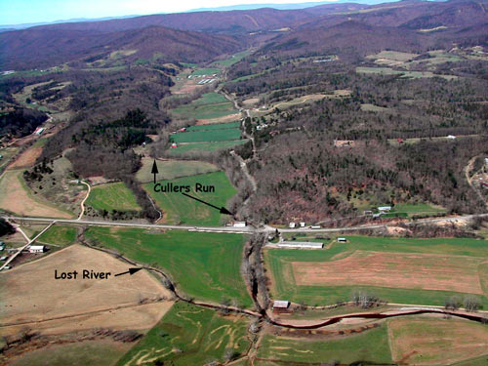
Study Area
Cullers Run watershed
A stream tributary of the Lost River in the eastern panhandle region of West Virginia.
Water quality sampling since 1995
Highest NO₃-N tributary in the Lost River watershed
Cacapon Institute, 2007

Slide 10
Study Area
Contains 2,978 hectares in West Virginia’s largest poultry production county.
Sixteen percent of the watershed is devoted to agriculture, with cropland concentrated at lower end.
Distinct nitrate gradient related to land use from upper to lower watershed.
Cacapon Institute, 2007

Slide 11
Study Area
The rest of the watershed is forest.
There are approximately twelve poultry houses conducting intensive poultry production in the watershed.
Most agricultural fertilizer use in the watershed is provided by poultry litter.
Cacapon Institute, 2007

Slide 12
Research Question
During our experiment, a question arose among farmers in the watershed about nitrates in the stream:
What more can we do?
The project outcome led to a targeted approach that answered this very question.

Slide 13
Economic Incentive
Monthly group payments to farmers were determined by:
Watershed = volume*unit price*Quality
Payment factor
Volume units are in acre-feet.

Slide 14
Unit Prices for Water
These were based on computation of the monetary loss from reduced agricultural production if riparian buffers were installed to improve water quality.
.
Table 1. Water Price Summary
May through September |  | October through April
Cullers Run Stream Discharge (ac-ft) | Dollars per Acre-Foot | Cullers Run Stream Discharge (ac-ft) | Dollars per Acre-Foot
Up to 320 | 18 | Up to 740 | 8
321-800 | 8 | Over 740 | 5
Over 800 | 5

Slide 15
Quality Factor
The quality factor incorporates water quality changes with NO₃-N ambient quality.
Equal to the ratio of loadings:
Pounds of NO₃-N from a control watershed divided by pounds of NO₃-N from the experimental watershed

Slide 16
Payments Made to Farmers
Over the three year project, a total of $16,483 was paid out to the farmer group.
The farmer group cost shared $6,288 for: (1) seed costs to plant cover crops on corn fields, and (2) to fence cattle out of a portion of the stream.
Farmers utilized $6,195 to help fund a constructed wetland treatment system.

Slide 17
Essential Elements of Social Engagement
Utilize multiple avenues to advertise and inform local farmers about the field experiment.
Be generous in holding meetings – provide free meals & maps.
Engage the local community: community groups, elected officials, county agent, and government agency personnel.

Slide 18
Institutional Outcomes
A written agreement was created and signed by farmers and researchers. Farmers were given numerous input opportunities and a lawyer was consulted.
A farmer advisory committee was established to recommend how to allocate the watershed payments among participants.

Slide 19
Participation Achieved
During the experiment, 15 farmer households, representing about 53% of the watershed farm households, signed-up to participate.
These farmers rent or own approximately 36% of the agricultural land in Cullers Run watershed.

Slide 20
Information Gathering
While cost-share funds accumulated in 2007 and 2008, farmers requested a series of watershed wide samplings to detect areas within the watershed that were contributing elevated levels of NO₃-N.

Slide 21
Sub-watersheds in Cullers Run
Whetzel
2nd BR
Shipe
RT 259

Slide 22
RESULTS OF SAMPLING

Slide 23
Information Gathering
As a result of these watershed wide samplings and some additional concentrated sampling along the lower part of the main stem of Cullers Run, a subsurface flow path of concentrated NO₃-N was pinpointed in August 2008.

Slide 24
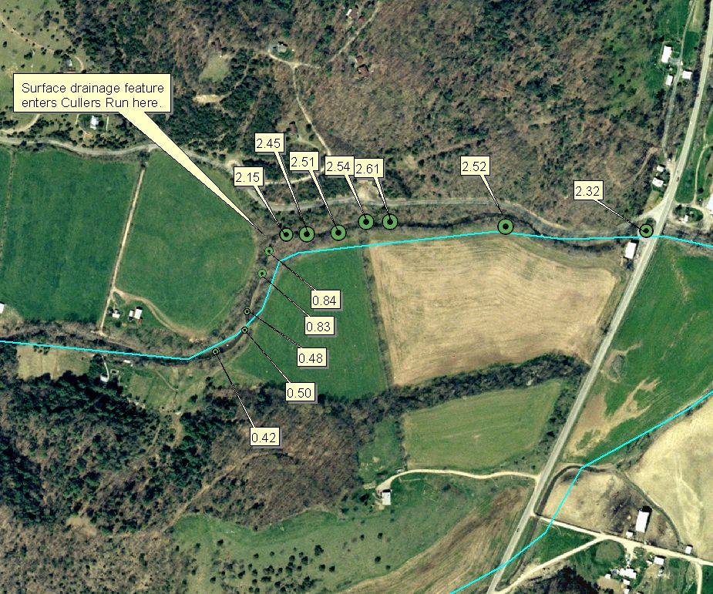
This resulted in conversion of a non-point problem into a point source problem.
Photo shows Water quality sampling for NO₃-N in mg/l on August 19, 2008.

Slide 25
What Needs to be Done?
Identify the possible source (s) of nitrates.
Come up with an action plan to prevent nitrates from entering the stream.
Implement and then assess this action plan.
In this situation, all of these steps need to occur by working in conjunction with a landowner who is not among the participants in the field experiment.

Slide 26
Source Identification
Landowner permission was received to install groundwater monitoring wells in the field adjacent to the nitrate discharge.
NRCS assessed the soils and assisted in drilling the wells in January 2009.
Groundwater quality sampling was conducted in February and March 2009.

Slide 27
Source Identification
While somewhat equivocal, NO₃-N results from the well closest to the stream and measured groundwater inflow to the stream supported the existence of a subsurface flow path.
Later sampling suggested that, during wet periods, this subsurface path occurred as sheet flow along the valley’s longitudinal axis, rather than a confined “stream”.

Slide 28
Action Plan
Shrub plantings along subsurface pathways were discussed to address nitrates. Ultimately, our focus shifted to a wetland treatment system which could potentially take care of the problem within a shorter timeframe while taking a minimal area out of production (less than ¼ of an acre).
Canaan Valley Institute (CVI) was hired in July 2009 to design a wetland treatment system.

Slide 29
Action Plan
The CVI engineer came up with an initial design which was modified based on discussions with and concerns of the landowner.
This design called for a 0.2 acre wetland consisting of a lined, horizontal trench to be constructed parallel to the stream.
This wetland is designed to capture subsurface flow and funnel it through an anaerobic, carbon rich environment in order to denitrify the groundwater.

Slide 30
Results
The farmer group agreed to pursue a treatment wetland system as a solution to subsurface NO₃-N flows in August 2009.
After more than two months of negotiations and coming up with a three page agreement, the landowner agreed to allow construction of the wetland in October 2009.

Slide 31
Results
Farmer participants were instrumental in convincing the landowner to participate by both meeting with him and sending him letters.
Final compensation to the landowner for lost production was agreed to be $2,000.

Slide 32
Results
Construction and material bids were put out in October 2009.
Two bids were received and farmer group selected the lowest bid.
Construction of the treatment system occurred in November 2009.

Slide 33
Treatment System Cost
DESIGN $ 5,129
CVI OVERSIGHT $ 7,743
NON BID MATERIALS $ 3,450
COMPENSATION $ 2,000
INSTALLATION $11,140
TOTAL $29,462

Slide 34
Farmer Group Contribution
Of the over $29,000 spent on the treatment system, the farmer group contributed 2/3 of their remaining funds (about $6,200) to pay for the treatment system. The rest came from unallocated group funds in the research grant.

Slide 35
Treatment System Outcomes
Data over a five year period (2006 to 2011) pre- and post- were analyzed.
In-stream reductions of NO₃N reductions during the growing season of 0.14 mg/l (17% decrease) attributed to installation of the system.
Estimated cost of removal was around $30 per kg.

Slide 36
What We Learned:
Farmers can problem solve to target BMPs on a watershed basis. Money is not the only motivation to provide this assistance.
Spending group funds is different from spending individually allocated funds.
Farmers needed assistance in information gathering and technical solutions.

Slide 37
What We Learned:
Farmers can make water quality decisions and take action to problem solve when provided with technical assistance and appropriate data.
Working as a group, farmers can put forth solutions that would have required regulatory enforcement to solve under a command and control framework.

Slide 38
What We Learned:
Water quality experts and farmers can work efficiently together to problem solve and, if necessary, target water quality solutions.
In our case study, cash incentives based on water quality turned this information into a tool farmers could use to make additional money, rather than a threat to their livelihood. It was this dynamic – an alignment of interests - that motivated participating farmers to cooperate with water quality experts.
38

Slide 39
Publications from this Project
Collins, A. R. and N. Gillies. 2014. “Constructed Wetland Treatment of Nitrates: Removal Effectiveness and Cost Efficiency.” Journal of the American Water Resources Association. 50(4): 898-908.
Maille, P. and A.R. Collins. 2012. “A Simple Approach to Calculating Performance-Based Payments for Water Quality.” Journal of Environment Management 99:27-35.
Collins, A.R. and P. Maille. 2011. “Group Theory and Behavior under Performance-Based Water Quality Incentives.” Ecological Economics 70(4):806-812.
Maille, P., and A. Collins. 2009. "Farmers as Producers of Clean Water: A Field Experiment” in Water, Agriculture and Sustainable Well-Being, Eds. U. Pascual, A. Shah, J. Bandyopadhyay. Oxford University Press: New Delhi. pp. 93-114.
Maille, P., A. Collins, and N. Gillies. 2009. "Performance-based Payments for Water Quality: Experiences from a Field Experiment.” Journal of Soil and Water Conservation. 64(3):85-87.

Slide 40
What now?
Tried to obtain an USDA/NIFA integrated grant (teaching, research, extension) in 2011 to target BMPs over the entire Lost River Basin using a similar collaborative approach – not successful.
What are the constraints to implementing group performance-based economic incentives elsewhere, particularly in larger watersheds?
Larger question is: what is the proper social construct that needs to be created so that stakeholders become engaged in targeting BMPs for water quality within a multiple landowner watershed?
40

Slide 41
References
Poe, G.L., W.D. Schulze, K. Segerson, J.F. Suter, and C.A. Vossler. 2004. Exploring the performance of ambient-based policy instruments when nonpoint source polluters can cooperate. American Journal of Agricultural Economics 86 (5), 1203-1210.
Romstad, E. 2003. Team approaches in reducing nonpoint source pollution. Ecological Economics 47 (1), 71-78.
Spraggon, J. 2004. Testing ambient pollution instruments with heterogenous agents. Journal of Environmental Economics and Management 48, 837-856.
Taylor, M.A., B. Sohngen, A. Randall, and H. Pushkarskaya. 2004. Group contracts for voluntary nonpoint source pollution reductions: Evidence from experimental auctions. American Journal of Agricultural Economics 86 (5), 1196-1202.
Vossler, C., G.L. Poe, W.D. Schultz, and K. Segerson. 2006. Communication and incentive mechanisms based on group performance: An experimental study of nonpoint pollution control. Economic Inquiry 44, 599-613.

Slide 42
QUESTIONS OR COMMENTS??

