Slide 1




STAC Targeting Workshop 11/12/2019
Presented By:
Water Science Institute and Lancaster Clean Water Partners
Presenters:
Joe Sweeney, Executive Director, Water Science Institute
Allyson Gibson, Coordinator, Lancaster Clean Water Partners
Contributors:
Carly Dean, Chesapeake Conservancy
Dr. Dorothy Merritts, WSI and Franklin and Marshall College,
Dr. Robert Walter, WSI and Franklin and Marshall College
Logan Lewis, WSI
Shelby Sawyer, WSI
Mike Rahnis, CEO, Topomatrix and WSI Partner

Slide 2


Copyright 2019
Water Science Institute
All rights reserved

Slide 3


Walter and Merritts, 2008. Natural Streams and the Legacy of Water Powered Mills.
Copyright 2019
Water Science Institute
All rights reserved

Slide 4
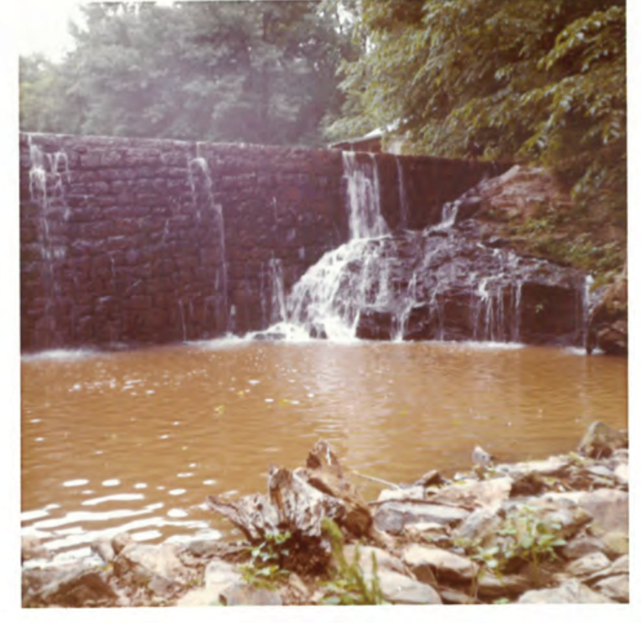
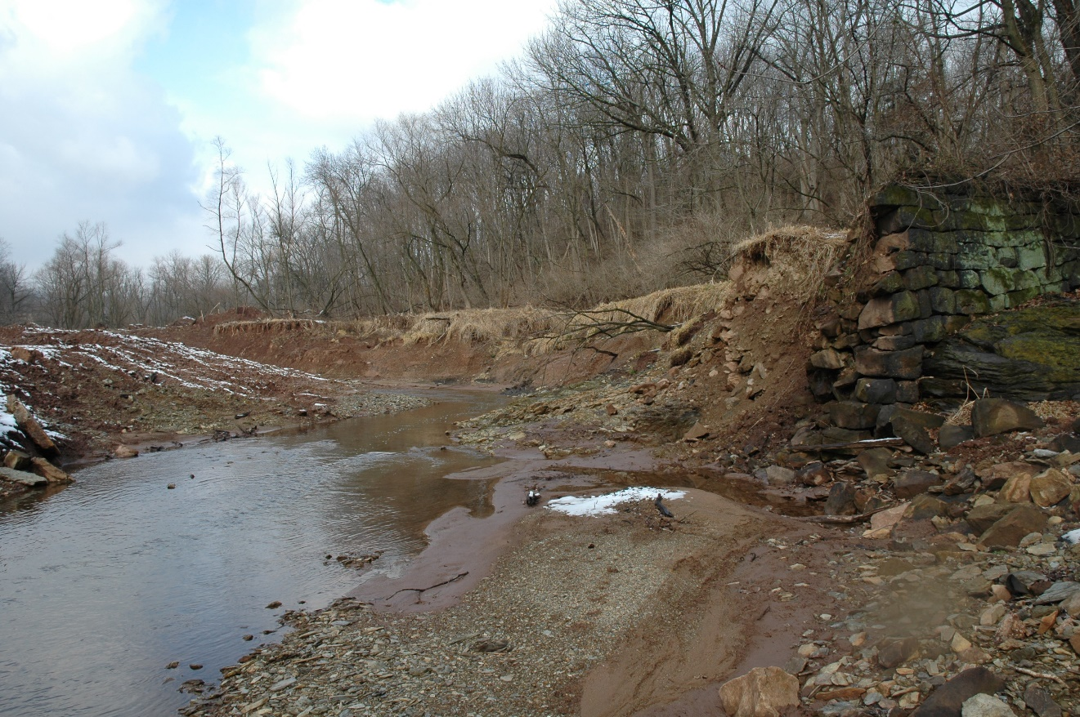
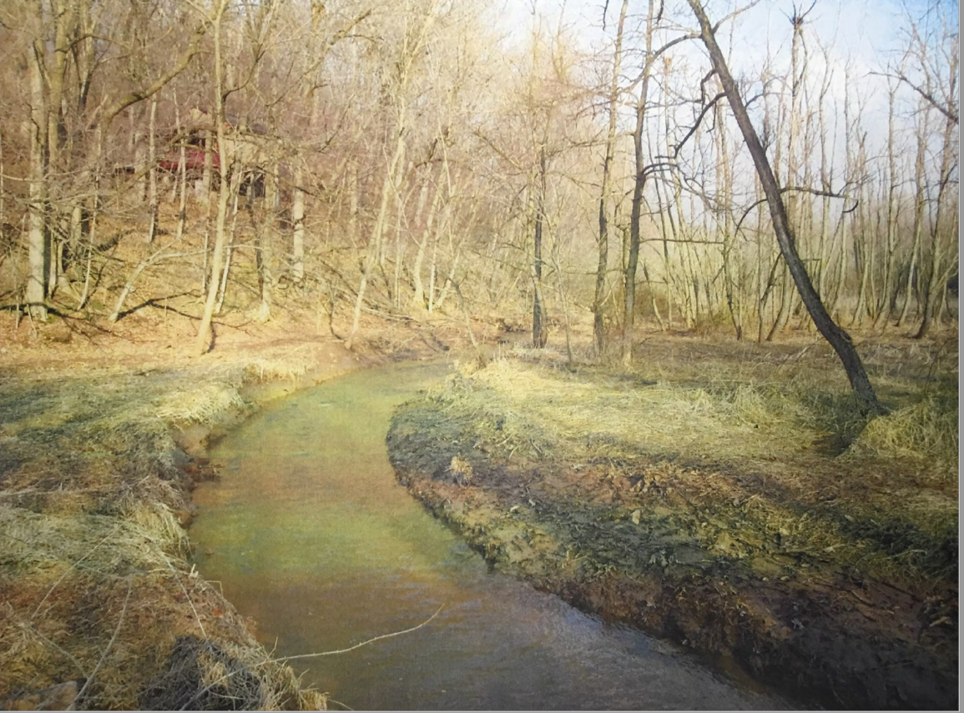
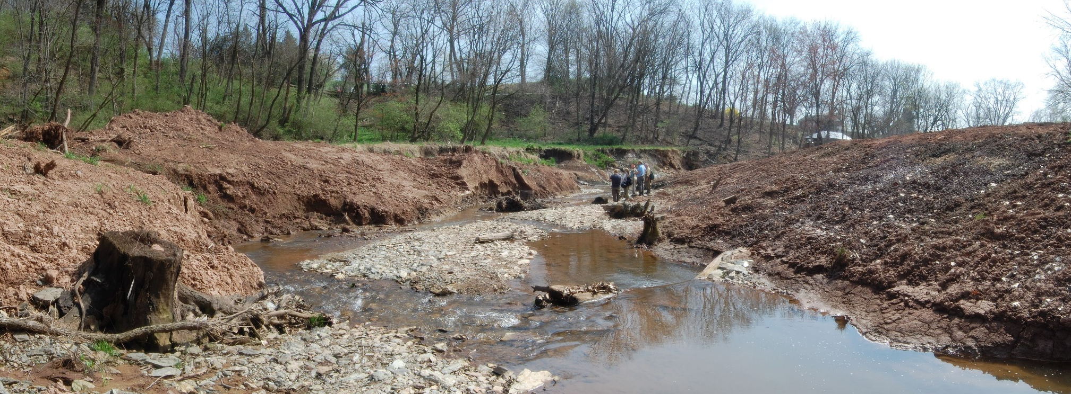
2011
1972
2012
Copyright 2019
Water Science Institute
All rights reserved
2012

Slide 5
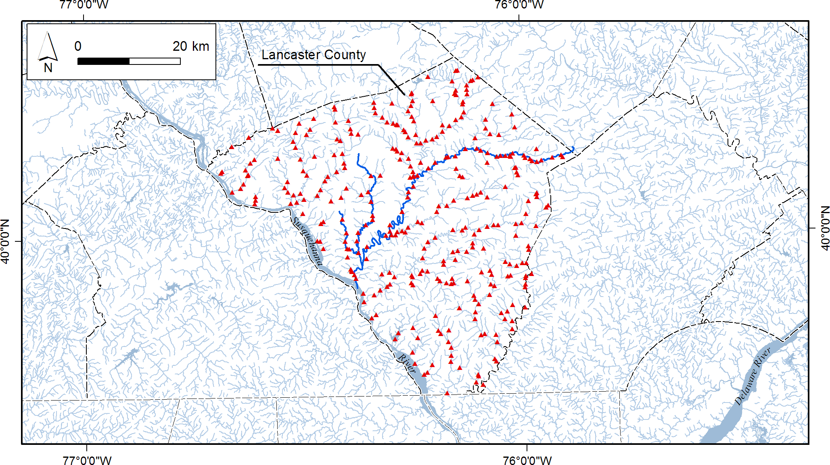
Historic Mill Dams of Lancaster County
~400 mill dams found in historic maps of Lancaster County
Location of mill dams
From Walter and Merritts, 2008
Copyright 2019
Water Science Institute
All rights reserved

Slide 6
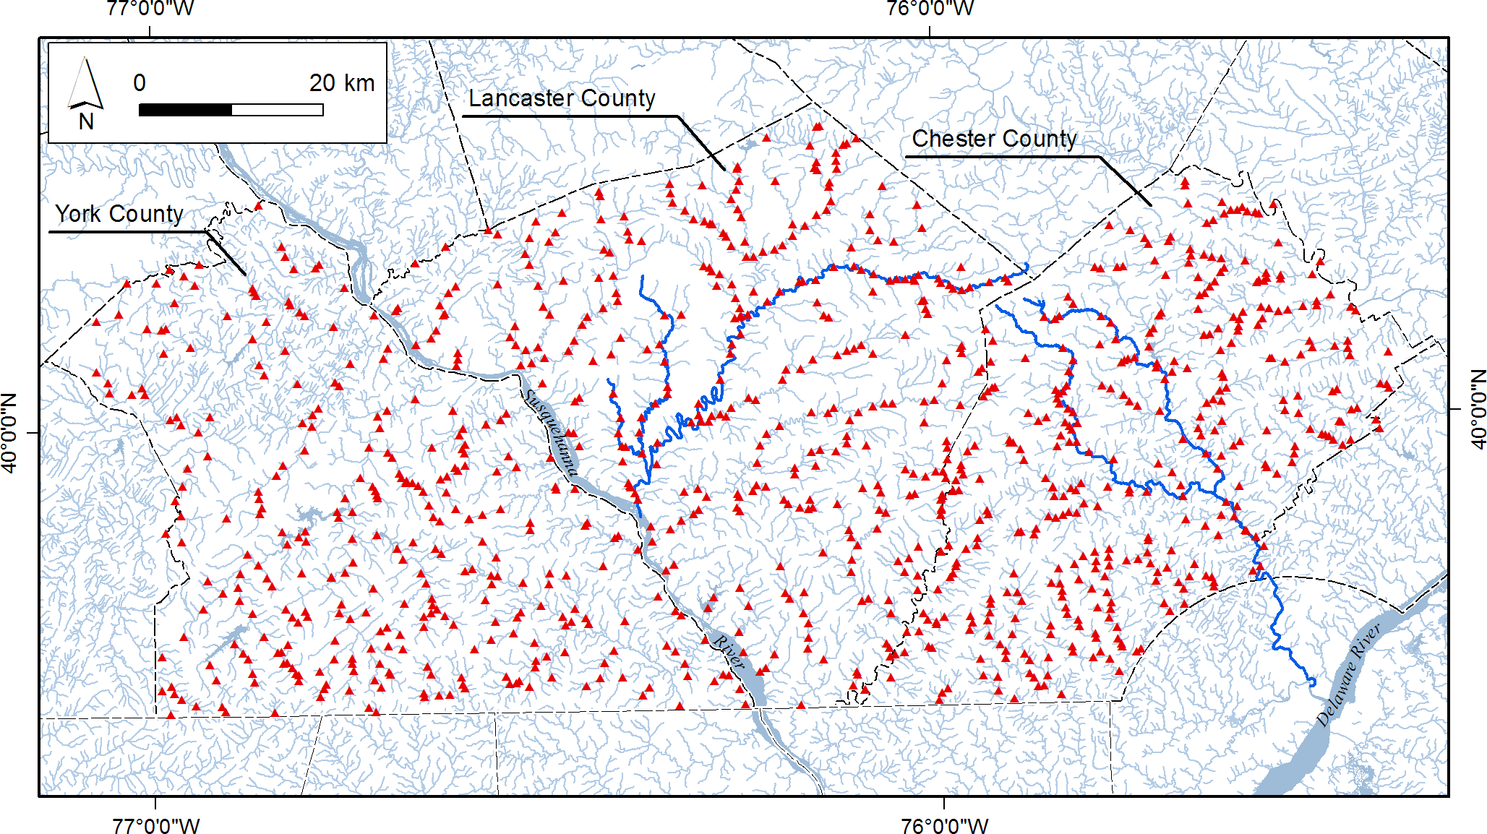
Historic Mill Dams of Lancaster County
Over 1,000 mill dams in historic maps of York, Lancaster & Chester Counties
Location of mill dams
From Walter and Merritts, 2008
Copyright 2019
Water Science Institute
All rights reserved

Slide 7

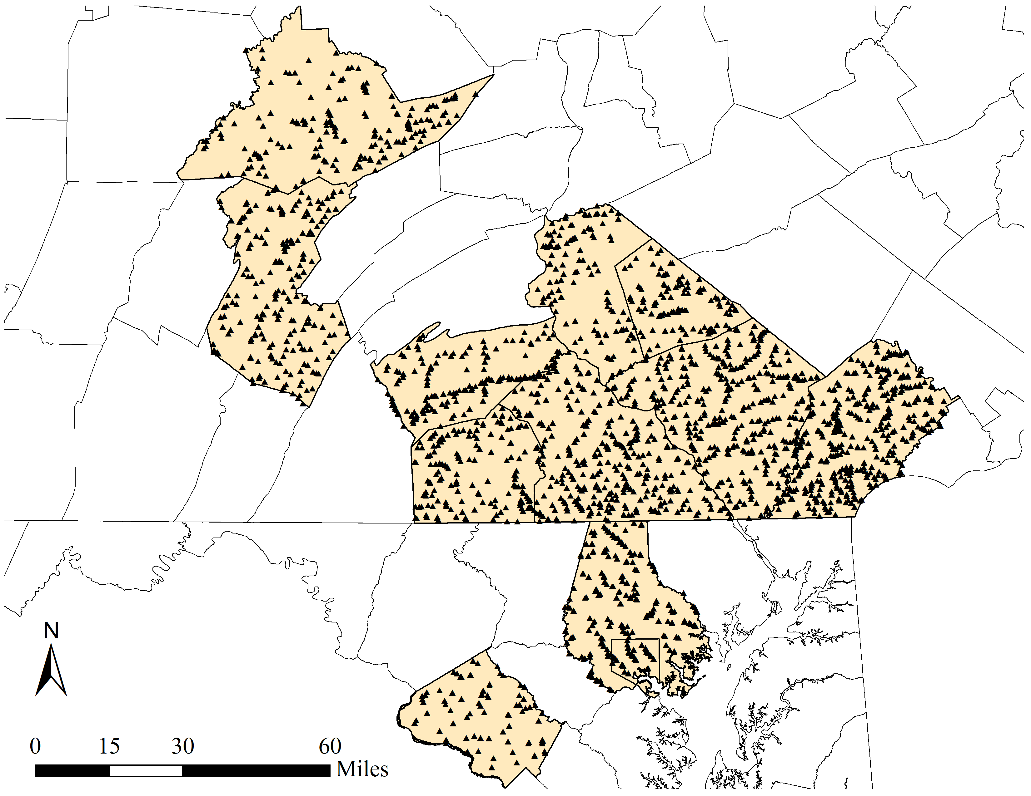

Hot Spot Mapping
Municipalities
HUC 10
HUC 12
Parcels
Legacy Sediment Terrace Mapping
Canopy
Historic Milldams
PA
MD
Copyright 2019
Water Science Institute
All rights reserved

Slide 8
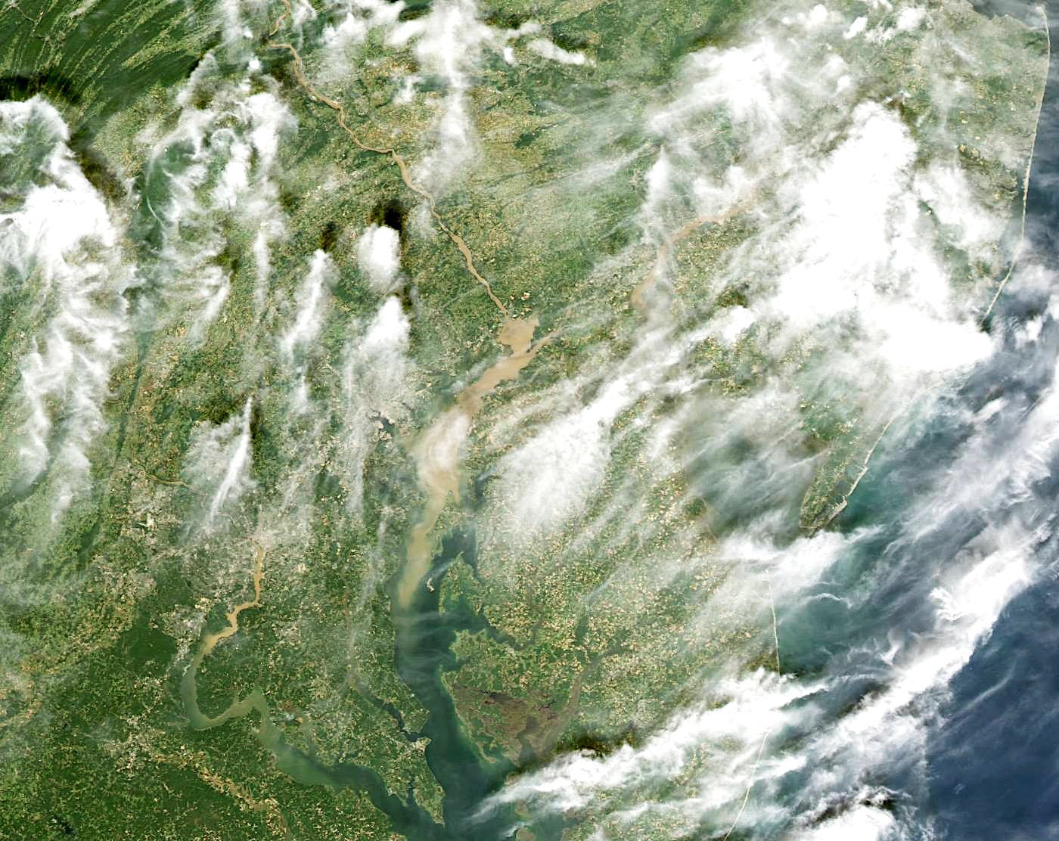
The Problem is Manifest--Sediment Plume from Hurricane Ivan 2004
Sediment sources?
Upland farm fields?
Construction sites?
Stream Banks?
Susquehanna River
Near-record discharge:
775,000 cfs
Chesapeake Bay:
4,000,000 TONS
Notes:
High resolution image:
Sediment plume from hurricane Ivan 9-21-04
http://earthobservatory.nasa.gov/NaturalHazards/shownh.php3?img_id=12456
Sediment from the Susquehanna River
As the remnants of Hurricane Ivan moved north over the United States, it dumped torrential rain in southeastern and mid-Atlantic states, triggering inland flooding. Major rivers, including the Ohio, Susquehanna, and Deleware Rivers, pushed over their banks and forced evacuations. Muddy run-off has colored the rivers around the Chesapeake Bay a dirty brown in this true-color image, acquired by the Moderate Resolution Imaging Spectroradiometer (MODIS) on NASA’s Terra satellite on September 21, 2004. By this time, the floods had largely subsided, but evidence of flooding remains in this image. The top third of the Chesapeake Bay, normally clear and dark, is now mud colored as sediment-laden flood water drains into the bay. The Susquehanna River flows down from the top left corner of the image into the bay, and the Delaware is visible under the clouds coming out of the top right corner.

Slide 9
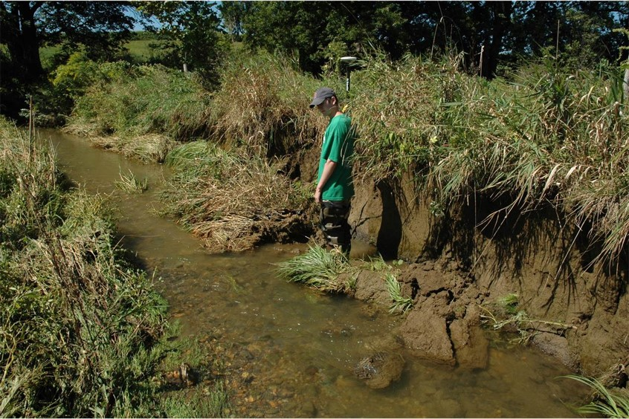
Highly Erosive Stream Banks
Copyright 2019
Water Science Institute
All rights reserved

Slide 10
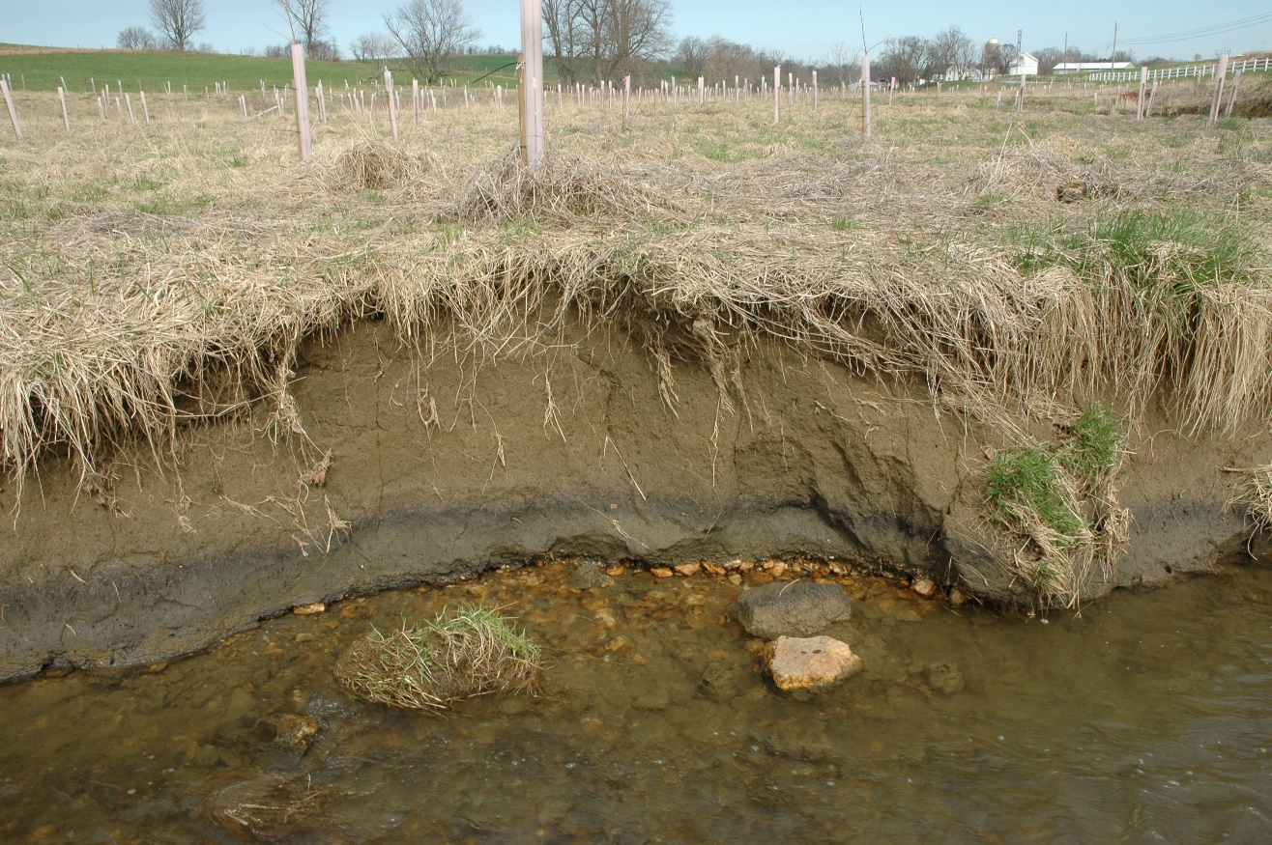
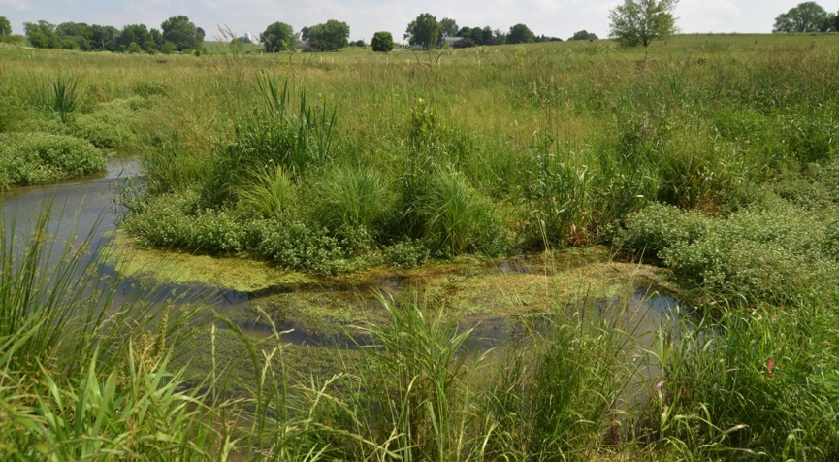
Big Spring Run Floodplain Wetland Restoration
Before Restoration – April 2004
After Restoration - June 2013
Copyright 2019
Water Science Institute
All rights reserved

Slide 11
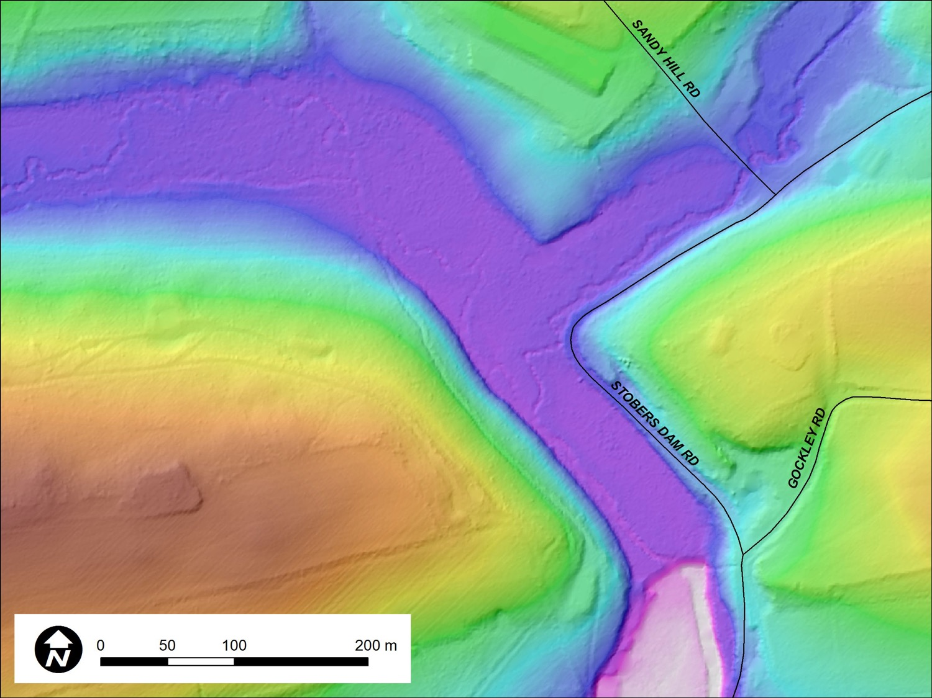
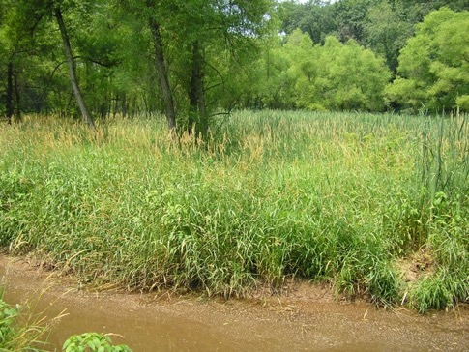
Indian Run, PA – Stobers Dam breach, 2011, Height 14 ft (4.3 m)
2007
2008 lidar DEM
4-m high 18th c dam
Stobers Dam
Copyright 2019
Water Science Institute
All rights reserved
Lidar: PA DCNR

Slide 12
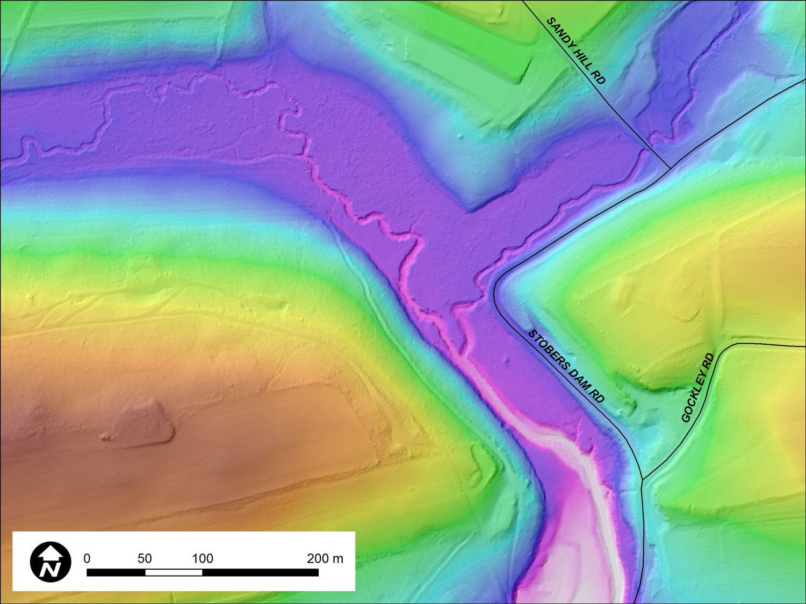
Indian Run, PA – Stobers Dam breach, 2011, Height 14 ft (4.3 m)
2014 lidar DEM
Breached in 2011
Stobers Dam
Copyright 2019
Water Science Institute
All rights reserved
Lidar: USGS CMGP
Notes:
2014 post-Sandy
=============
Horizontal
--------------
estimated horizontal accuracy is RMSEr = 0.26 m
The technician also evaluated the achieved post spacing against project specified 0.7 meter nominal post spacing as well as making sure no clustering in point distribution.
Vertical
---------
Vertical_Positional_Accuracy_Report: RMSE 5 cm.
SVA - Cumulative 10 cm
Crops/Ag - 10 cm
Urban - 5 cm
Woods - 12 cm
Nominal Pulse Spacing - 0.7Quantitative_Vertical_Positional_Accuracy_Assessment: Vertical_Positional_Accuracy_Value: 0.05Vertical_Positional_Accuracy_Explanation: RMSEz derived. Provided in the accuracy report as Vertical tested at 95% (RMSEz x 1.96) = 0.09 m.
2008 PAMAP
==========
Horizontal
--------------
The horizontal accuracy standard follows the NSSDA-1998 standard. The maximum permissible RMSE for 95% of the horizontal check points for the mapping product is 5 feet or better.
MIKE NOTES: We calculate to roughly 0.7 m spacing, however the spacing is irregular and in many areas is closer to 1.5-2.0 m. In wooded areas the ground point spacing can be large.
Vertical
----------
RMSEz 0.53 ft
Open Terrain - 0.40 ft
High Grass - 0.58 ft
Brush - 0.66 ft
Forest - 0.10 ft
Urban - 0.60 ft
Vertical_Positional_Accuracy_Report:
NSSDA/FEMA: (1) Compared to criteria RMSEz less than or equal to 0.61 ft in Open Terrain, tested 0.535 ft; (2) Compared to criteria Accuracy z less than or equal to 1.19 ft at 95% confidence level, tested 1.049 ft.
NDEP/ASPRS: (1) Compared to criteria Fundamental Vertical Accuracy less than or equal to 1.19 ft at 95% confidence level, tested 1.049 ft; (2) Compared to criteria Consolidated Vertical Accuracy less than or equal to 2.38 ft at 95% confidence level, tested 1.134 ft.
Consolidated Vertical Accuracies from individual metadata reports 95% Confidence, tested Southern PA Collections Vertical Accuracies (cm)
2006 Central South : 20.4
2006 SouthWest : 27.1
2006 WestCentral South : 31.7
2007 North Central South : 19.2
2007 South Central South : 20.7
2008 Allentown : 12.2
2008 Doylestown : 24.4
2008 Harrisburg : 23.8
2008 Hazleton : 15.2
2008 Lancaster : 23.8
2008 Philadelphia : 3.7
2008 Pottsville : 19.5
2008 Reading : 14.0
2008 Selinsgrove : 7.3
2008 Stroudsburg : 7.9
2008 Westchester East : 29.9
2008 Westchester West : 18.0
2008 York : 15.2
Average ---- 18.6
Quantitative_Vertical_Positional_Accuracy_Assessment:Vertical_Positional_Accuracy_Value: 0.19
Vertical_Positional_Accuracy_Explanation:The 95% confidence level could be phrased as "95% of the points meet or exceed the specified accuracy level." This statistic provides information on the quality of the data collection parameters (global quality). It can be calculated using RMSE x 1.96 if the errors have a normal distribution, which most bare-earth points follow

Slide 13
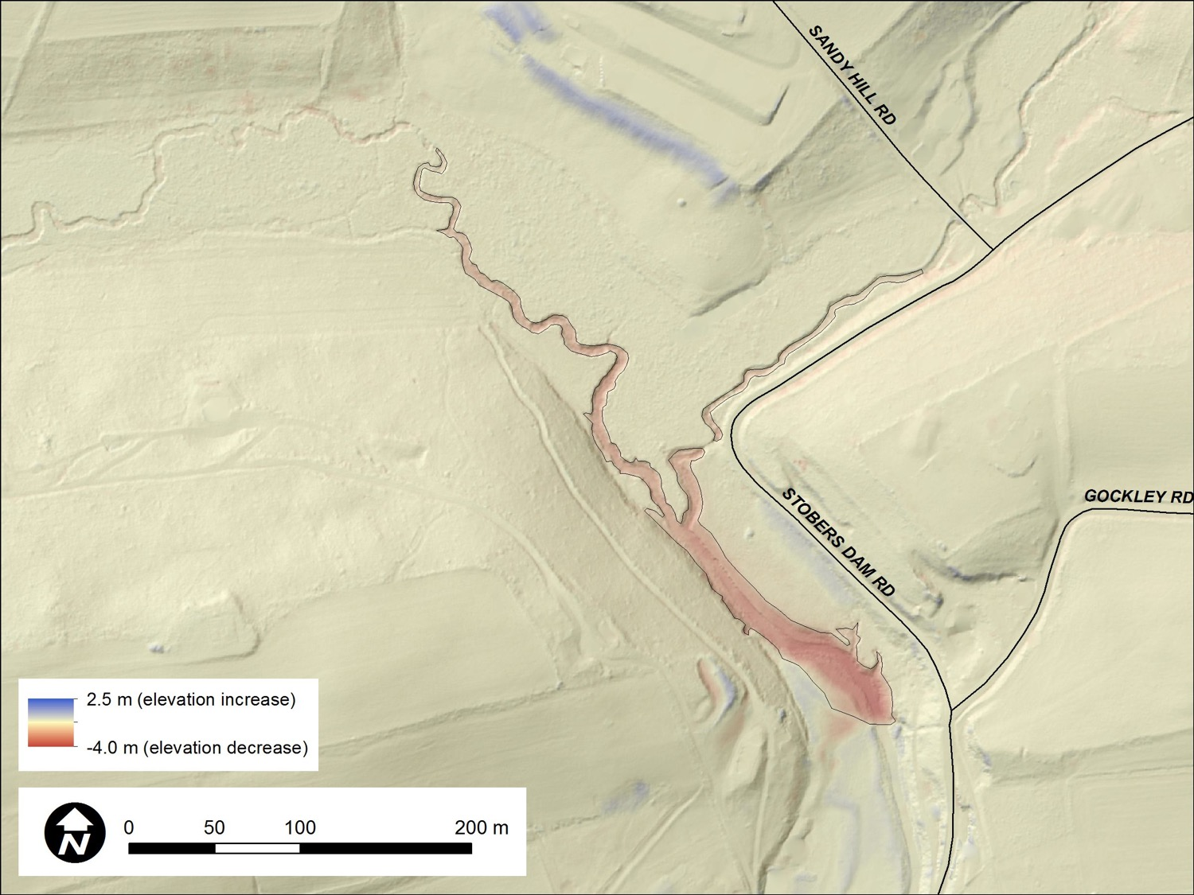
Indian Run, PA – Stobers Dam breach, 2011, Height 14 ft (4.3 m)
2014 – 2008 lidar DEM difference
~30,000 m³ erosion in 3 years
~13,000 tons/yr of sediment
Copyright 2019
Water Science Institute
All rights reserved
Notes:
See slide 7 for details on methodology and uncertainty.

Slide 14
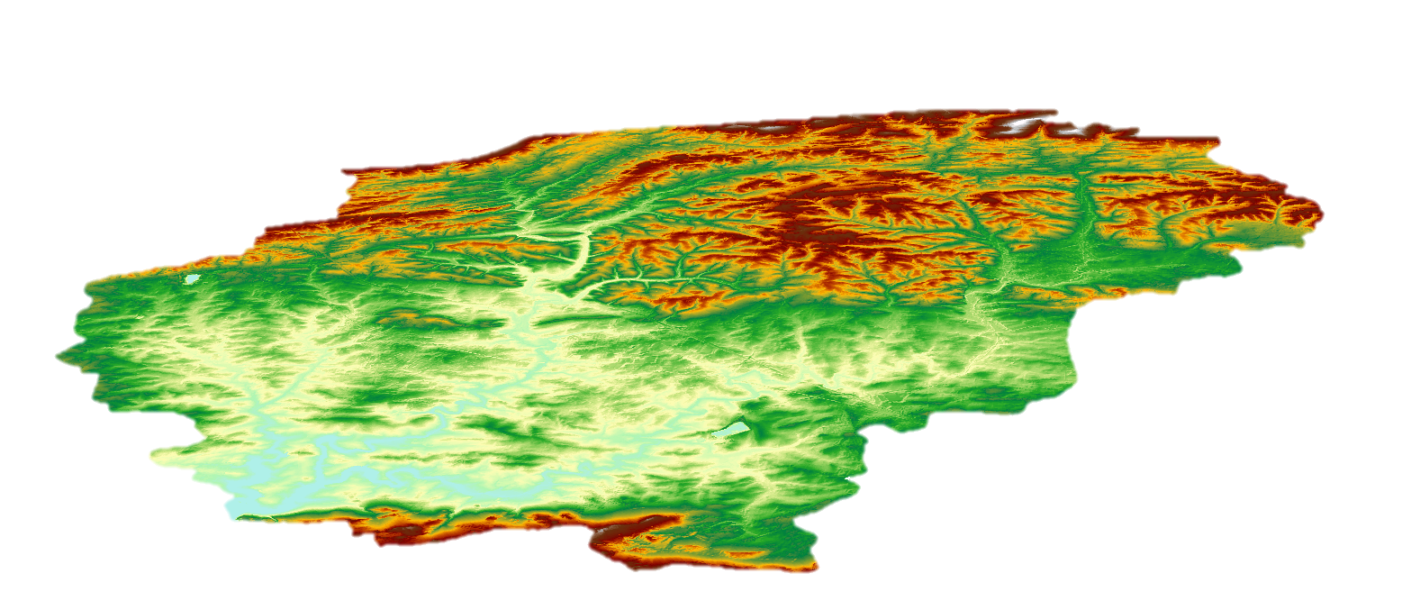
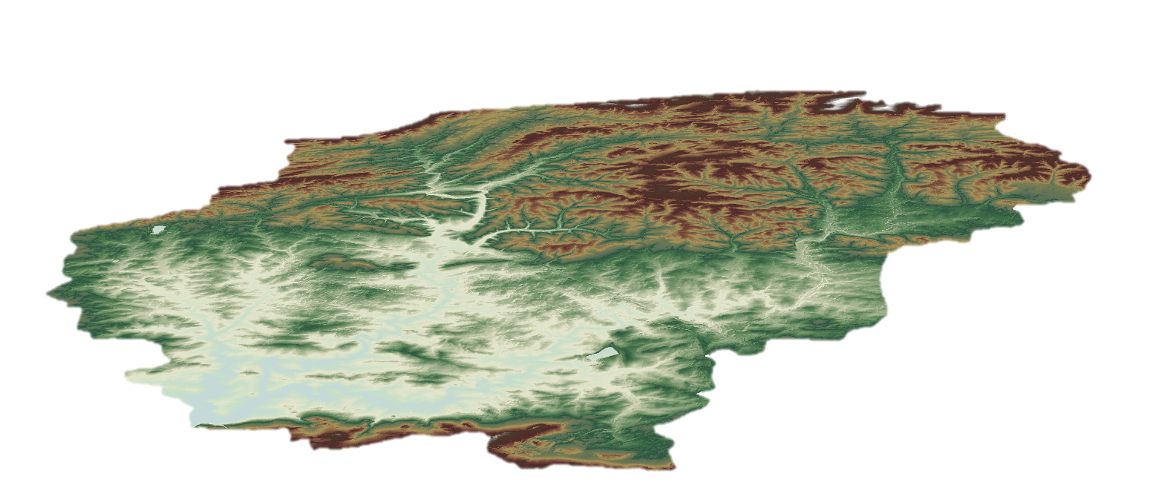
Triage Mapping of Erosion Hotspots
Using Lidar DEM Differencing
2014 Lidar
-
2008 Lidar
=
Quantifies Magnitude of Vertical and Horizontal Change
Copyright 2019
Water Science Institute
All rights reserved

Slide 15
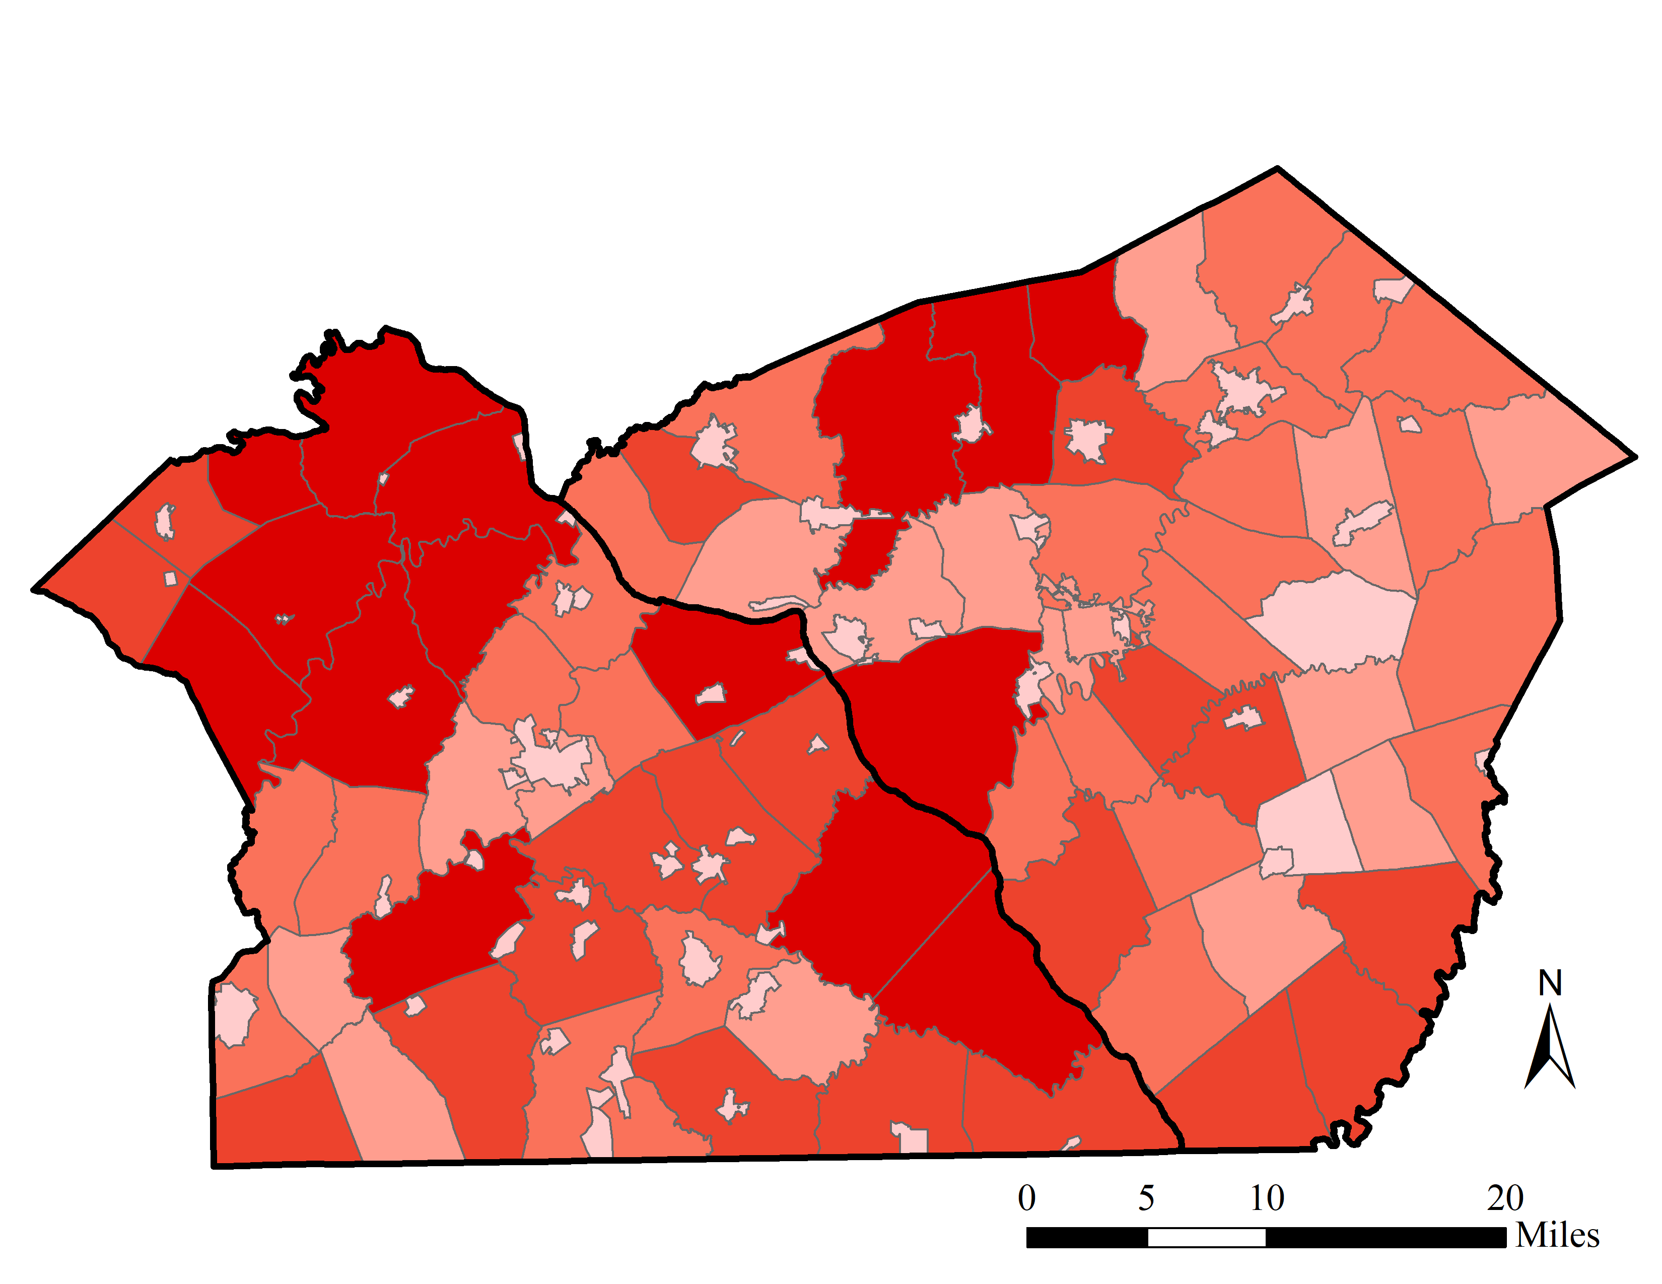
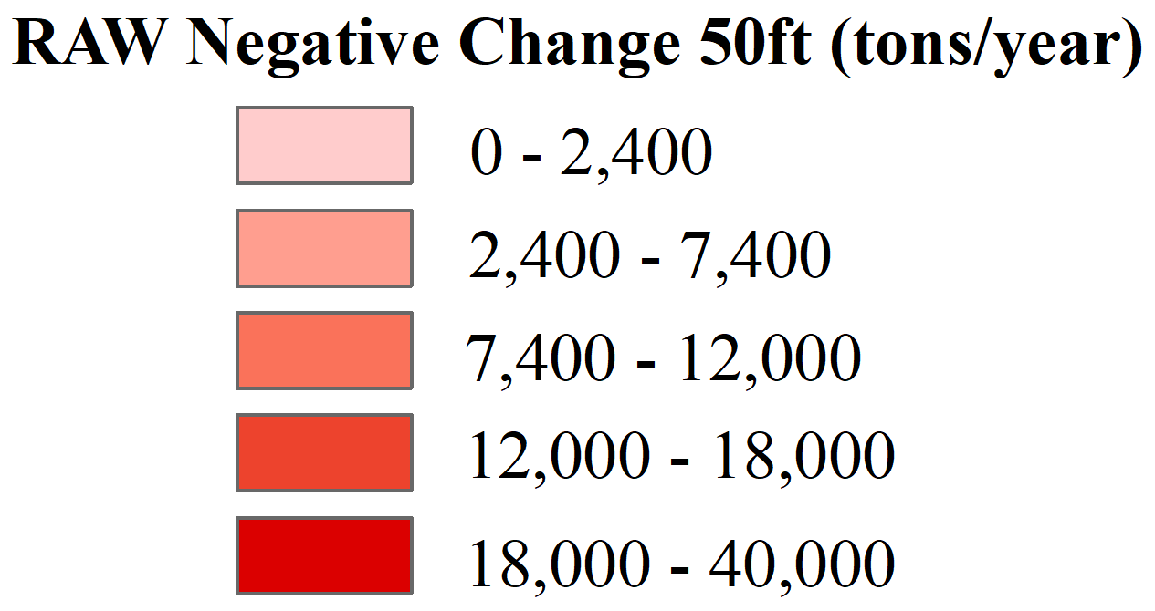
Hotspot Mapping
Municipalities
Copyright 2019
Water Science Institute
All rights reserved
York County (left) and Lancaster County (right).

Slide 16
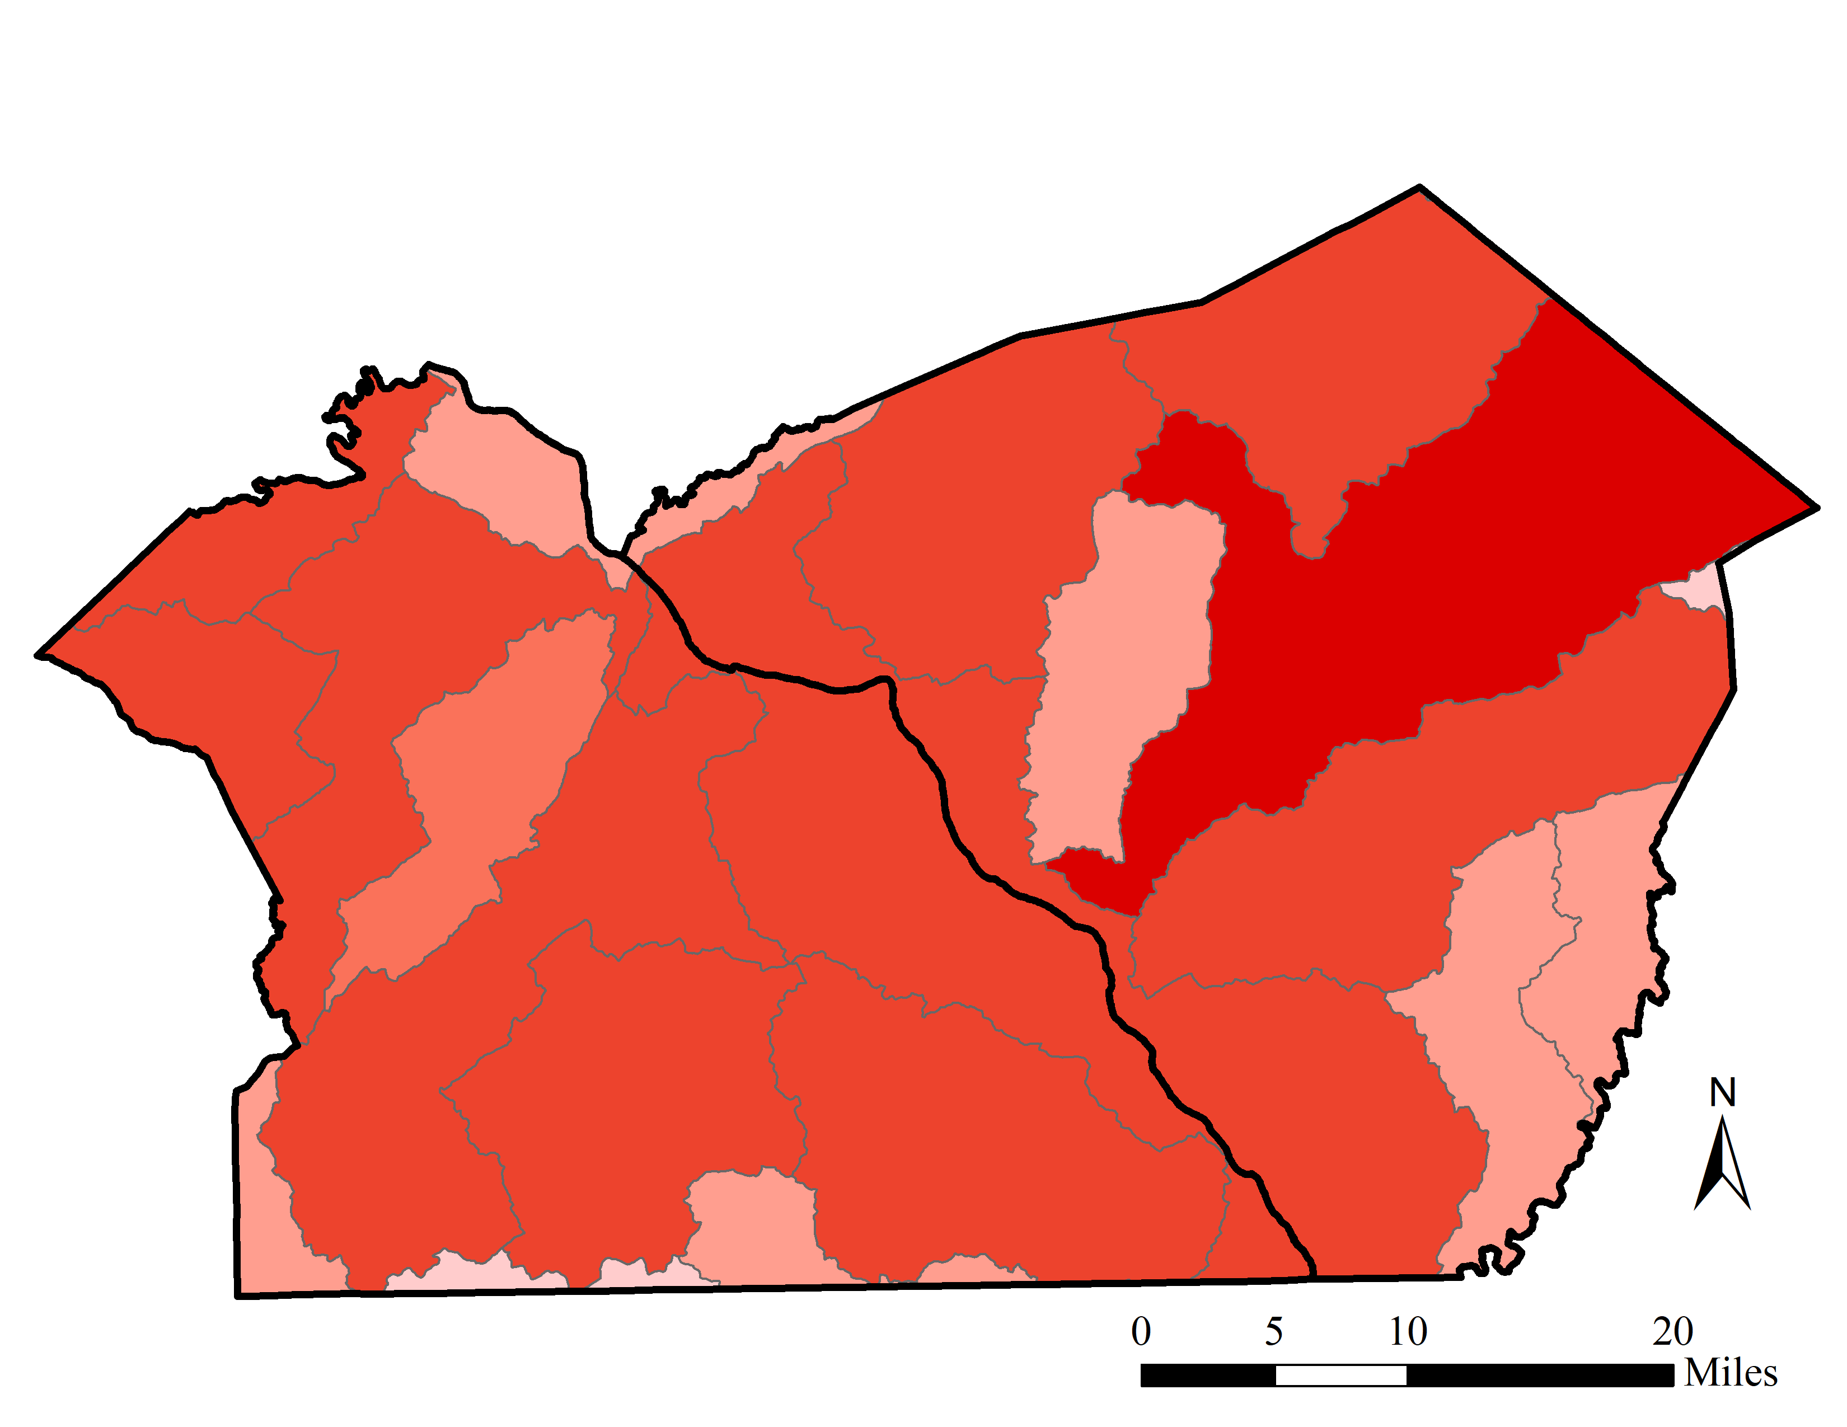

Hot Spot Mapping
Municipalities
HUC 10
Copyright 2019
Water Science Institute
All rights reserved
York County (left) and Lancaster County (right).

Slide 17
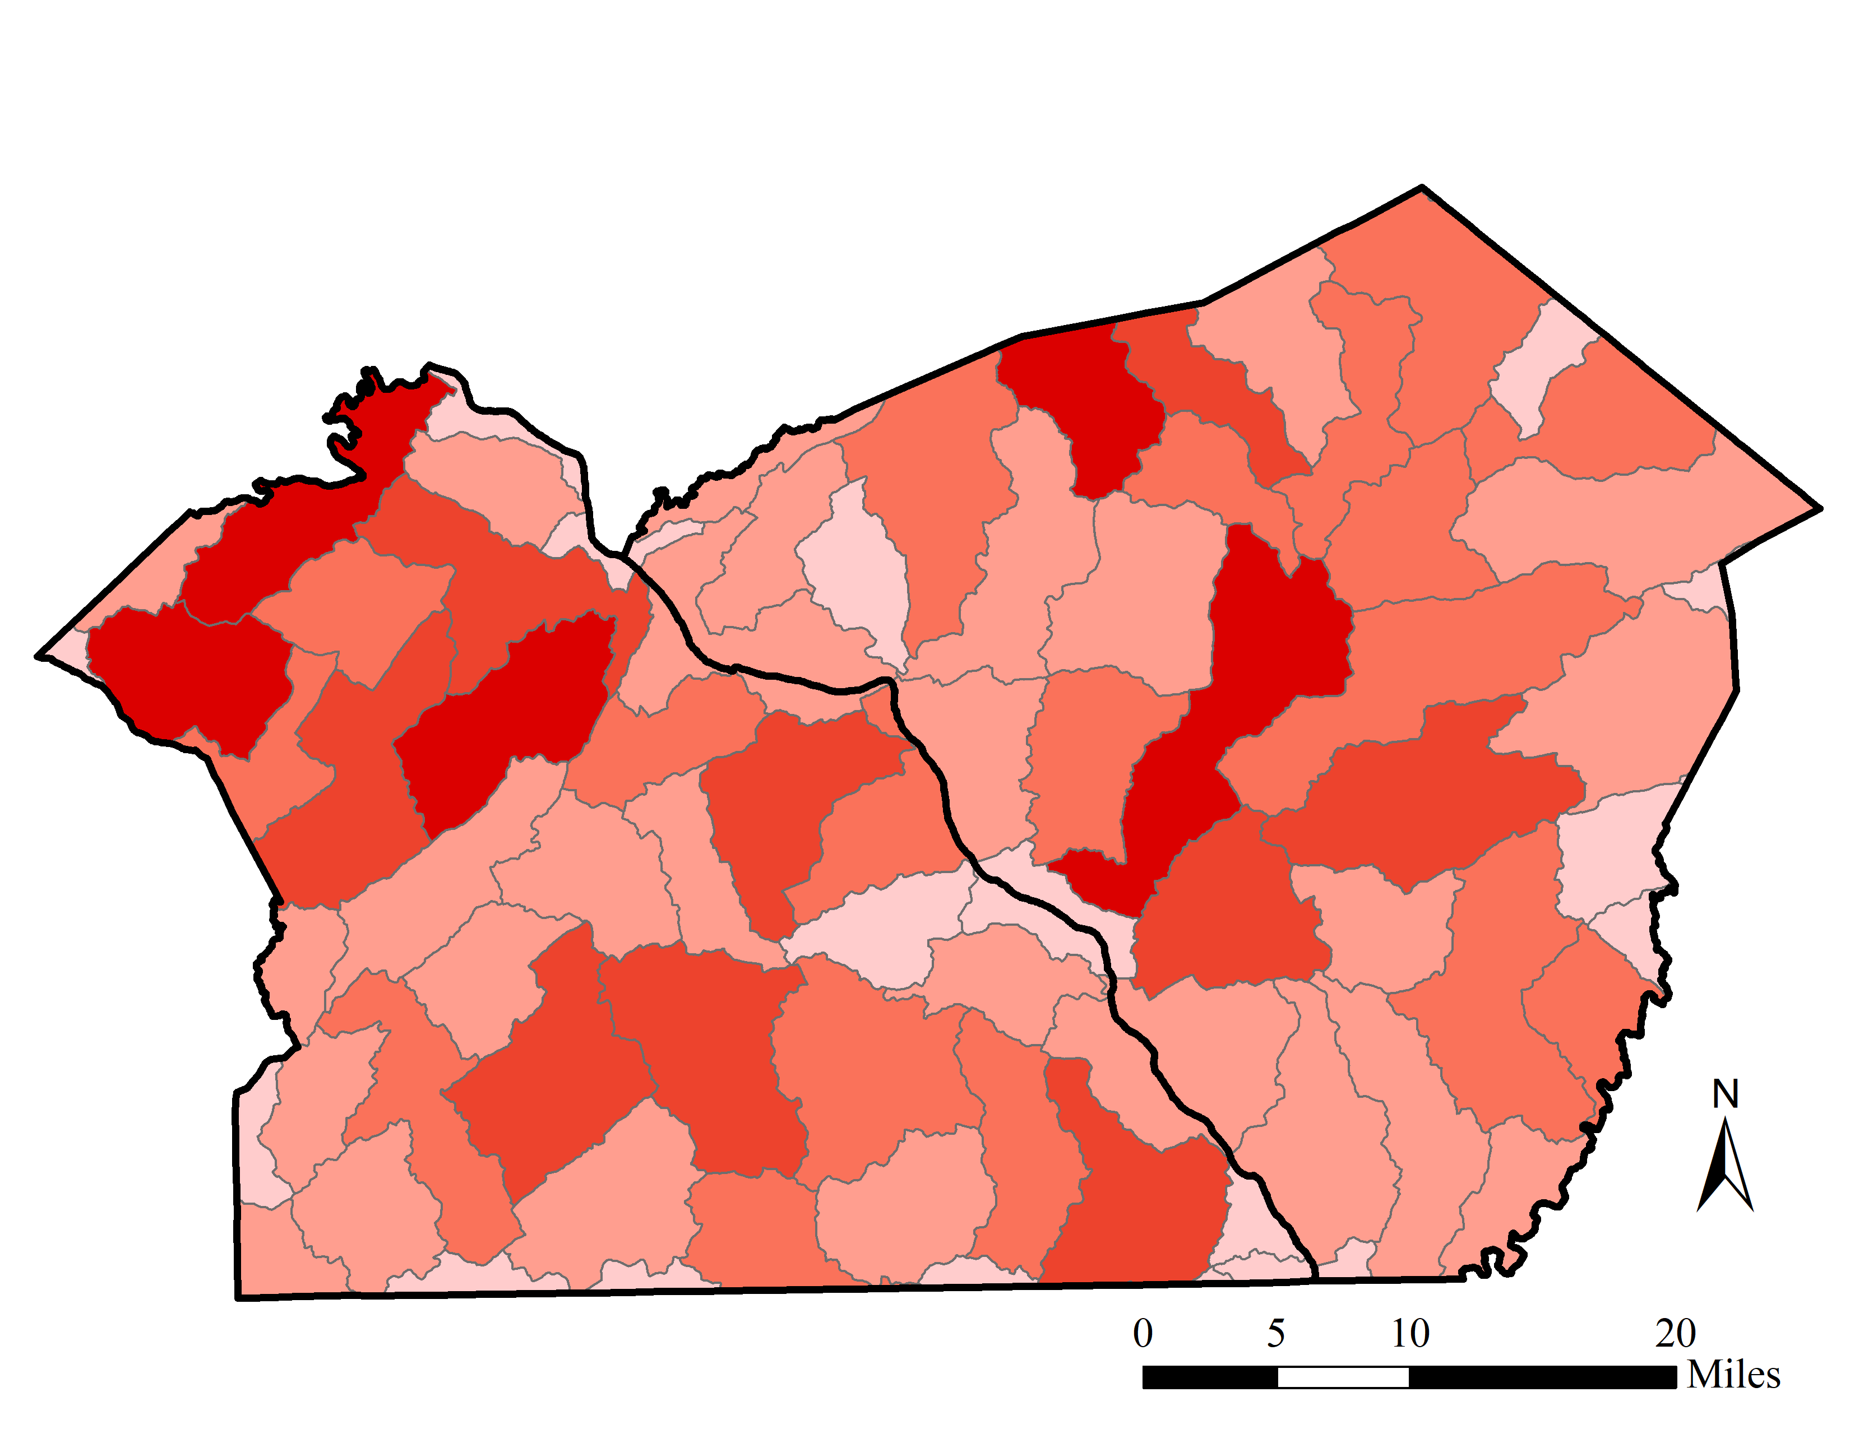


Hot Spot Mapping
Municipalities
HUC 10
HUC 12
Copyright 2019
Water Science Institute
All rights reserved
York County (left) and Lancaster County (right).

Slide 18
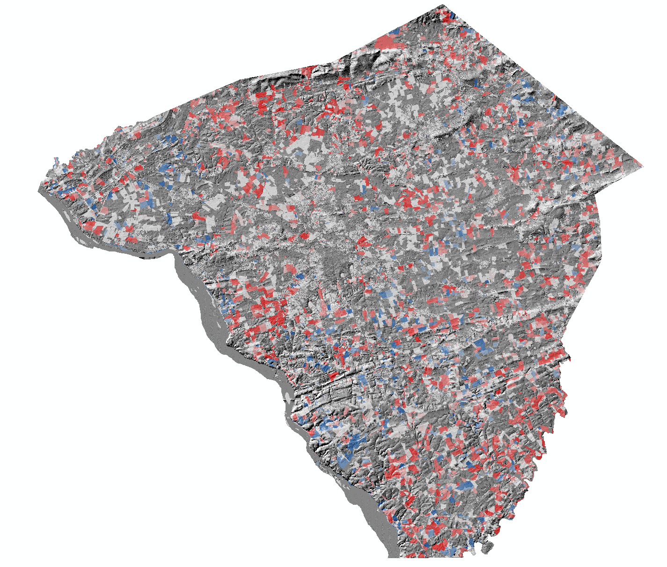
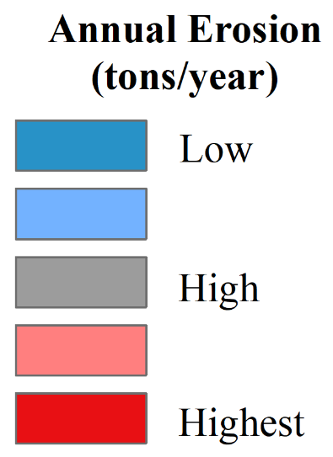

Hot Spot Mapping
Municipalities
HUC 10
HUC 12
Parcels
Copyright 2019
Water Science Institute
All rights reserved
Slopeshade from 2014 USGS Post Sandy Lidar.

Slide 19
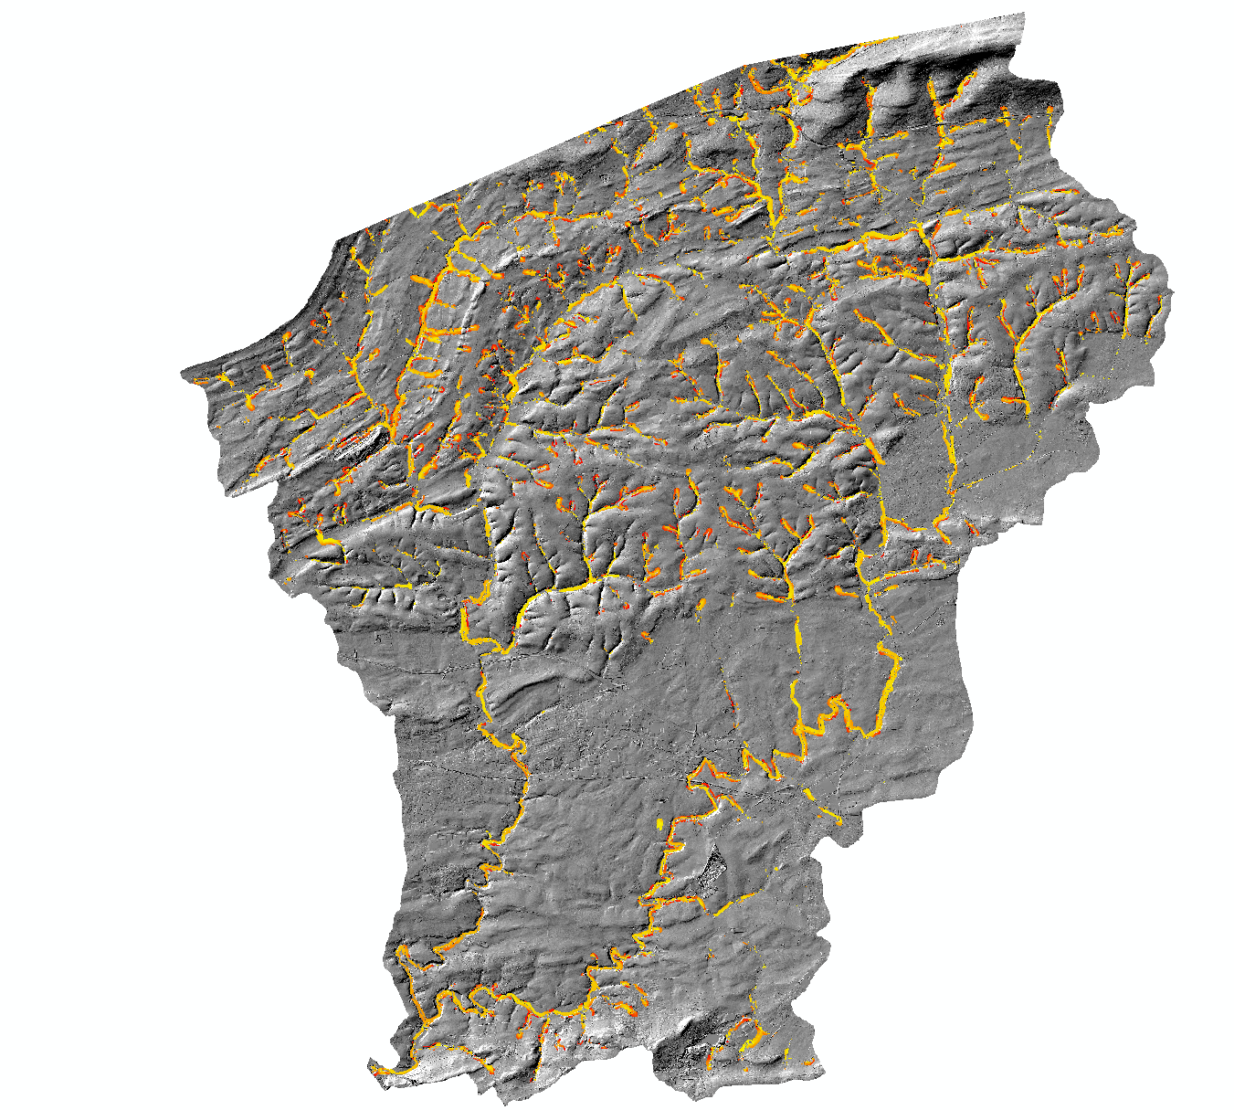
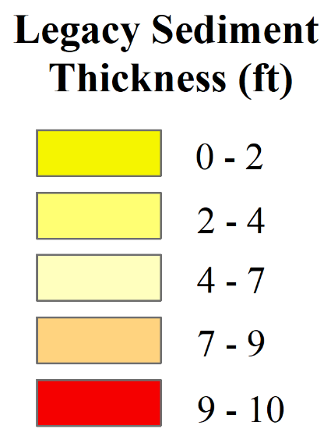

Hot Spot Mapping
Municipalities
HUC 10
HUC 12
Parcels
Legacy Sediment Terrace Mapping
Slopeshade from 2014 USGS Post Sandy Lidar.
Copyright 2019
Water Science Institute
All rights reserved

Slide 20
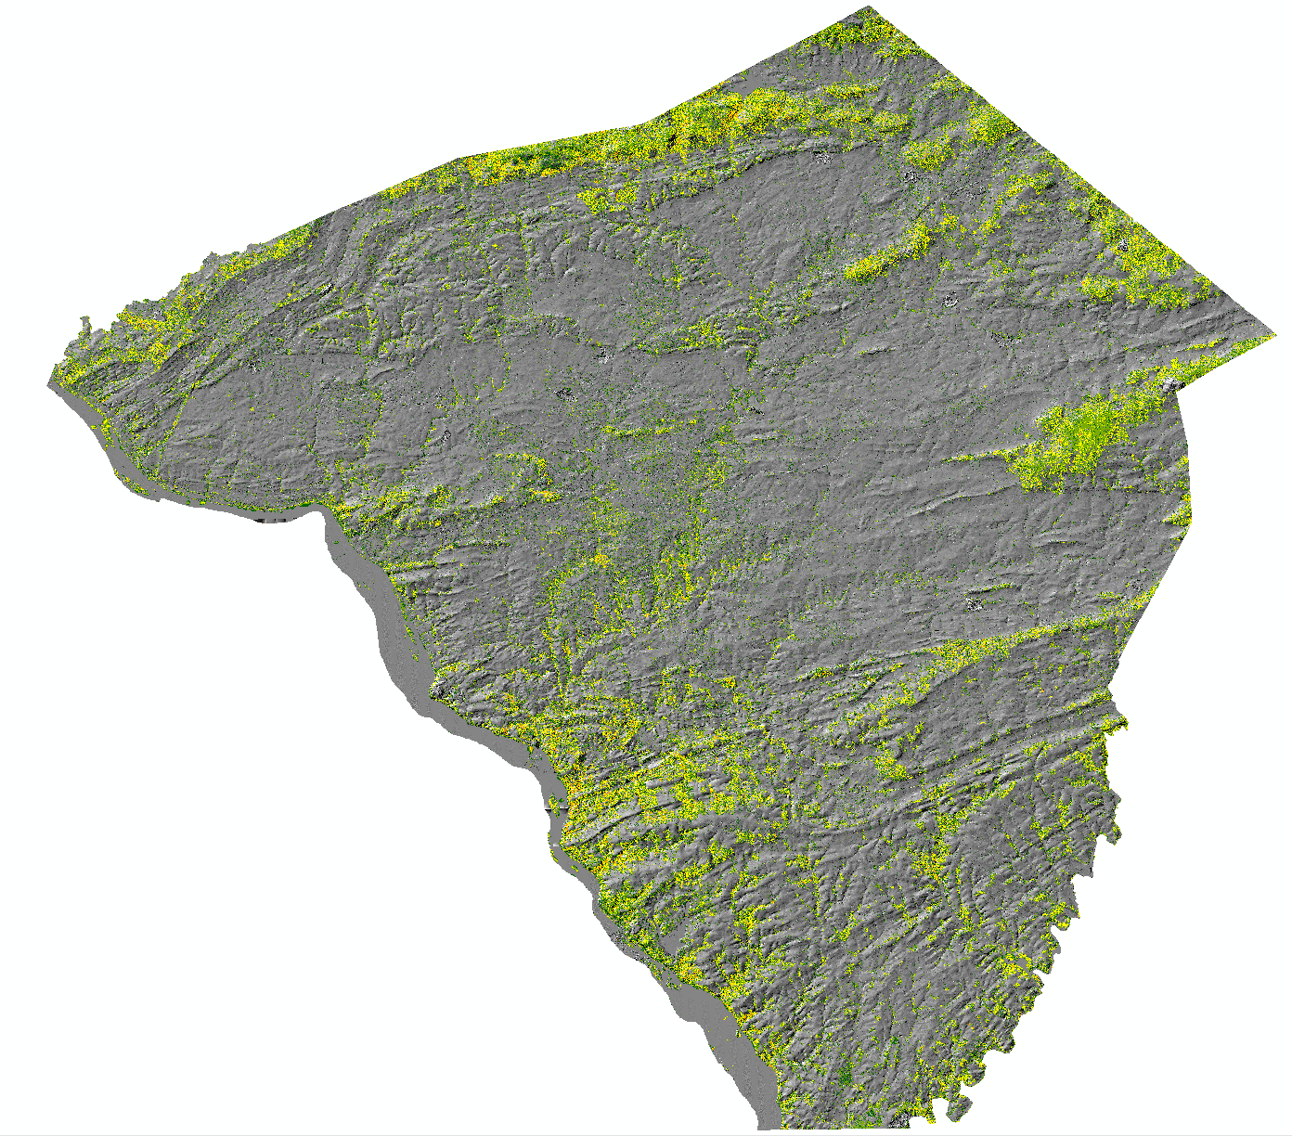
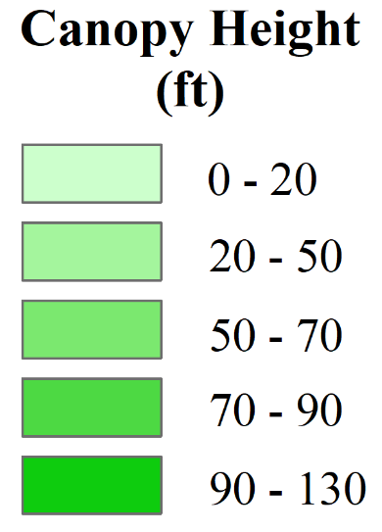
Hot Spot Mapping
Municipalities
HUC 10
HUC 12
Parcels
Legacy Sediment Terrace Mapping
Canopy
Copyright 2019
Water Science Institute
All rights reserved
Slopeshade from 2014 USGS Post Sandy Lidar.

Slide 21
Copyright 2019
Water Science Institute
All rights reserved

Slide 22
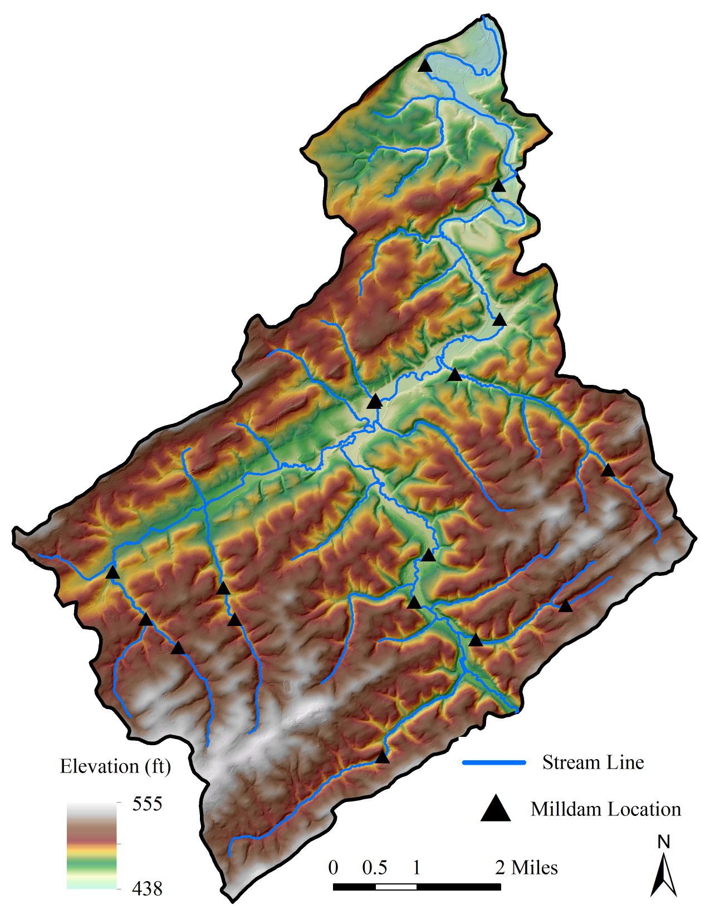
Heat Mapping – Watershed Analysis
2014 USGS Post Sandy Lidar.
HUC 12 Lower South Branch Codorus Creek, York County
Watershed Area: 40 square miles
Historic Milldams:17
Copyright 2019
Water Science Institute
All rights reserved

Slide 23
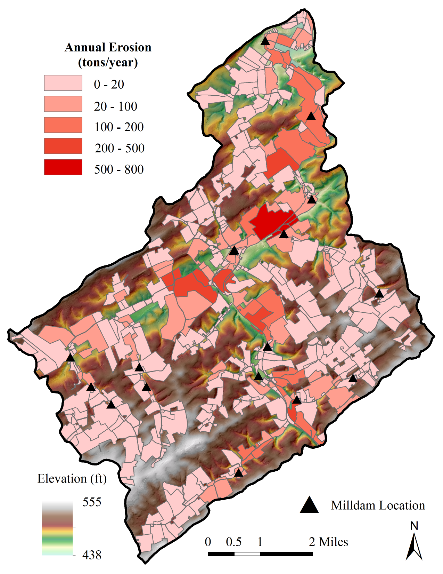
Heat Mapping – Watershed Analysis
2014 USGS Post Sandy Lidar.
HUC 12 Lower South Branch Codorus Creek, York County
Watershed Area: 40 square miles
Historic Milldams:17
Watershed Annual Erosion:
5,000 – 11,000 tons/yr
10,000,000 – 22,000,000 lbs/yr
Average Annual Erosion/Parcel:
24 tons/yr
48,000 lbs/yr
Copyright 2019
Water Science Institute
All rights reserved

Slide 24
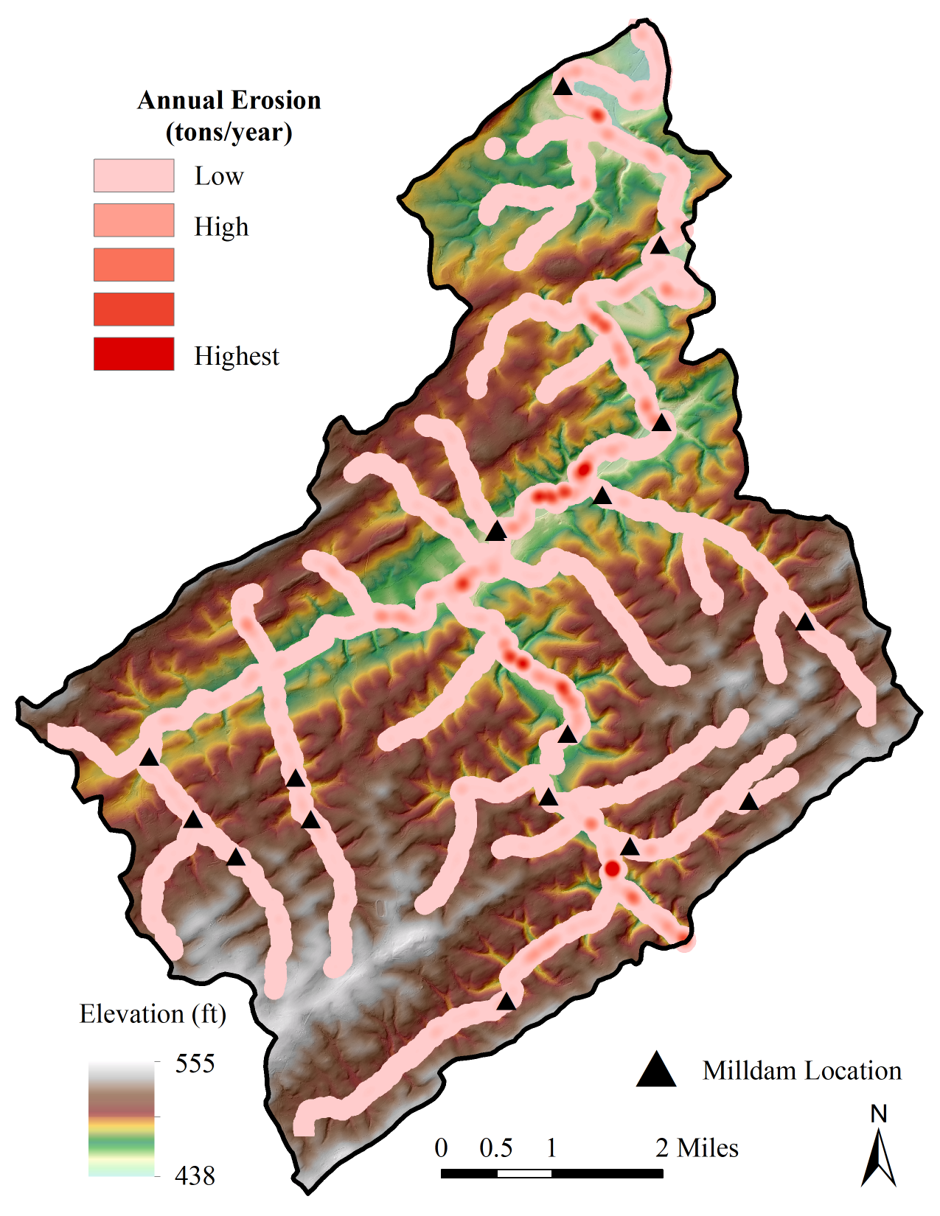
Heat Mapping – Watershed Analysis
2014 USGS Post Sandy Lidar.
Kernel Density Heat Map
Copyright 2019
Water Science Institute
All rights reserved

Slide 25
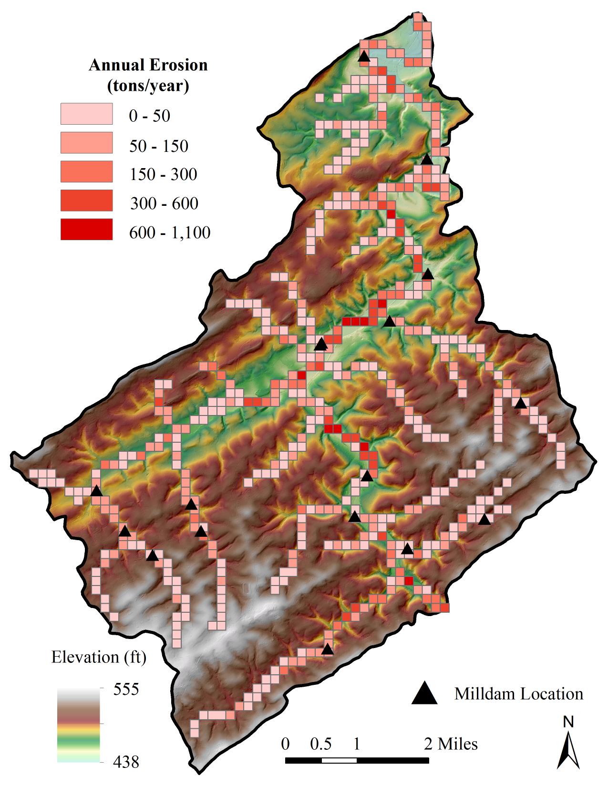
Heat Mapping – Watershed Analysis
2014 USGS Post Sandy Lidar.
Kernel Density Heat Map
Block Statistics Heat Map
1
2
Copyright 2019
Water Science Institute
All rights reserved

Slide 26
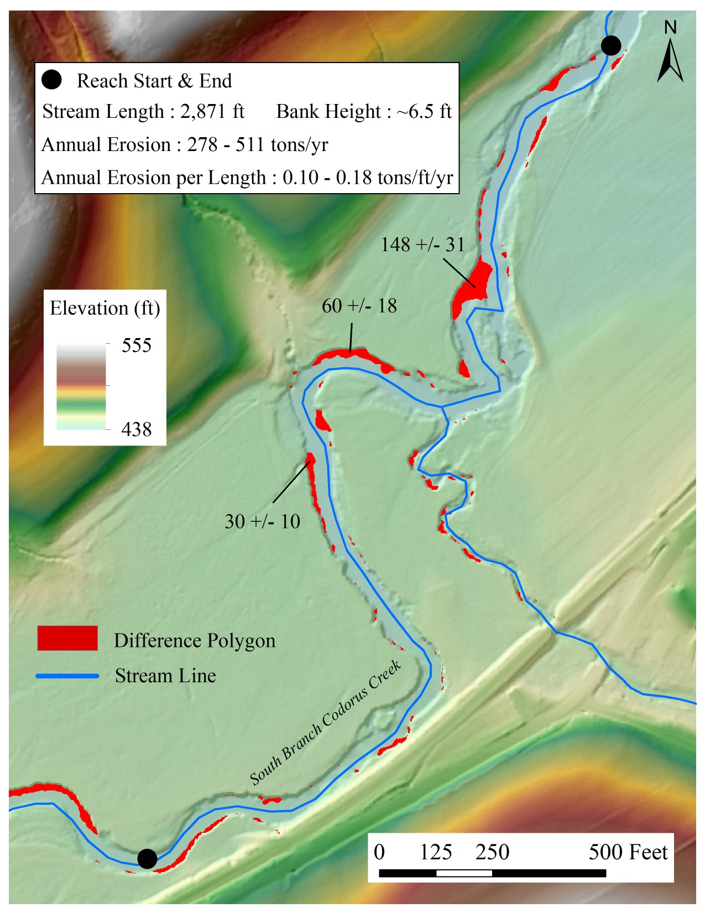
Heat Mapping – Watershed Analysis
1
Kernel Density Heat Map
Block Statistics Heat Map
Hotspots
Copyright 2019
Water Science Institute
All rights reserved
2014 USGS Post Sandy Lidar.

Slide 27
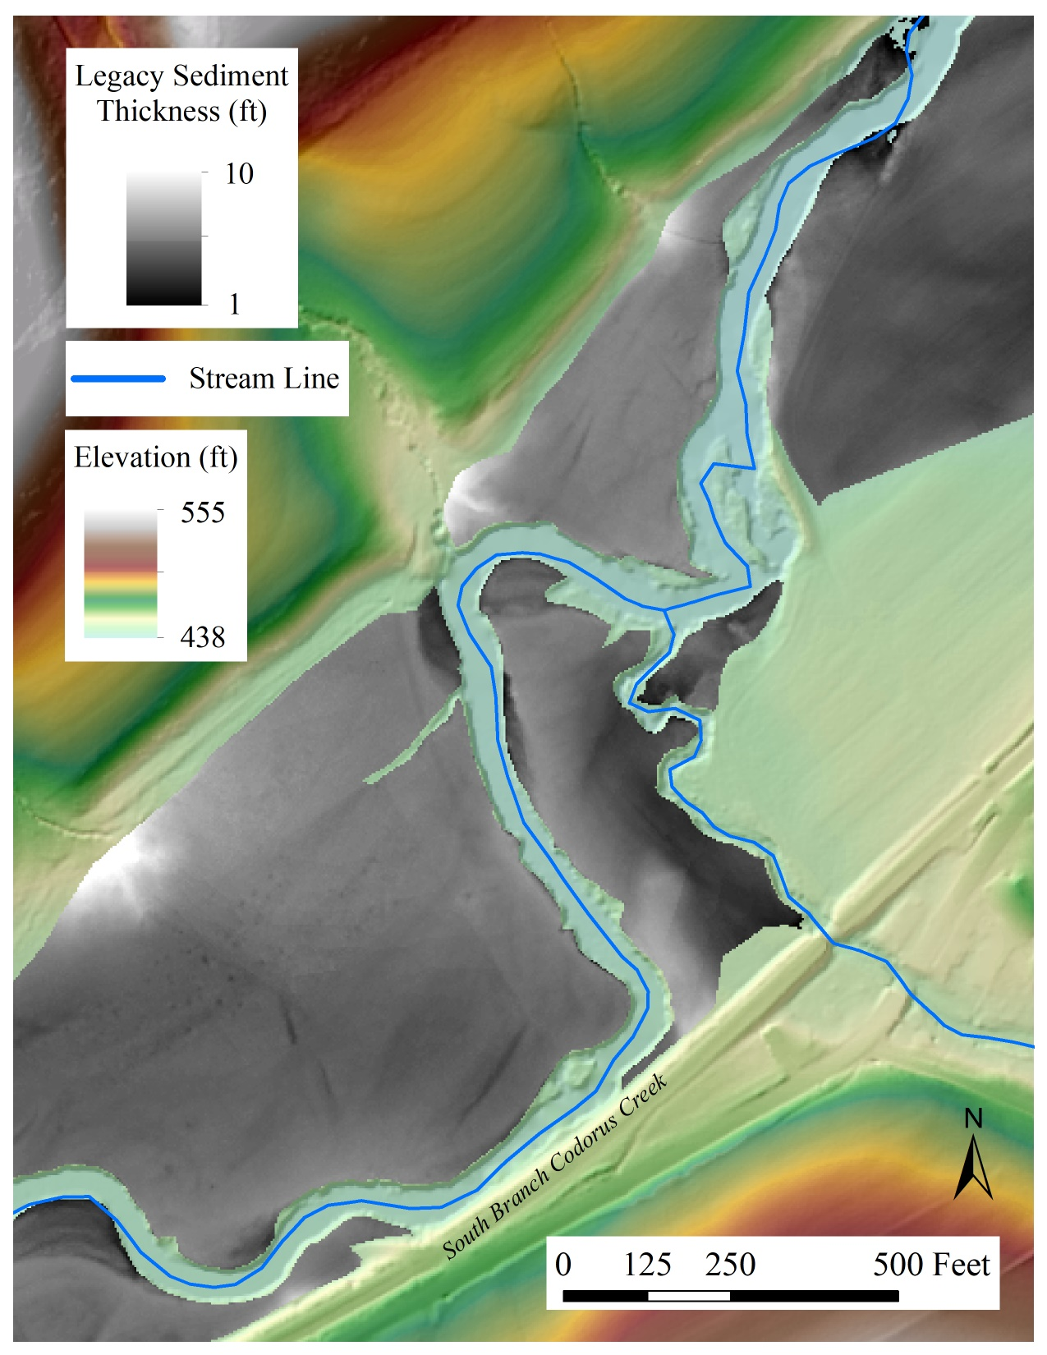
Heat Mapping – Watershed Analysis
1
Kernel Density Heat Map
Block Statistics Heat Map
Hotspots
Copyright 2019
Water Science Institute
All rights reserved
2014 USGS Post Sandy Lidar.

Slide 28
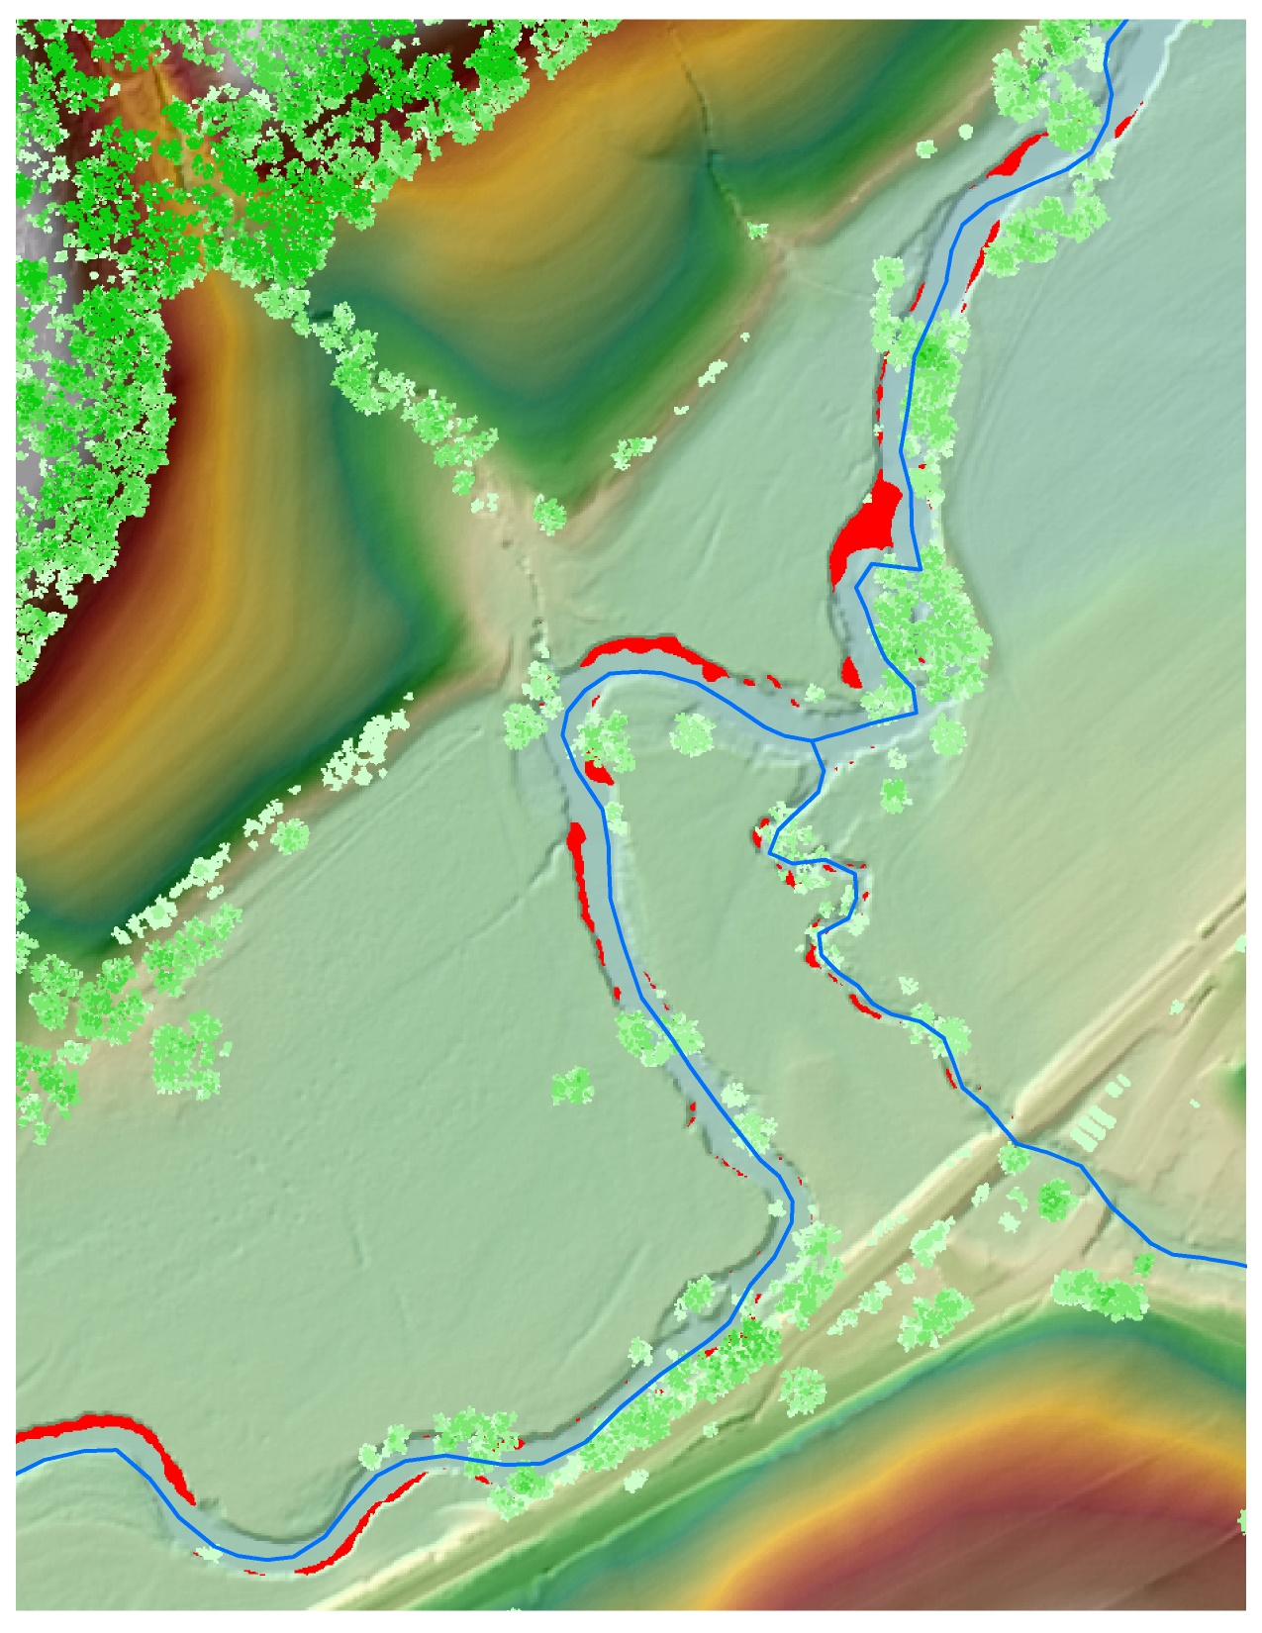

Heat Mapping – Watershed Analysis
1
Kernel Density Heat Map
Block Statistics Heat Map
Hotspots
Copyright 2019
Water Science Institute
All rights reserved
2014 USGS Post Sandy Lidar.

Slide 29
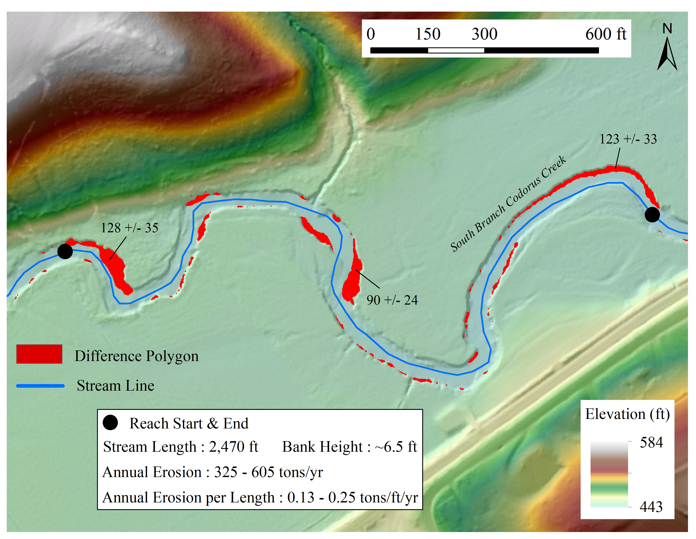
2
Copyright 2019
Water Science Institute
All rights reserved
2014 USGS Post Sandy Lidar.

Slide 30
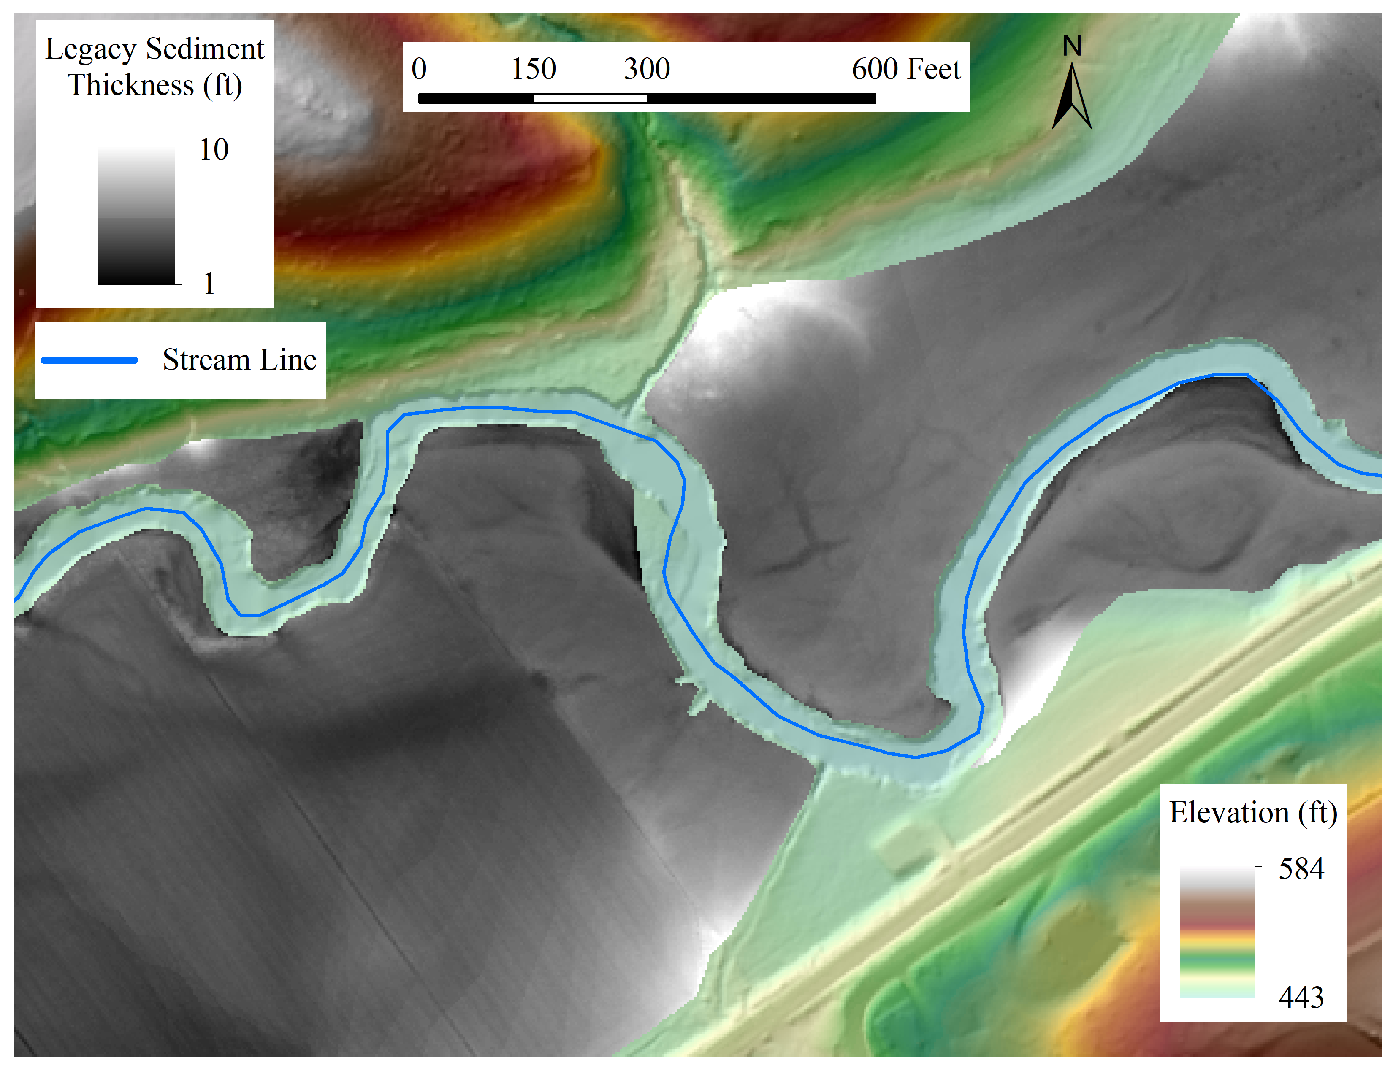
2
Copyright 2019
Water Science Institute
All rights reserved
2014 USGS Post Sandy Lidar.

Slide 31
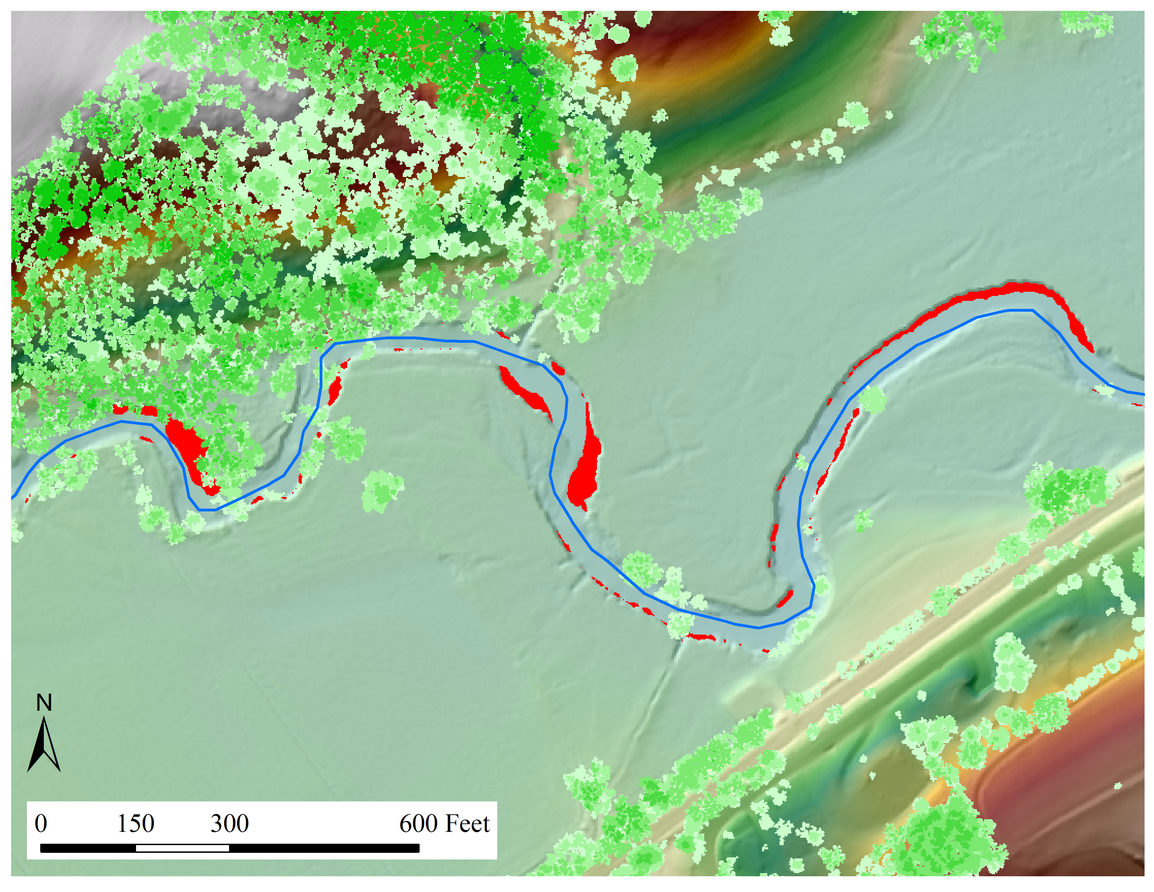
2
Copyright 2019
Water Science Institute
All rights reserved
2014 USGS Post Sandy Lidar.

Slide 32
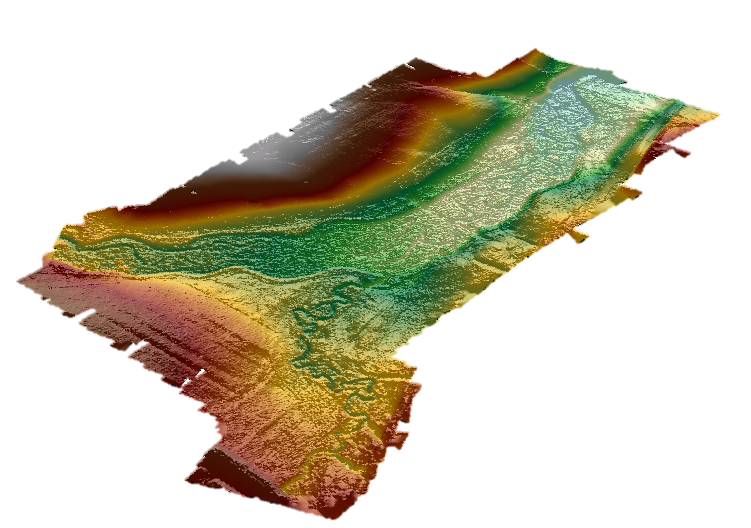
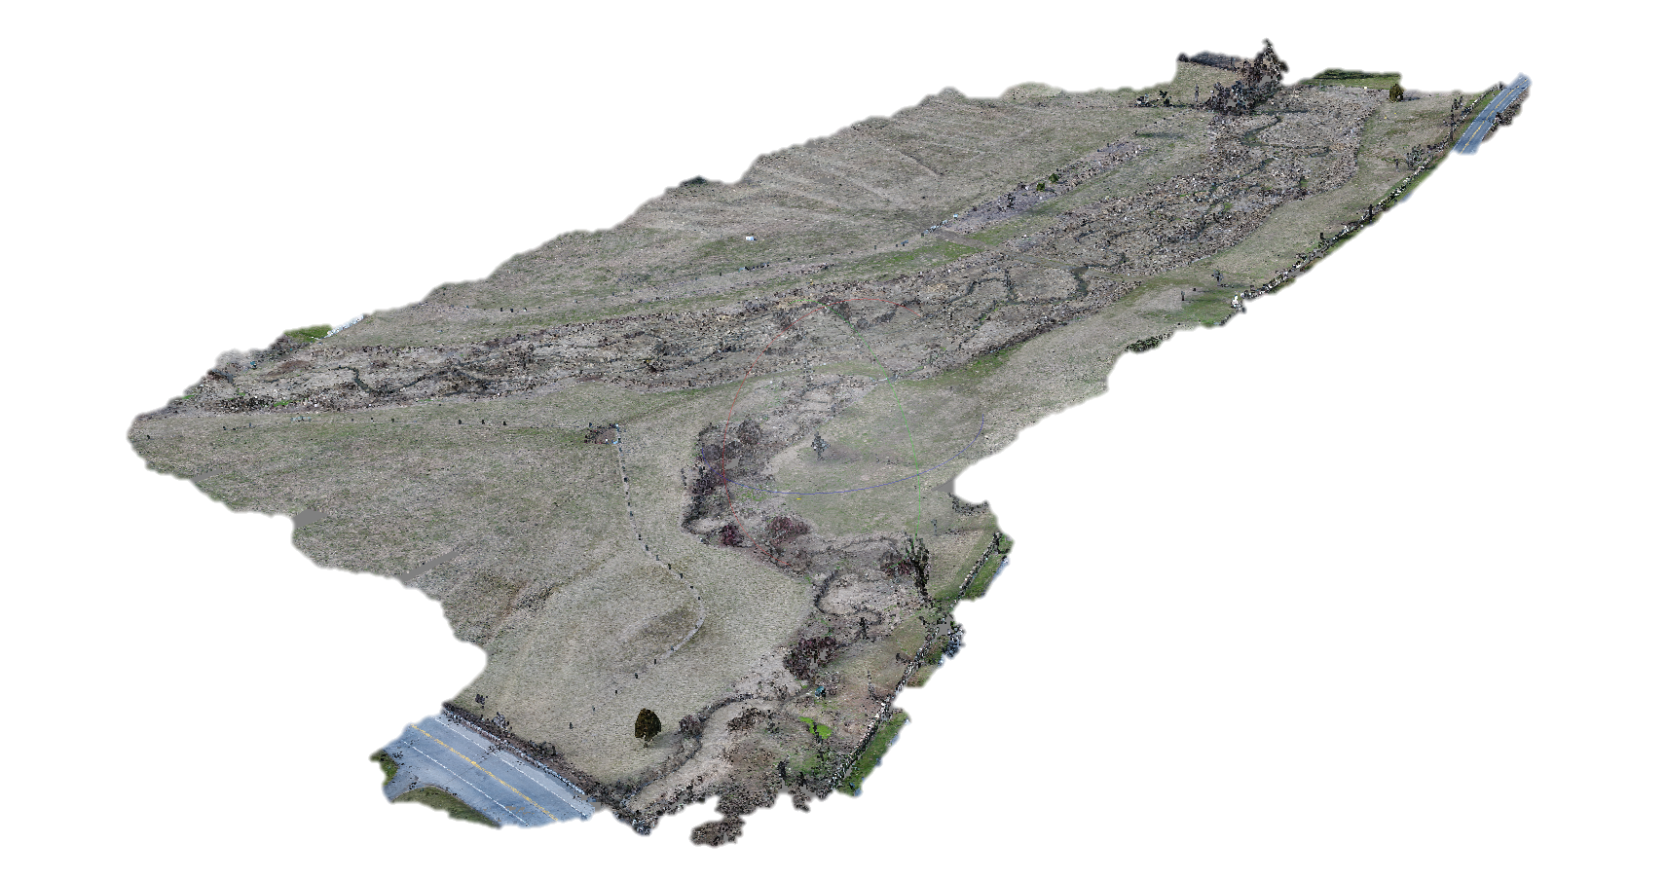
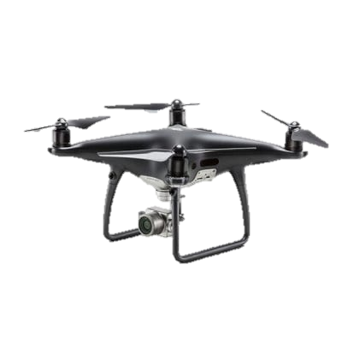
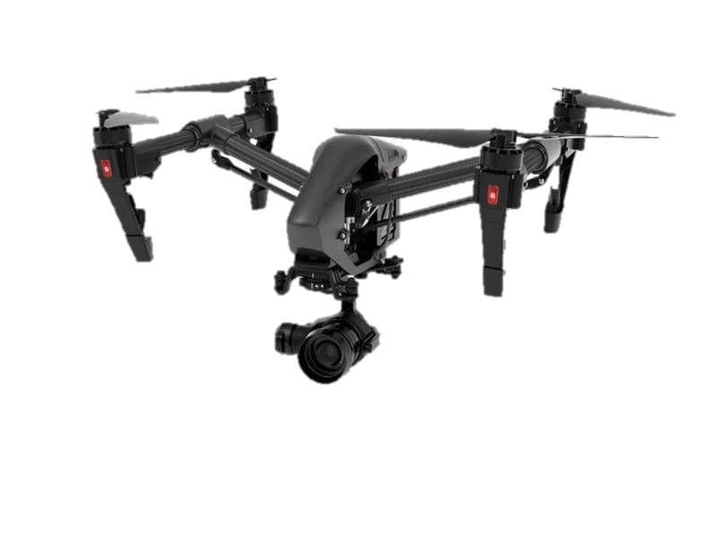
Drone Photogrammetry
Big Spring Run Restoration Site, Lancaster County. Drone Flight: May 2018.
Copyright 2019
Water Science Institute
All rights reserved
Notes:
1) Point Cloud
2) Drone DEM
Pixels have 3 dimensions in space just like lidar
Final product can be used to calculate erosion over time at a centimeter scale resolution increasing accuracy to a new level
Lowest Resolution ~ 2cm in moderate canopy

Slide 33
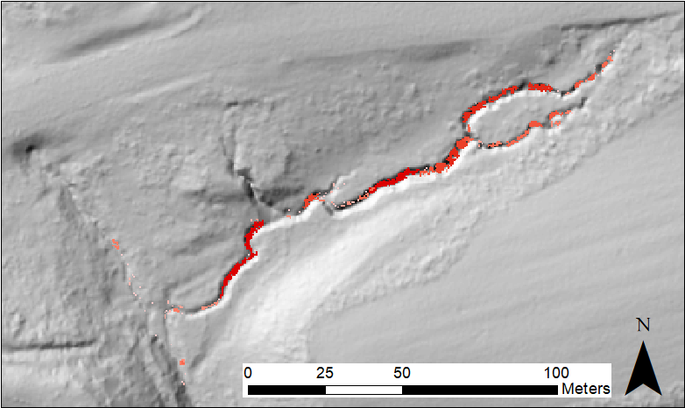
Knickpoint
Slopeshade from 2016 USGS QL2 Lidar.
Small bar
Bed incision
Freeze-thaw apron
Copyright 2019
Water Science Institute
All rights reserved

Slide 34
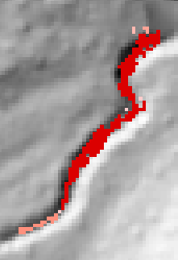
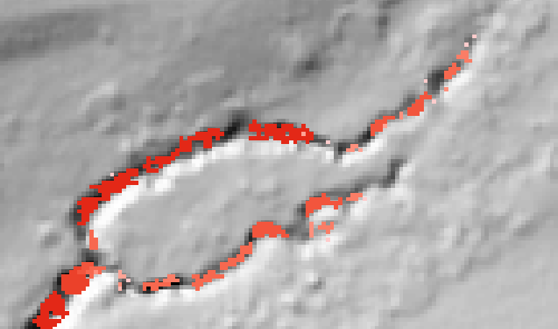

Slopeshade from 2016 USGS QL2 Lidar.
Erosion: 18.7 ± 6.6 m³
Erosion: 53.6 ± 16.4 m³
6.3 ± 1.9
Veterans Park, Dauphin County
Lidar Date | 3-24-2016
Drone Flight Date | 11-28-2018
Period Duration | 2.7 years 980 days
Stream length | 285 m 935 ft
Total erosion volume | 113 ± 35 m³ 147 ± 45 tons 294,000 ± 90,000 lbs
Erosion/year | 42 ± 13 m³/yr 59 ± 18 tons/yr 118,000 ± 36,000 lbs/yr
Erosion/stream length/year | ~0.15 m³/m/yr ~0.06 tons/ft/yr ~126 lbs/ft/yr
7.5 ± 2.1
17.2 ± 5.8
Erosion: 113 ± 35 m³
4.2 ± 1.3
24.8 ± 3.0
Flow Direction:
Erosion:
Copyright 2019
Water Science Institute
All rights reserved

Slide 35

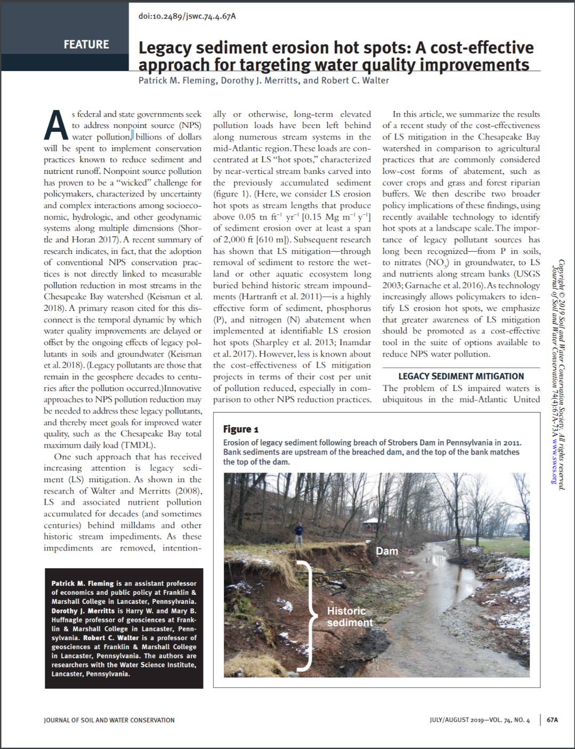
Copyright 2019
Water Science Institute
All rights reserved
Notes:
See slide 7 for details on methodology and uncertainty.

Slide 36
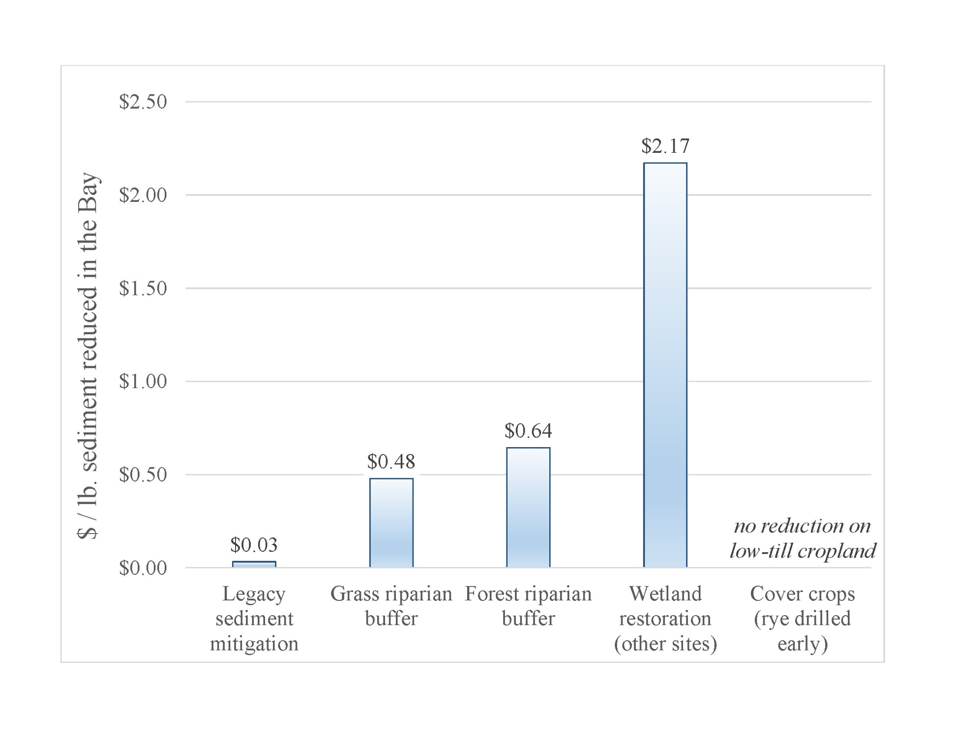
Sediment
Copyright 2019
Water Science Institute
All rights reserved
Notes:
See slide 7 for details on methodology and uncertainty.

Slide 37
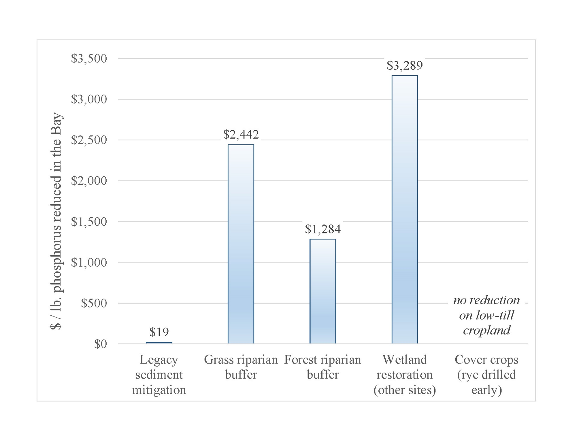
Phosphorus
Copyright 2019
Water Science Institute
All rights reserved
Notes:
See slide 7 for details on methodology and uncertainty.

Slide 38
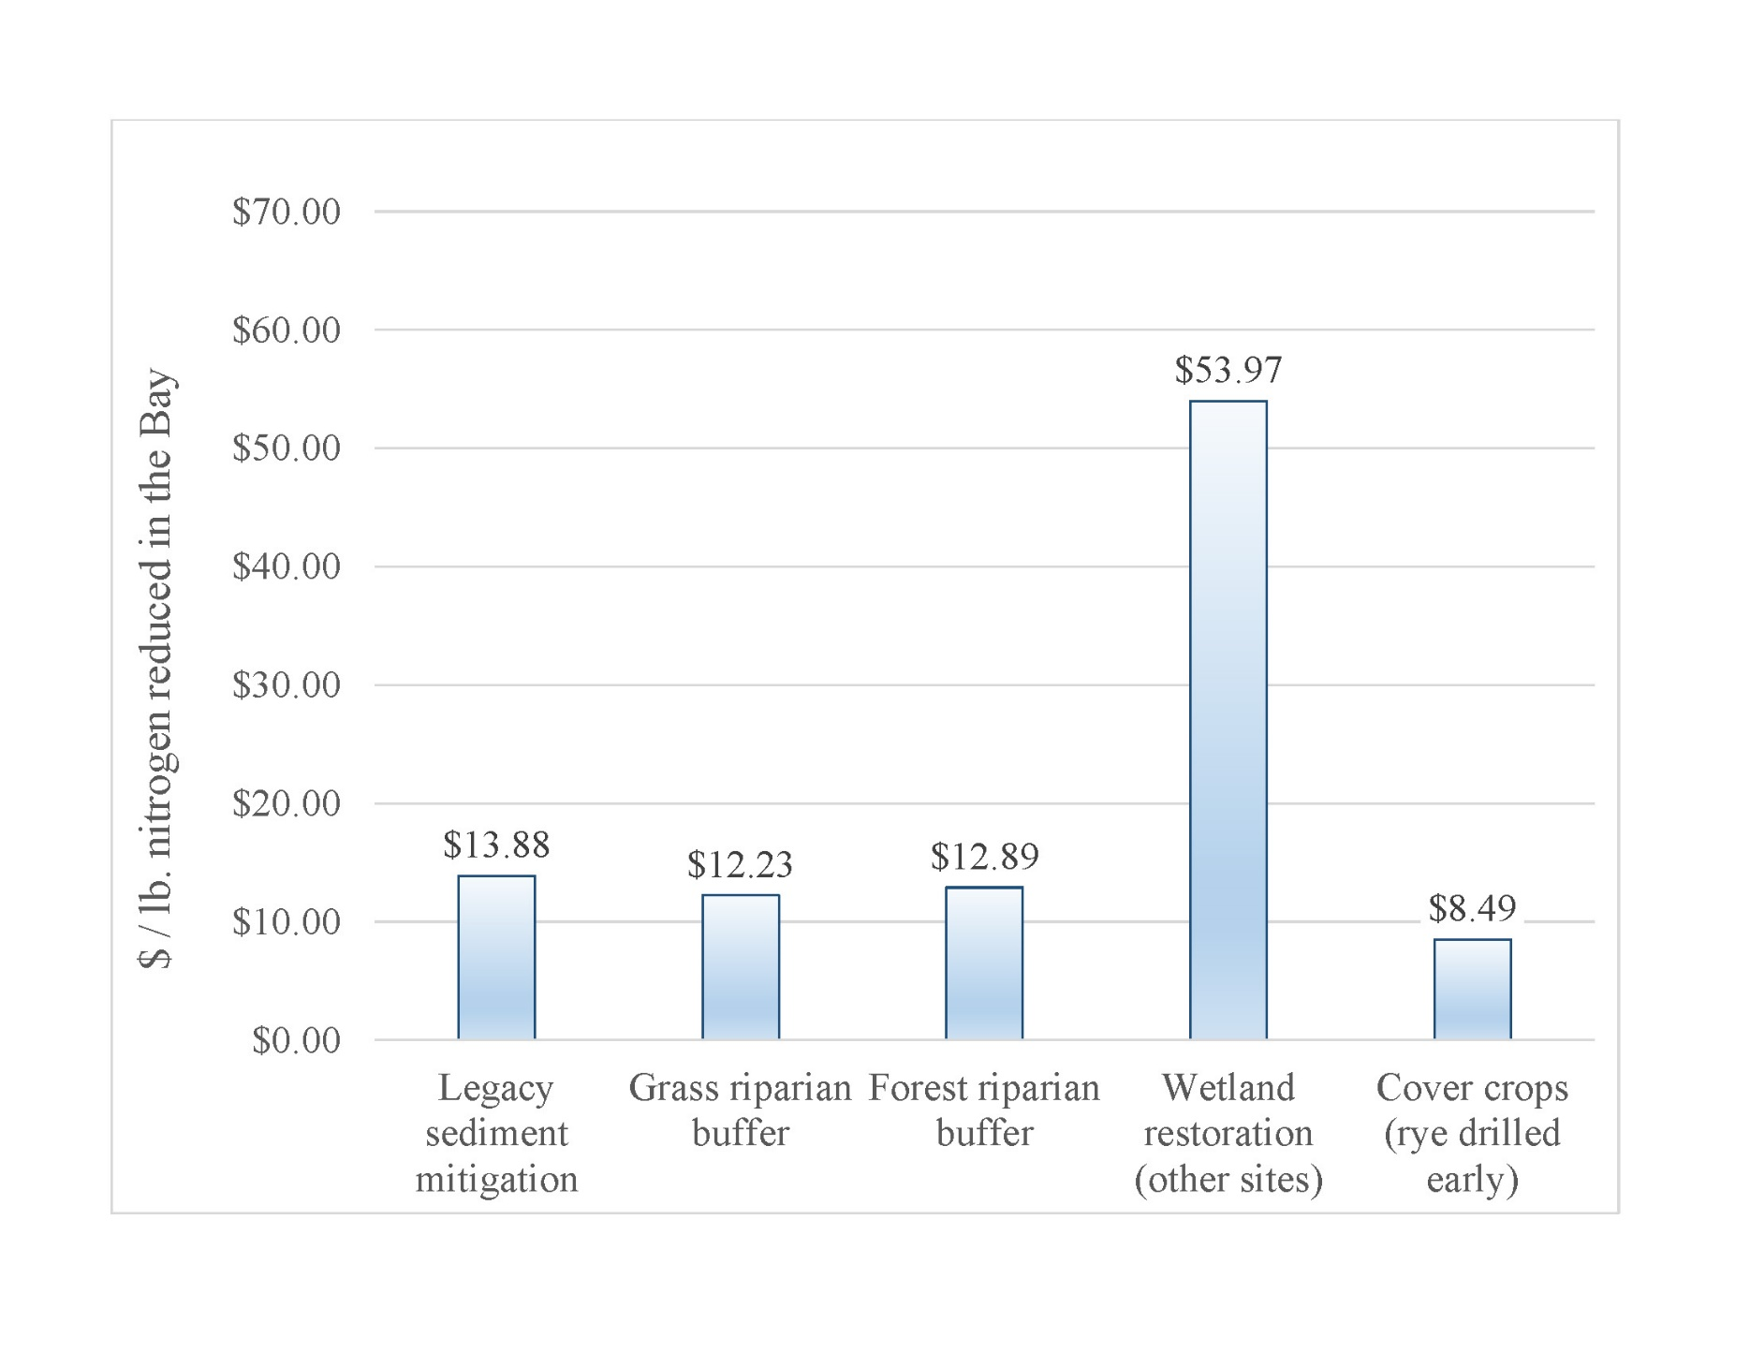
Nitrogen
Copyright 2019
Water Science Institute
All rights reserved
Notes:
See slide 7 for details on methodology and uncertainty.

Slide 39
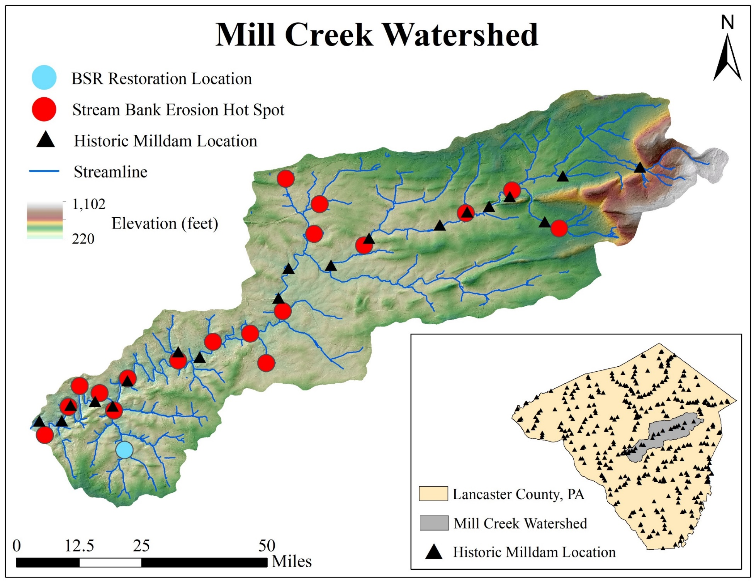
Copyright 2019
Water Science Institute
All rights reserved
Notes:
See slide 7 for details on methodology and uncertainty.

Slide 40
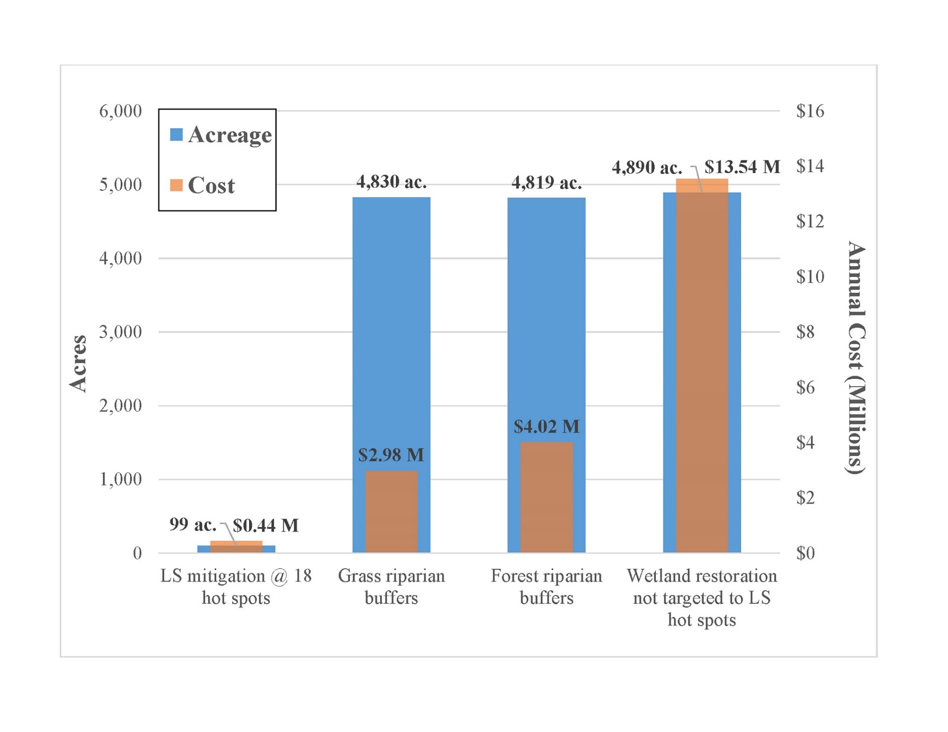
Copyright 2019
Water Science Institute
All rights reserved
Notes:
See slide 7 for details on methodology and uncertainty.

Slide 41
Watershed Action Team
Collaborative Watershed Mapping Tool
GIS to Support Collective Impact
Lancaster GIS Day
November 8, 2019
Carly Dean, Program Manager, Chesapeake Conservancy
Notes:
Introductions:
Working with the data management team for about two years to develop the colloaborative watershed mapping tool. I’m going to describe to you the process our team went through to develop the tool and give you some examples about how it’s being used, then I’ll hand it over to Emily to talk about our initial conversations with CS Datum and CWP to integrate water quality monitoring data, and have a group discussion about how you all would like to see your water quality monitoring data mapped, and the types of restoration and conservation decisions you think it should be used to make.

Slide 42

Watershed Action Team
Collaborative Watershed Mapping Tool
Image: Denver Education Attainment Network
Notes:
The process we went through to develop this mapping tool was just as important as the final product. The goal here was to bring together a group of different restoration professionals, each with their own perspective, to find common ground around where to focus restoration effort based on data.
Data is such a powerful tool to help people get on the same page. Before, each group may have been looking at a diversity of parameters, which have led us a to wildly different restoration strategies, and even though these may have been working on their own, it was hard to see how all of these pieces were coming together to form a county-wide picture of improving water quality. Now, we’re using this tool to help restoration professionals align their goals and their strategies so we can work as a unified force to make some strides toward improving Lancaster’s creeks and streams that we can finally piece together to form a county-wide success story.
While what I just described was our process for the watershed action team and the people who are actually out there designing and installing BMPs, I hope you see your role in collecting water quality monitoring data as being really a central feature of this entire data-driven, collective-impact effort.
When I talk about about the action team, here are a few of the groups that are represented…

Slide 43

Watershed Action Team
Collaborative Watershed Mapping Tool
http://lancastercleanwaterpartners.com/collaborative-mapping/

Slide 44





Step 1: Educate
Reference Layers
Stream Layers
Agriculture Layers
Wildlife Layers
Urban Layers
Commonly used data and new datasets
Case-studies & lessons learned
Chesapeake Conservancy
Chesapeake Conservancy
Doc Fritchey TU
Wikimedia Commons
Notes:
Get everyone on the same page about data that’s out there, and how people have used it to prioritize restoration

Slide 45
Step 2: Define objective
Encourage collaboration
We envision a publicly accessible tool that provides a variety of relevant information about Lancaster County watersheds to support smart watershed restoration decision making.
Examine workflow: what bottlenecks or challenges does this tool address?
Who is intended tool user?
Notes:
Consider stakeholders

Slide 46
Step 3: Develop strategy
How would you describe an area that is a high priority for restoration?
Example 1: Streams that are close to delisting
Have high loading, buffer gaps, stream bank erosion and drainage areas (many opportunities for restoration) but IBI scores and % forest cover are also fairly high = rapid delisting.
Example 2: Ready to go: optimize outreach efforts
Have relatively few large farms or developed parcels, properties have easements, are upslope of impaired segments of streams, contributing drainage through a gap in forested buffer coverage.
Example 3: Greatest opportunities for water quality improvement
Have large acreage of polluting land uses drains to a buffer gap, upslope or along impaired stream; steep slope & highly erodible soils; impervious surface runoff drains through a buffer gap; impervious surface is close to stream.
Describe priority areas using common language
Consider what may initiate a user logging into the tool
Some strategies are mutually exclusive when it comes to GIS analysis
Notes:
Interactive activities
Stakeholders are not necessarily GIS professionals, but they are going to be using this to make decisions

Slide 47

Step 4: Define geographic unit
Unit to be prioritized reflects approach
Scale can be applied in practical ways
1035 Catchments in Lancaster County prioritized for restoration
NHDPlus High Resolution 2017 dataset:
Stream reaches segmented at confluence points. Average: 3,030 ft. in length
Catchments associated with each stream reach. Average: 600 acres
Notes:
Reflects environmental conditions. Large enough to avoid targeting individual landowners: small enough to concentrate efforts
Cocalico Creek near Rothsville. 143 acres

Slide 48
Step 5: Identify datasets
Metrics | Units
Nitrogen, Sediment, Phosphorus Loading Rates | (N, P, S) (lb/acre)
Average Stream Length per Parcel | (miles)
Stream Bank Volume Loss | (cubic meters)
Buffer Restoration Opportunity Area | (acres)
Percent of Streams Impaired (for aquatic life uses | (%)
Sum of weights | Points
Datasets get us to our strategy
Geographic coverage is relative to scale of unit
Data is up-to-date, limitations are understood and accepted

Slide 49


Step 6: Strawman prioritization
Does the prioritization reflect understanding of on-the-ground conditions?
Is the tool intuitive?
4
3
2
1
Notes:
Provide stakeholders with examples of geographies

Slide 50

Step 7: Launch, train, apply, adjust
“I have a specific parcel in mind.”
“Where should I do outreach?”
Documentation and tutorials
Specific examples of when in their workflow user may access the tool
Support partners in real-world applications
Notes:
Scenario 1 Tutorial: Orientation to generate a pdf property map.
Presentation: Prioritization overview
Scenario 2 Tutorial: Explore useful ArcGIS Online features to generate a spreadsheet with parcel addresses.
Discussion: Directing action in 2019.
You may consider accessing the Collaborative Watershed Mapping tool when you’re…
… on the phone with a landowner who has just contacted you about a resource concern.
… preparing to go on a site visit.
… out in the field and have your tablet and an internet hotspot.
… putting together a grant proposal.
… completing a grant report.
You may consider accessing the Collaborative Watershed Mapping tool when you’re…
… preparing a mailing list for a farmer field day.
… setting watershed- or municipality-scale goals.
… looking for hotspots across the county.
… focused on areas where many partners could collaborate.

Slide 51

Step 8: Measure progress
Watershed Action Team
Collaborative Watershed Mapping Tool has been accessed 1,183 times
Successes
Barriers to adoption
Refer back to objective & strategy
Settle on a final prioritization to set long-term goals
Notes:
Survey
Evaluate datasets & visualization
How are you using the tool?
Is the tool encouraging collaboration?

