Slide 1
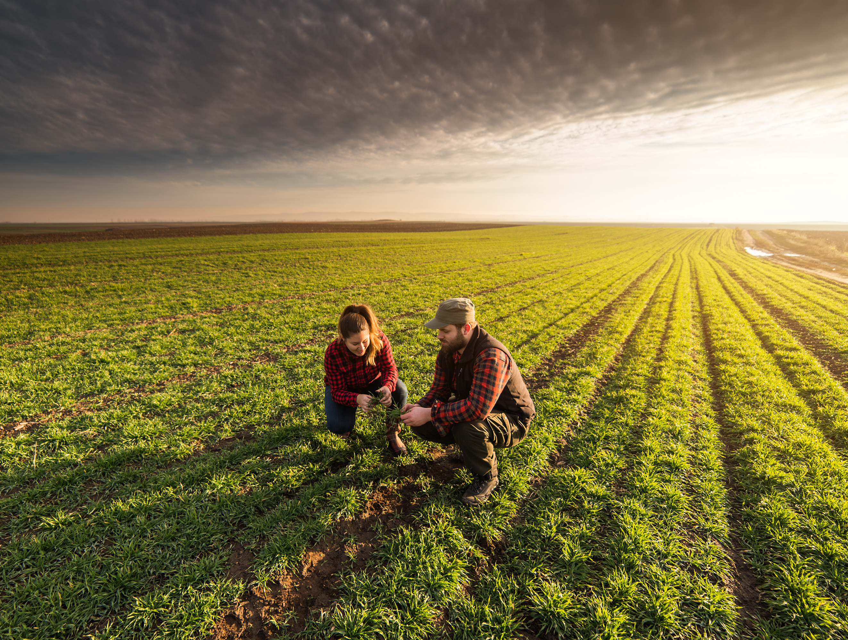



Session V: Cross-Walking Perspectives

Slide 2
Advancing Outreach Effectiveness to Improve Conservation Practice Adoption: Today’s Agenda
SESSION V: Cross-walking Perspectives and Tying it Together
9:30 Welcome Back, Day 2 Reflections
9:40 Results and Findings
Operator Concerns
Understanding the Farmer Decision-Making Process
Outreach Exchange
Crosswalk Synthesis
10:40 Break – 5 minutes
10:45 Breakout Discussions
11:15 Break – 15 minutes

Slide 3
Which sector do you represent?
Mean : 2.775 | Confidence Interval @ 95% : [2.436 - 3.113] | Standard Deviation : 1.456 | Standard Error : 0.173

Slide 4
What is your affiliation?
Mean : 6.750 | Confidence Interval @ 95% : [5.819 - 7.681] | Standard Deviation : 2.124 | Standard Error : 0.475

Slide 5
Within which USDA Farm Resource (agro-ecosystem) Region do you mostly work?
Mean : 2.429 | Confidence Interval @ 95% : [1.895 - 2.962] | Standard Deviation : 1.248 | Standard Error : 0.272

Slide 6
Within which major US water resource region do you mostly work?
Mean : 2.762 | Confidence Interval @ 95% : [2.087 - 3.437] | Standard Deviation : 1.578 | Standard Error : 0.344

Slide 7
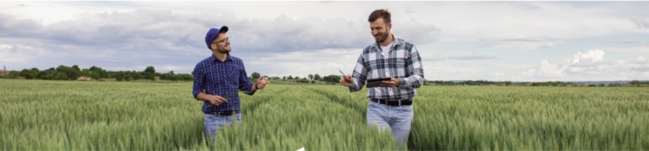
Day 1, Session II: breakout group notes
Advancing Outreach Effectiveness to Improve Conservation Practice Adoption

Slide 8
SESSION II: Concerns
Financial impediments… it’s complicated!
  Integrating short- vs- long-term risks
  Complexity of day-to-day operations
  Risk adds to complexity, including threat of extreme weather events
Policies, regulations, programs… often constraining rather than helpful
  Inflexibility
  Reliability of decision criteria for qualifying
  Complexity of programs
Time… for evaluating the risk of practice adoption, as well as time for implementation and maintenance
Soil health and watershed health… but too much uncertainty in prescribed practices, which presents too much risk in terms of vulnerability to policy constraints or sunk costs. Need for better access to technical support.

Slide 9
Day 1, Session III: breakout SUMMARY
Advancing Outreach Effectiveness to Improve Conservation Practice Adoption

Slide 10
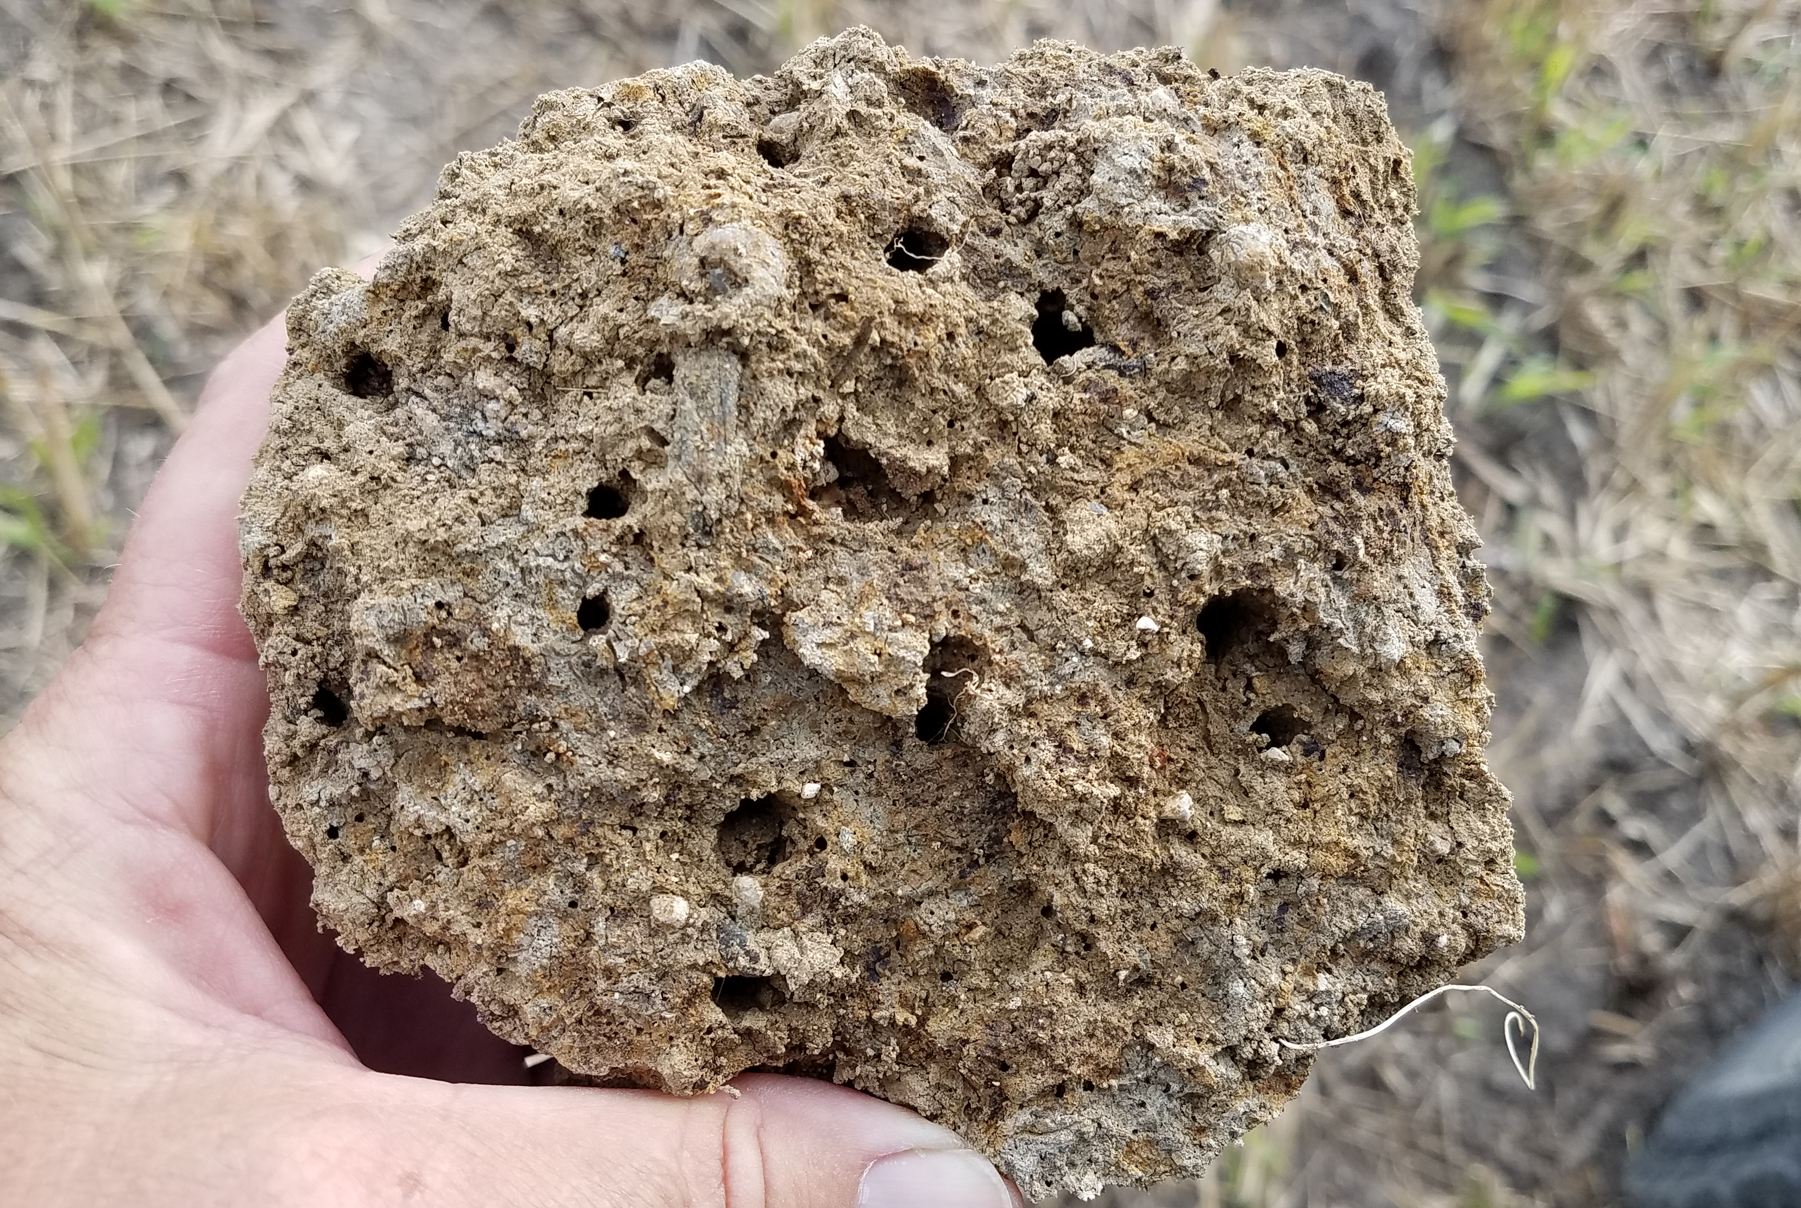
Advancing Outreach Effectiveness to Improve Conservation Practice Adoption
SYNTHESIS of SESSION II:
What About Farmer Concerns & Priorities is Least Understood?
Financial
Risk
Knowledge (information)
Constraints
Evaluation

Slide 11
Can this Framework Serve as a Predictive model for Conservation Practice Adoption?

Slide 12
Take-home Points
Does the skeleton of the framework provide a useful sequence of events?
  Yes
Does the framework, as is, provide a useful conceptual structure to discuss practices?
  Yes
Can the framework, as is, be the basis of a predictive model for conservation adoption?
  No
  There are some missing elements
  The causal linkages are not yet clear
  But there’s promise…

Slide 13
Trust, Relationship, Durability
Insights from Breakout Discussions
The relationship of the TSP to the local community is a foundational element
  Long-term relationship
  Connection to the community
  Trust
The hypothesis is that the nature of this relationship is a predictive factor in understanding the effect of any outreach practice
A number of the activities that TSP’s undertake are specifically designed to help develop this relationship

Slide 14
Individuality of Farmer Perspectives
Insights from Breakout Discussions
The framework needs to acknowledge the role of farm and farmer characteristics as important predictors of many of the later steps
  See Linda’s presentation on Tuesday
Outreach practitioners have an important awareness step themselves
  Awareness of the local community context
  Awareness of the individual farm context
What are the farm and farmer characteristics that are the best predictors of the various transitions?
  How can outreach strategies be customized in respond to that knowledge?

Slide 15
Clarity about Values, Beliefs, Attitudes
Insights from Breakout Discussions
The framework would benefit from explicit recognition of the fundamental objectives of the farmer or landowner
  That is, some marriage of prescriptive and descriptive decision theory might be valuable
  A better understanding of the common array of fundamental objectives would help
    Economic objectives
    Conservation objectives
    Impacts to neighbors and community
    Reputation (of farmer)
    Generational legacy
The relationship between values, beliefs, and attitudes is more complex than characterized
  The causal connections could be better depicted

Slide 16
There’s more than 1 kind of awareness
Insights from Breakout Discussions
Awareness of the existence of conservation practices and programs
Awareness of the costs and benefits of conservation practices
Awareness of the specific regulatory requirements, permits, paperwork, and other implementation considerations

Slide 17
The Role of Norms is More Complex
Insights from Breakout Discussions
Norms affect intention (commitment) as much as they affect behavior (adoption)
Norms can change
  What are the factors that affect norms?
Are there outreach practices that specifically address norms?

Slide 18
Formation of Attitudes
Insights from Breakout Discussions
How are farmer’s synthesizing the information available to them, the beliefs and values they hold, to determine an attitude about practices?
  Weighing conflicting objectives
  Grappling with risk
  Considering short- vs. long-term costs and benefits
  Thinking about portfolios of actions: how conservation actions integrate with farm operations

Slide 19
Importance of Persistence
Insights from Breakout Discussions
There are steps after adoption
  Persistence of conservation practices
  Adaptation to changing regulatory environments
  Feedback from adoption to improvement of outreach practices

Slide 20
The Farmer’s Decision
Combining LENSES:
Decision Analysis & Behavioral Economics

Slide 21
A Working Framework
Positive or negative evaluations of a behavior, informed by beliefs
Social influences or constraints
For understanding and predicting adoption decisions
Trust
Trust
Attitudes
Norms
Starting Point
Creating
Awareness
Generating Commitment (Intention)
Implementing the Practice (Behavior)
Trust
Knowledge
Trust
Trust
Beliefs
Constraints
Information specific to an opportunity
Deep-seated values and worldviews that serve as goals and guide actions
Physical, economic, regulatory, and other barriers to adoption

Slide 22
Trust
Trust
Trust &
Relationship
Norms
A Revised Framework?
Starting Point
Creating
Awareness
Generating Commitment (Intention)
Implementing the Practice (Behavior)
Persistence
Trust
Knowledge
I
Trust
Attitudes
Trust
Knowledge
III
Trust
Knowledge
II
A LOT to understand here
Trust
Constraints
Trust
Trust
Trust
Farm-specific
Factors
Fundamental
Objectives
Beliefs

Slide 23
Closing Thoughts
This framework is a work in progress
  But the conversations this week have been very fruitful
How important is it to develop a common framework for talking about these processes?
  I want to argue it’s very important
A common framework
  Allows clarity about hypotheses and causal assumptions
  Allows development of clear empirical studies to test assumptions and effect strength
  Allows learning to be passed more quickly among practitioners

Slide 24
Day 2, Session IV: breakout group Key Themes
Advancing Outreach Effectiveness to Improve Conservation Practice Adoption

Slide 25
SESSION II: Outreach Strategy Exchange
Develop relationships with the communities
  Relationships with long-term local staff, retailors; investing in the community
  Working with multiple stakeholders in the community for improved communication-including Amish and religious communities; use local retailers to spread the message
  Partner with trusted sources– who are they
  Importance of strategies that are about developing trust and ties to the community, building relationships and understanding context, long-standing reputation of TSPs, durability of relationships matters

Slide 26
SESSION II: Outreach Strategy Exchange
New approaches for outreach: workshops, field demonstrations, social media, billboards, local radio stations and tv networks, ads at local movie theaters, programs at schools with provided take-home materials
  Highlight stories of individual farmer experiences with conservation programs
  Emphasized importance of using local avenues of outreach
  With COVID preventing in-person outreach, these new approaches are important as ever. Post-COVID, in-person outreach is more effective
  Focus on diversity of farmers: age, gender, etc
  Public/private partnerships

Slide 27
SESSION II: Outreach Strategy Exchange
Develop relationships with the communities
  Relationships with long-term local staff, retailors; investing in the community
  Working with multiple stakeholders in the community for improved communication-including Amish and religious communities; use local retailers to spread the message
  Partner with trusted sources– who are they
  Importance of strategies that are about developing trust and ties to the community, building relationships and understanding context, long-standing reputation of TSPs, durability of relationships matters

Slide 28
SESSION II: Outreach Strategy Exchange
Make funding opportunities and helpful resources easily available
  Private funding: farmers may not be aware of private funding sources or specific grant funding opportunities; instead of expecting them to do the research on their own, NGOs (such as TNC) should act as a funnel for a broad suite of opportunities; how to increase awareness of this resource?
  TSPs as liaisons to understand farmer objectives and connect them with funding and resource opportunities that are relevant
  Retailers could help direct programs by ordering equipment and assisting with scheduling plantings
  Online tools to make regulatory paperwork easier

Slide 29
SESSION II: Outreach Strategy Exchange
Evaluating outreach effectiveness
  Ranking system gives compliance farms higher priority, which is frustrating to early adopters
  Explicitly map out strategy to reach adoption and where outreach fits in; focus on the whole system and how outreach fits in→ use this to evaluate overall effectiveness
  Hands-on projects to track effectiveness: what works and what doesn’t (research need)

Slide 30
Day 2, Session IV: breakout group Key Themes
Advancing Outreach Effectiveness to Improve Conservation Practice Adoption

Slide 31
SESSION V: Crosswalk
Emerging Themes:
Challenges are similar across geographies….
  But how these challenges touch down vary locally.
Most of concerns are willingness to adoption/ implementation while outreach strategies still include a lot of general awareness of practices and programs that do not focus on specific concerns.
Need to continue to expand connections with trusted advisors and invest in their support to address concerns and support adoption of practices.
Some concerns are based on ensuring a viable farm operation and there is a disconnect with outreach strategies focused more on benefits of conservation practices without linking the context or providing solutions.
Need to establish common language between social science and outreach practitioners.
Common framework could help with prior but also help to link outreach efforts across different areas addressing the same concerns.

Slide 32
SESSION V: Crosswalk
Critical opportunities for building “tri-sector” partnerships:
Diversity of interpretations around the term knowledge and its relevance in farmer decision-making related to conservation practice adoption
  Value of communication vs strength of evidence base
Effectiveness of top-down/external approaches (e.g., consumer demand for sustainable practices) vs. local-led coalitions, advancing commitment within a community based on local context (e.g., multi-stakeholder action groups)
Value of investing in building awareness and willingness vs facilitating adoption, especially when engaging farmers on parcels deemed critical for advancing restoration goals; also understanding effort needed to build trust as well as address concerns related to long-term maintenance and commitment.
Overall, need for exploring and improving alignment between farmer concerns and outreach strategies.

Slide 33
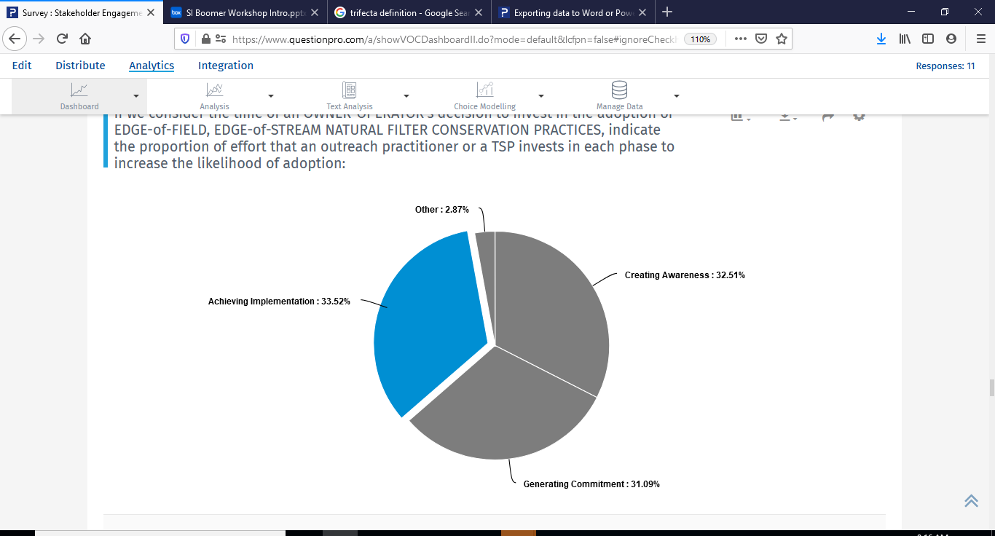
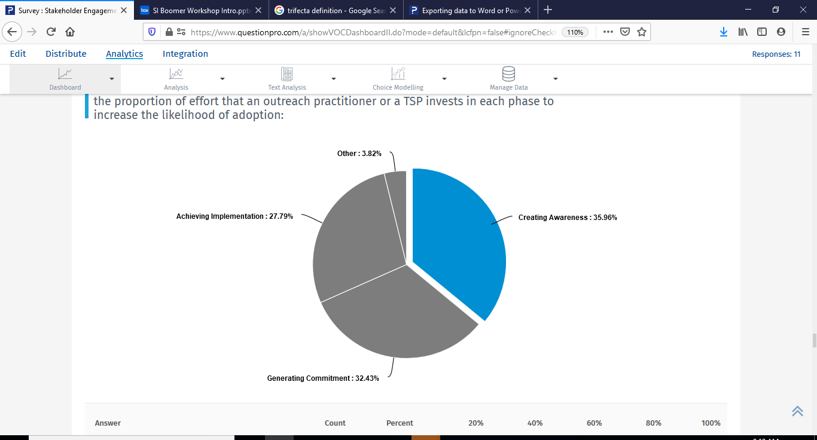
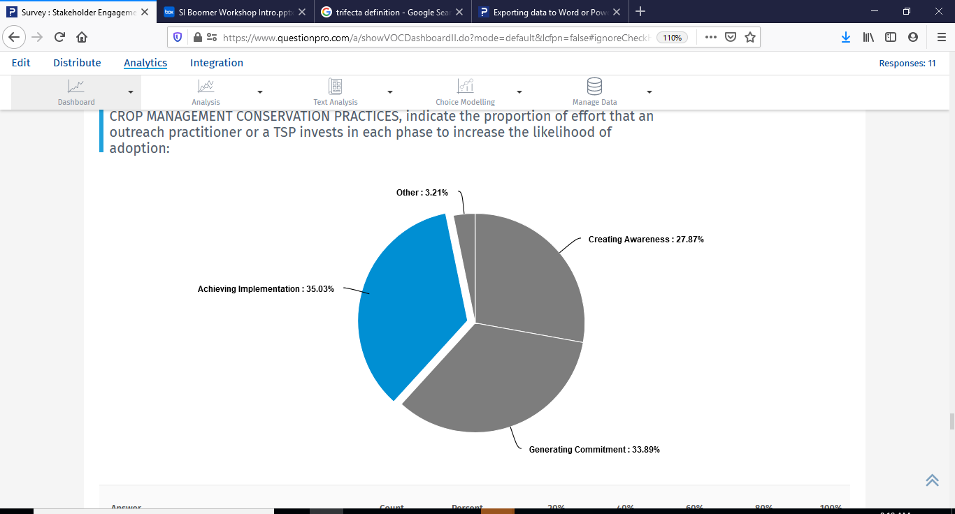
Advancing Outreach Effectiveness to Improve Conservation Practice Adoption:
Effort to Decision Milestone
Other
Achieving Adoption
Creating Awareness
Creating Willingness
Operator owner adoption of EOF/EOS file practices.
Non-operator owner adoption of EOF/EOS file practices.
Operator adoption of infield crop practices.

Slide 34



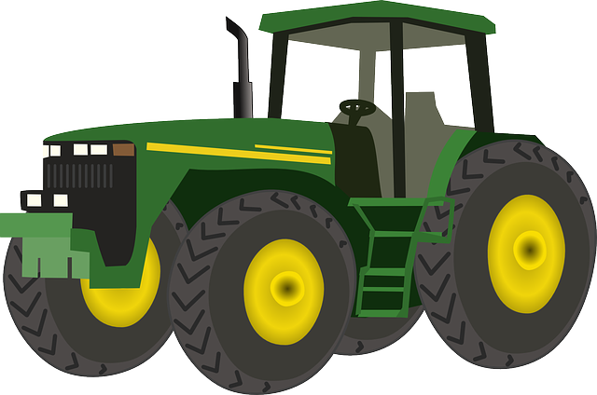
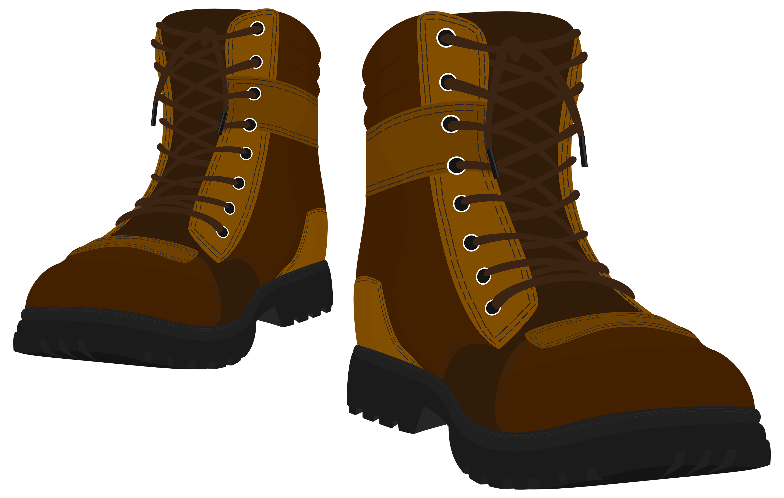

ACADEMICS PERCEIVED CONCERNS
TSP PERCEIVED CONCERNS
FARMER’S CONCERNS:
.
.

Slide 35
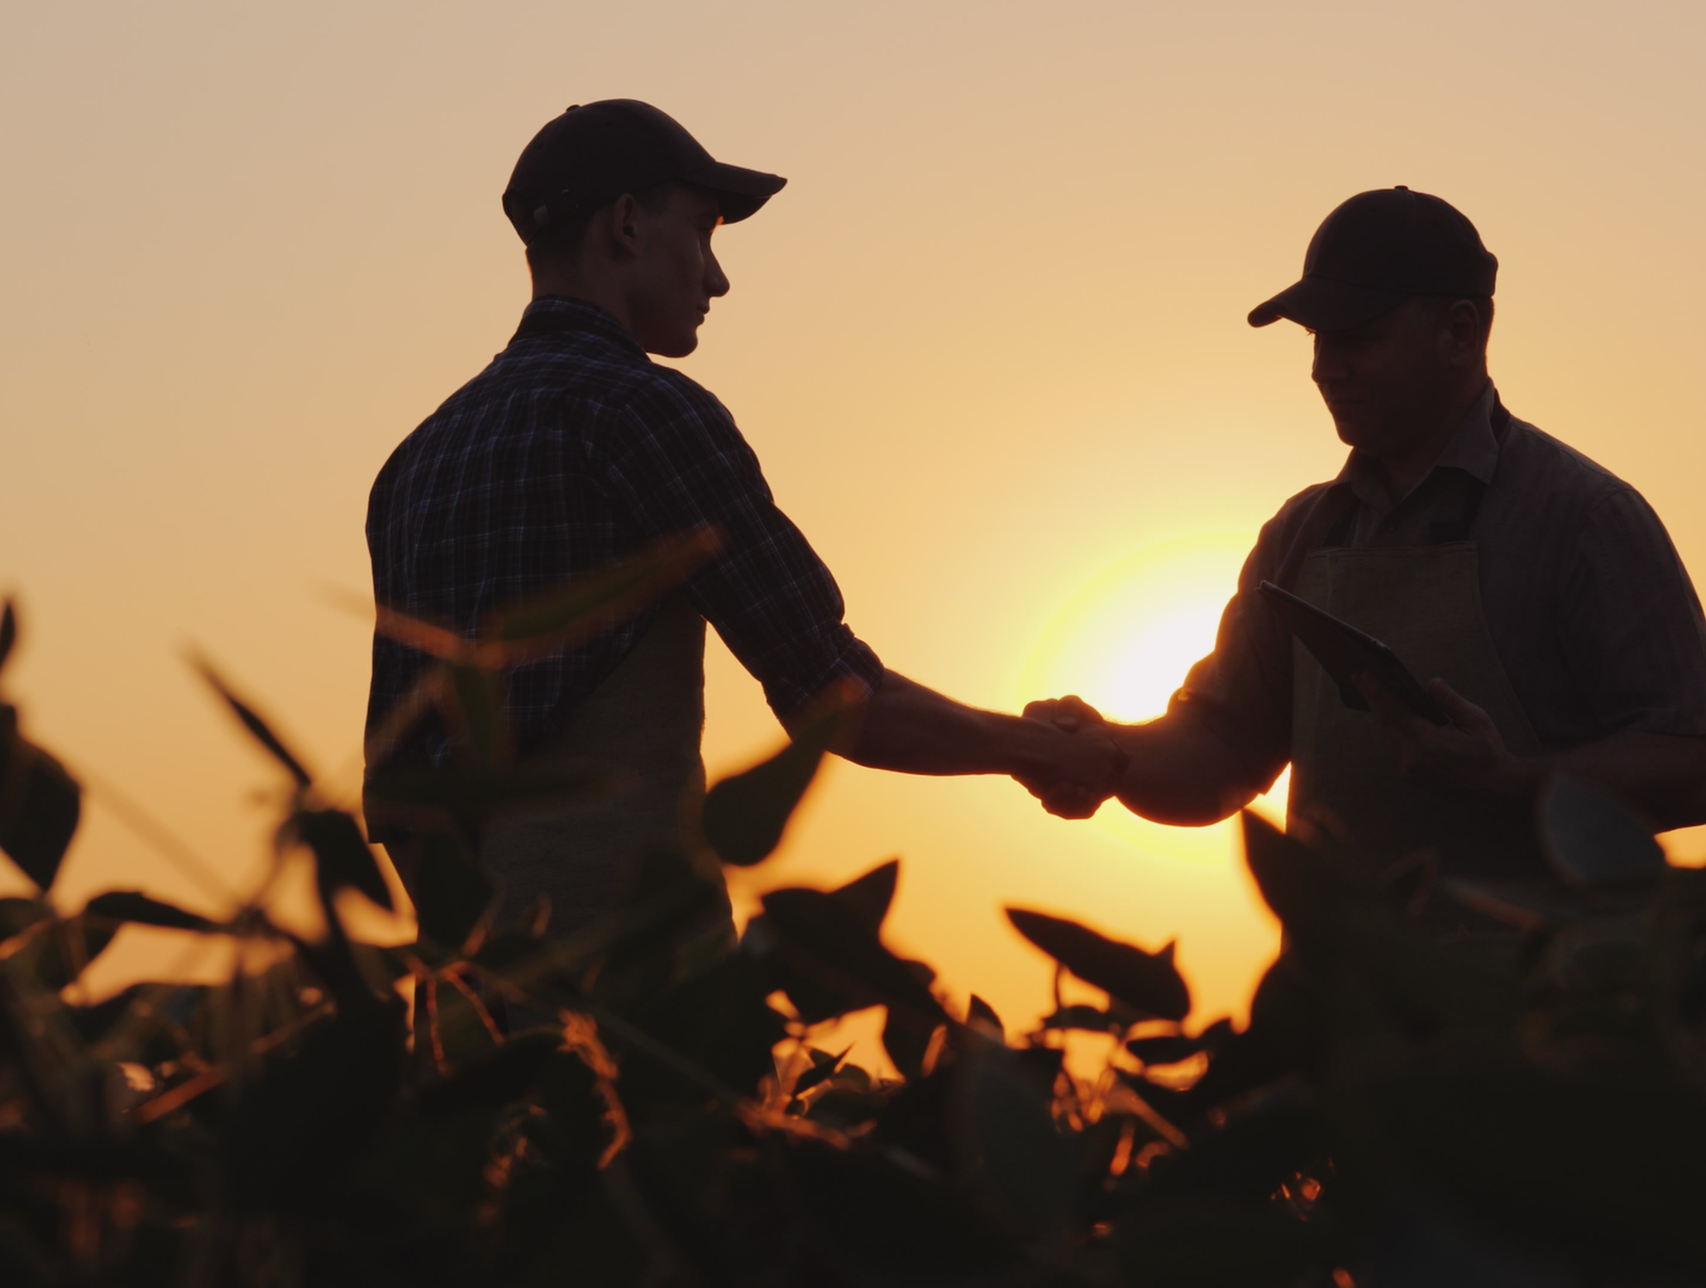
Session VI: Tying It All Together

Slide 36
Today’s Agenda Continued
SESSION VI: Tying it All Together: Key Take-Aways, Next Steps, and Closing Remarks
11:30 Session Overview
11:35 Breakout Discussions (continued)
12:00 Full Group Discussion
12:15 Panel Discussions: Workshop Conclusions, Key Takeaways, and Next Steps
With Leah Palm-Forster (UDel), Brandon Hunnicutt (Hunnicutt Farms), Ryan Heiniger (Pheasants Forever, Inc.), Amanda Bahn-Ziegler (TruTerra)
12:50 Next Steps and Adjournment

Slide 37
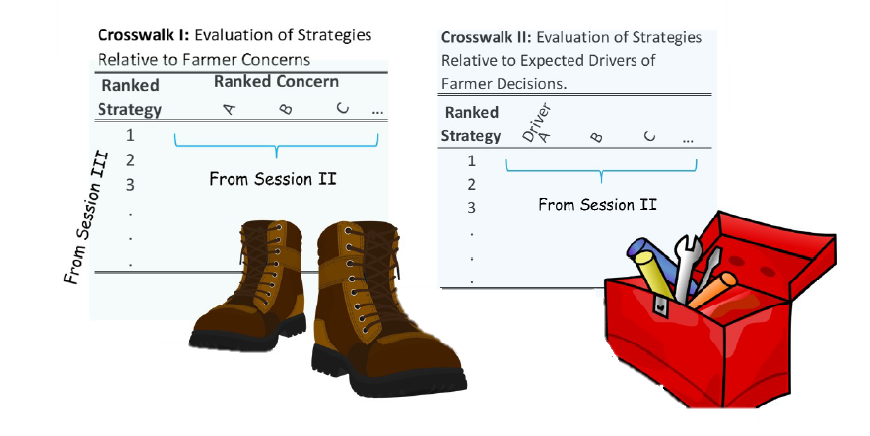
Session VI Breakout Group

Slide 38
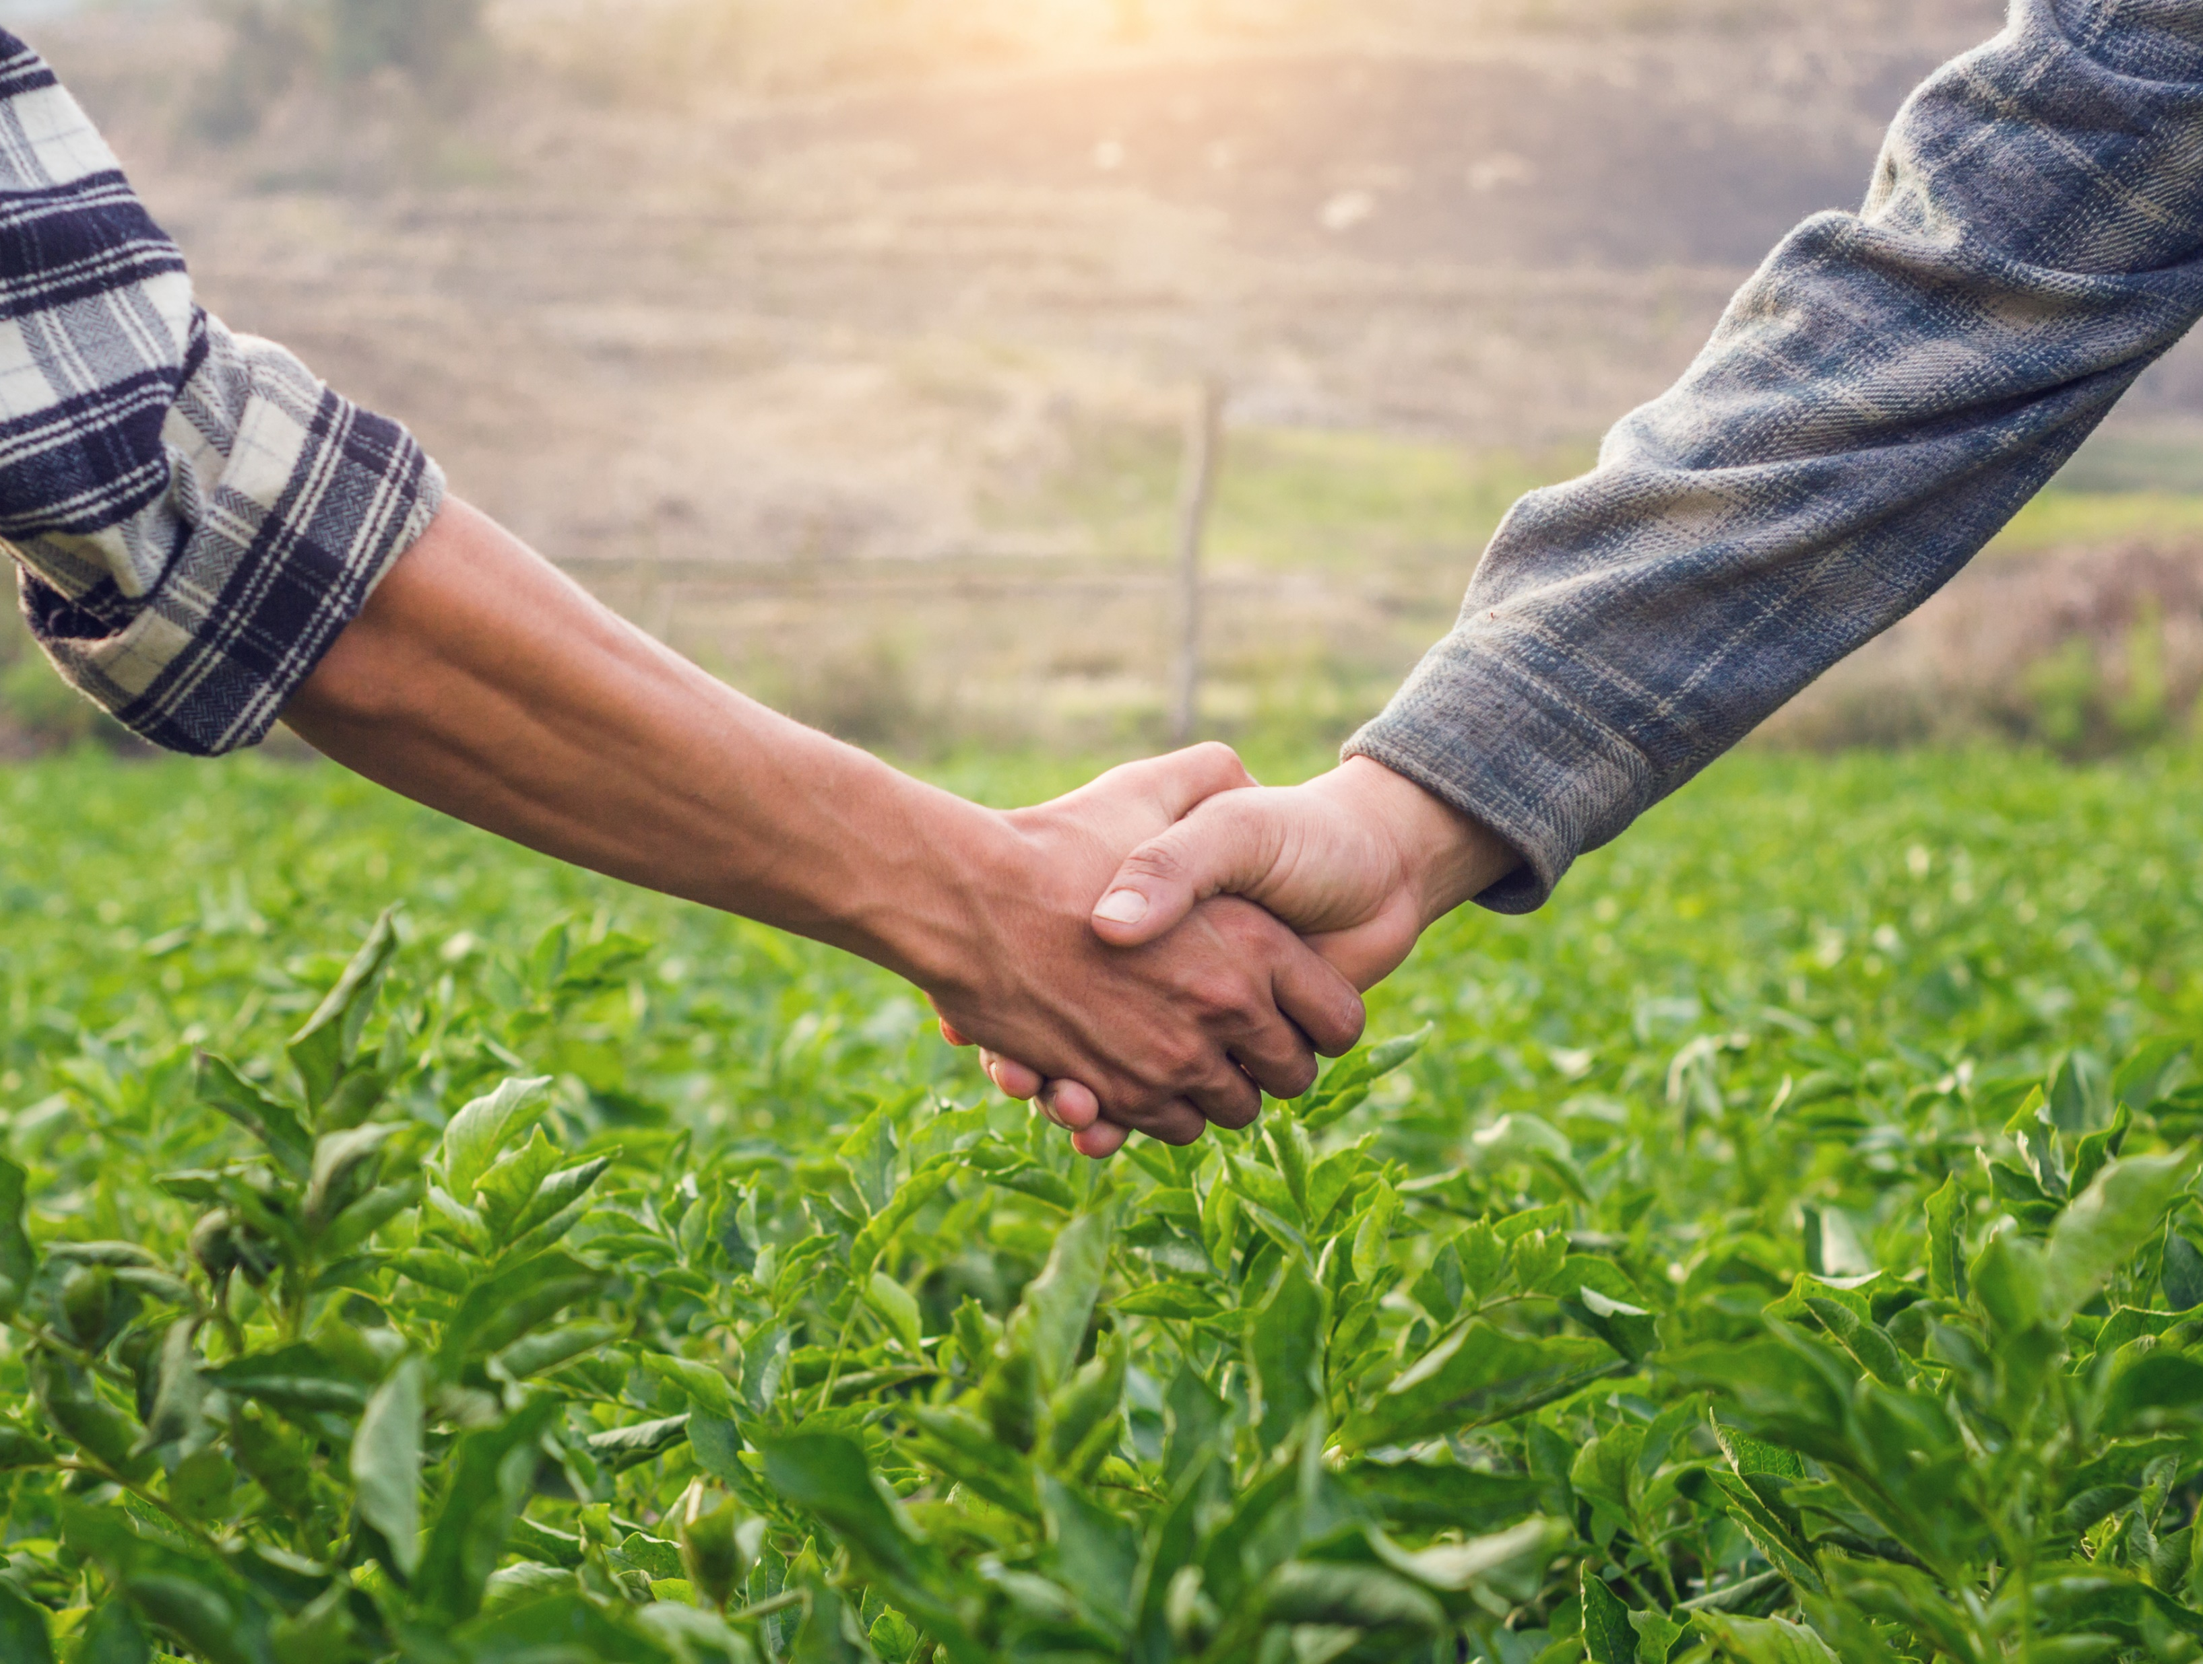
Advancing Outreach Effectiveness to Improve Conservation Practice Adoption
Next Steps:
Poll Summary & Report
Public-Private Partnership building to advance a trifecta partnership to address emerging opportunities.

Slide 39
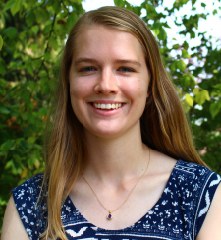
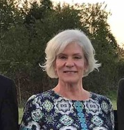
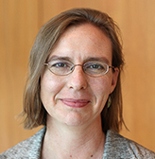
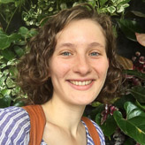
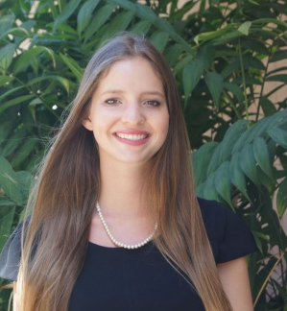
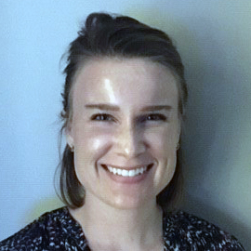

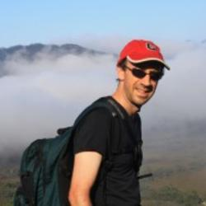
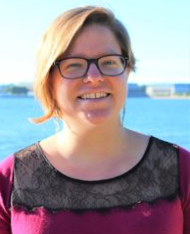
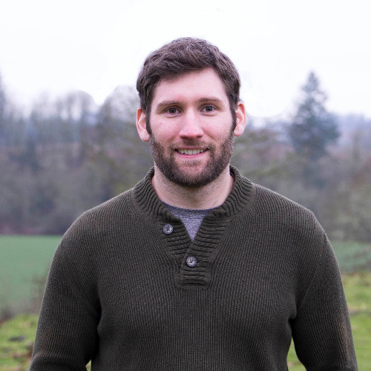
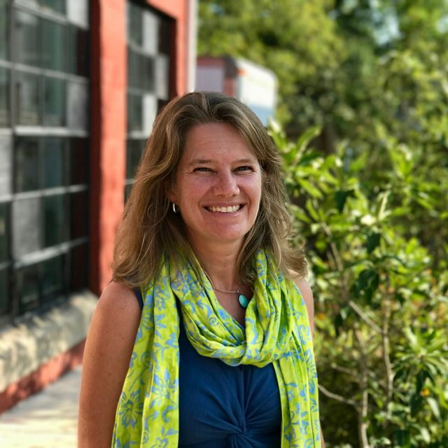
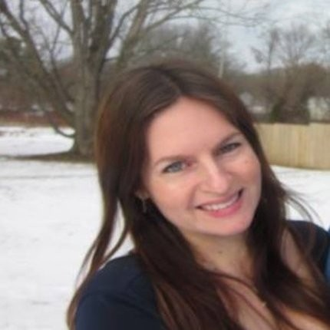
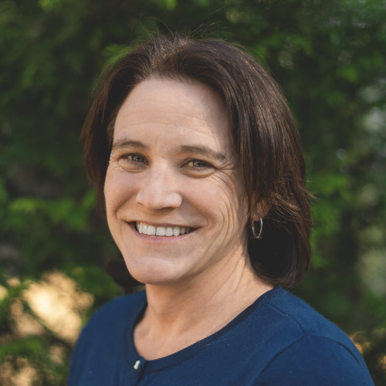
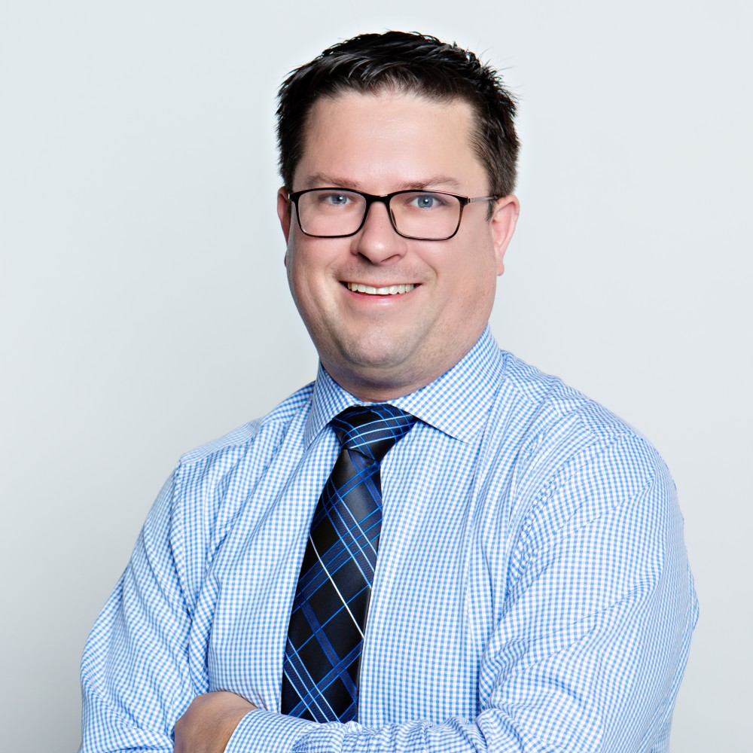
Advancing Outreach Effectiveness to Improve Conservation Practice Adoption
Workshop Facilitators and Note Takers:
Maggie Beetstra
OSU
Christine Conn
MD DNR
Lara Fowler
Penn State
Julianna Greenberg
EPA
Maile Hartsook
FFAR
Lauren Hershey
FFAR
Cordelia Hiers
FFAR
Amy Jacobs
TNC
Michael Runge
USGS
Taryn Skinner
WWF
Allison Thomson
Field to Market
Katie Walker
Chesapeake Conservancy
Collin Weigel
JHU/TNC
Paul Wolfe
Walton Family Foundation
Thank you!

Slide 40
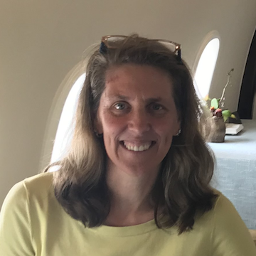
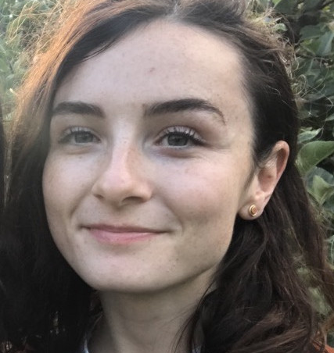
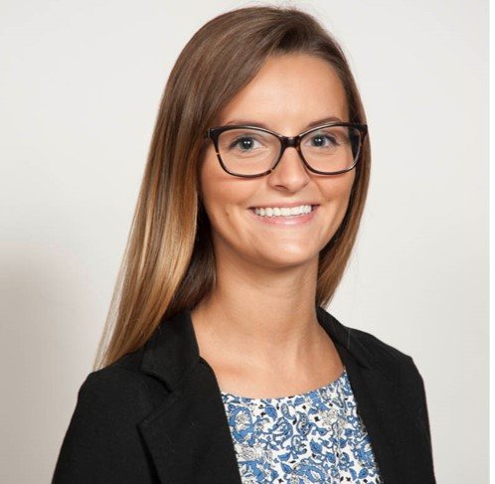
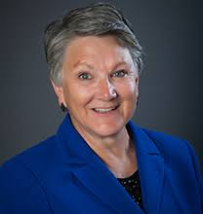
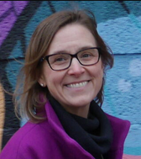

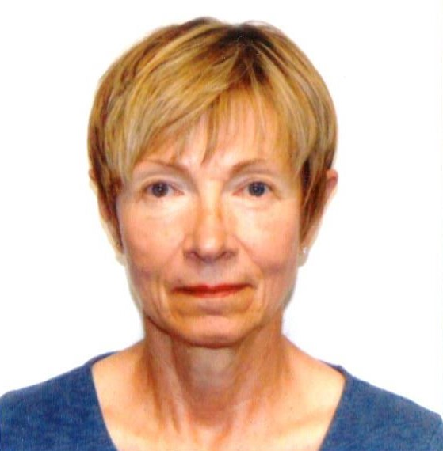
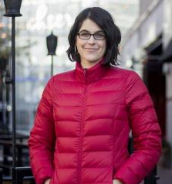
Advancing Outreach Effectiveness to Improve Conservation Practice Adoption
Workshop Steering Committee Members:
Kathy Boomer
FFAR
Meg Cole
CBP STAC
Christine Conn
MD DNR
Annabelle Harvey
CBP STAC
Cordelia Hiers
FFAR
Amy Jacobs
TNC
Rochelle Krusemark USFRA
Sarah Preisser
Mindset Talent
Jake Reilly
NFWF
Michael Runge
USGS
Allison Thomson
Field to Market
Jan Urban-Lurain
Spectra Data and Research
Collin Weigel
JHU/TNC
Robyn Wilson
OSU
Paul Wolfe
Walton Family Foundation
Thank you!

Slide 41
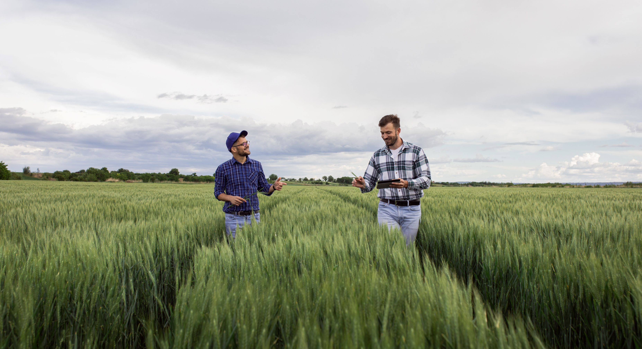

Program Contact
Dr. Kathleen Boomer
kboomer@foundationfar.org
FOUNDATIONFFAR.ORG
202.624.0700

Slide 42
Key Definitions
Beliefs/values: These are deep-seated beliefs or values about the world. These are very hard to change.
Knowledge/awareness: Having information specific to an opportunity (program, event, etc) or practice.
Constraints/Barriers: broadly anything in the local to national (or even international) context that makes it hard to form or act on one’s intentions to engage in conservation. So, social constraints (e.g., my neighbors will disapprove), economic constraints (e.g., there is no ROI, the incentives offered are too small), physical constraints (e.g., weather uncertainty, lack of equipment), etc. Specific constraints often found to limit adoption:
  Attitudes: Attitudes are easier to change than beliefs/values. For adoption decisions, attitudes toward a specific practice or program are important, e.g. having a positive attitude towards the cost of a program or the benefits emerging from a practice.
  Perceived behavioral control: An individual’s perception of their ability to control a specific decision.
  Norms: Two common types of norms influence decision-making: Descriptive norms – what are other people around me doing? And subjective norms- what do people I trust and respect think I should do?
Behavioral Intention/Willingness to adopt: Prior to actual adoption of a practice or program, a person first has to become willing to adopt it. There is not a clear path from behavioral intention to actual adoption as many things can interfere in this process, including inertia and actual behavioral control (defined as a person’s ability to control the behavior which might not be clear until they actually try to move forward with adoption and then realize they don’t have the necessary permits, it costs more than expected, etc.)
Adoption: This is the point at which someone actually adopts a practice or program. Of course, there can be varying levels of adoption even at this stage.
Persistence: This is the action of continuing to use a practice over time vs. discontinuing use.
Infield Conservation Practices: Modifications to cropping systems to provide multiple conservation benefits like building soil health, improving water quality and reducing erosion. Practices include cover crops, no-till planting, buffer and filter strips.
Edge-of-Field Practices: Engineered modifications placed along field edges or in-field waterways to reduce nutrient and sediment loss. These include conservation drainage water management, grass buffers, saturated buffers, level-lip spreaders, terraces, and sediment control.
Edge-of-Stream Practices: Engineered modifications placed adjacent to surface waters to reduce nutrient and sediment loss and store water. These include conservation restored wetlands, riparian buffers.
Natural Filters: Wetlands restored, created, or managed to intercept and sequester pollutants, usually excess nutrients and sediment but also other chemical of emerging concern.
Owner operator – person that owns agricultural land and performs all of the farming/ management of that land
Renter operator – person that rents or leases agricultural land from another person and who performs the farming/ management of the rented land
Non-operator Landowner – person that owns agricultural land and has another person perform the farming/ management of the land

