Slide 1
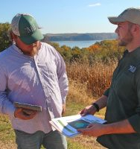
Advancing Outreach Effectiveness to Improve Conservation Practice Adoption
SESSION III:
Assessing Potential to Influence Operator Decisions
Michael C. Runge
USGS Patuxent Wildlife Research Center
Photo Credit: Gates Rhodes for
The Nature Conservancy

Slide 2
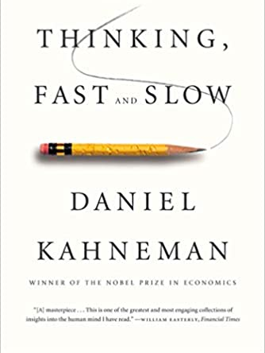
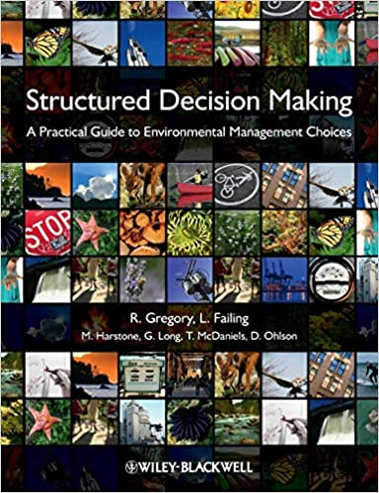
Decision Science
Descriptive Decision Theory
How real people do, in fact, make decisions
Daniel Kahneman (“Thinking, Fast & Slow”) won the Nobel Prize in Economics in 2002
Deeply embedded in behavioral economics, marketing, other fields
Normative & Prescriptive Decision Theory
How people could make decisions
Presents a framework for making rational decisions
Accounts for risk, multiple objectives, time-delays, etc.
Deeply embedded in operations research, optimization, industrial processes

Slide 3
The Outreach Practitioner’s Decision
The Decision Analyst’s Lens

Slide 4
There are only so many hours in the day…
What activities and efforts to undertake to increase adoption of conservation practices?
Problem Framing
Maximize the number of high-priority acres adopting conservation practices
Maximize ecosystem benefits of farm practices
Implement Action
Elicit Objectives
Which mix of practices will produce the best results in a particular landscape and community?
Identify Preferred Alternative
Develop Alternatives
All the outreach strategies we’re going to discuss
Evaluate Consequences
Can we predict the response of operators and owners to the array of potential practices?
Source: Runge et al. 2013. Structured decision making. Chapter 5 in Krausman et al.

Slide 5
The Farmer’s Decision
The Behavioral Economist’s Lens

Slide 6
Background Factors:
Personal Characteristics
Farm Characteristics
Farm Context
Practice Characteristics
Relative advantage
Complexity
Compatability
Observability
Trialability
Risk
Attitudes
Norms
Intention
Behavior
Persistence
Perceived Behavioral Control
Source: Linda S. Prokopy, Purdue University
Based on: Arbuckle and Roesch-McNally 2015; Fishbein and Ajzen 2010; Reimer et al. 2012; Rogers 2003
Notes:
There are several models of how humans make decisions. This particular version is a merger of the Theory of Planned Behavior and Diffusion of Innovations and I find it to work very well when trying to explain farmer behavior. Unfortunately, farmers are just like all other humans in how irrational many of their choices actually are and, despite decades of research into what motivates adoption of CPs, there are still a lot of things we don’t understand. But we do know some things…
I’m going to talk about farmers but this model applies just as well to landowners.

Slide 7
Cognitive Strategies
(intervention points for practitioners italicized/bolded)
Technological/Structural Strategies
(intervention points for practitioners italicized/bolded)
Norms
Knowledge
Beliefs
Attitudes
Intentions/Willingness
Actual Control (Feasibility)*
Behavior
Values
Perceived Control
(Feasibility)
Source: Robyn S. Wilson, The Ohio State University

Slide 8
A Working Framework
Positive or negative evaluations of a behavior, informed by beliefs
Social influences or constraints
For understanding and predicting adoption decisions
Trust
Trust
Attitudes
Norms
Starting Point
Creating
Awareness
Generating Commitment (Intention)
Implementing the Practice (Behavior)
Trust
Knowledge
Trust
Trust
Beliefs
Constraints
Information specific to an opportunity
Deep-seated values and worldviews that serve as goals and guide actions
Physical, economic, regulatory, and other barriers to adoption

Slide 9
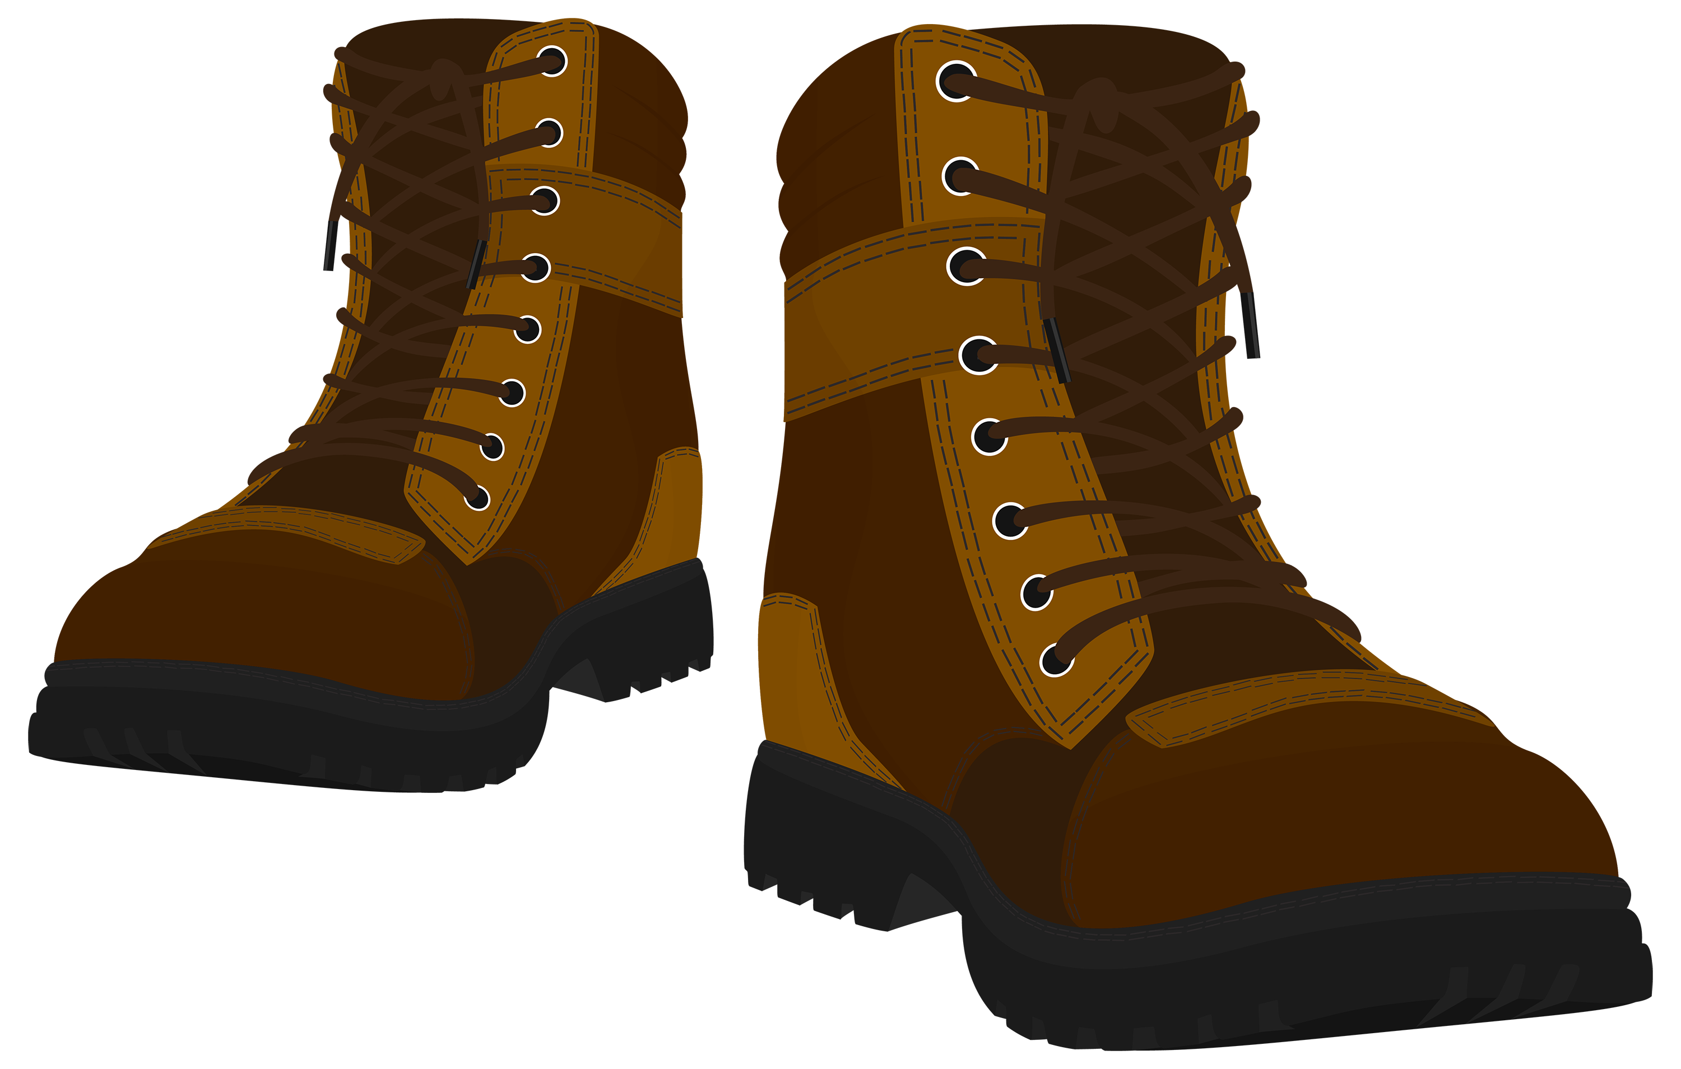
Advancing Outreach Effectiveness to Improve Conservation Practice Adoption
SESSION III: Assessing Potential to Influence Operator Decisions
Trust
Trust
Attitude
Trust
Norms
P(Influence)?
TSP
Trust
TSP
t₀
Trust
Awareness
Knowledge
Commitment
Adoption
Knowledge
TSP
TSP
TSP
TSP
P(Convincing)?
P(Success)?
Legend:
Trust
Constraints
TSP Action
Trust
Remember, we can rearrange or redefine components and linkages!
Beliefs
Decision Factor
Outcome

Slide 10
Surveys & Discussion
Phase III Aim
Grapple with this conceptual framework for adoption
Examine its components
Consider whether modifications are needed
Preparation for Phase IV (later today)
The framework is meant to provide us a way to understand the role of individual outreach strategies

