Slide 1
Monarch butterfly

Slide 2
About Us
Who We Are
Chartered by Congress in 1984
30 member Board appointed by Secretary of the Interior
Includes FWS Director and NOAA Administrator
What We Do
Sustain, restore and enhance wildlife
Bring collaboration among federal agencies and private sector
Bald eagle
NFWF is
An implementer – we fund projects that directly result in on-the-ground conservation outcomes
NFWF is not
An advocacy organization that engages in lobbying or litigation
How We Do It
Leverage public funding with private money – average 3:1

Slide 3
How We Do It

Slide 4
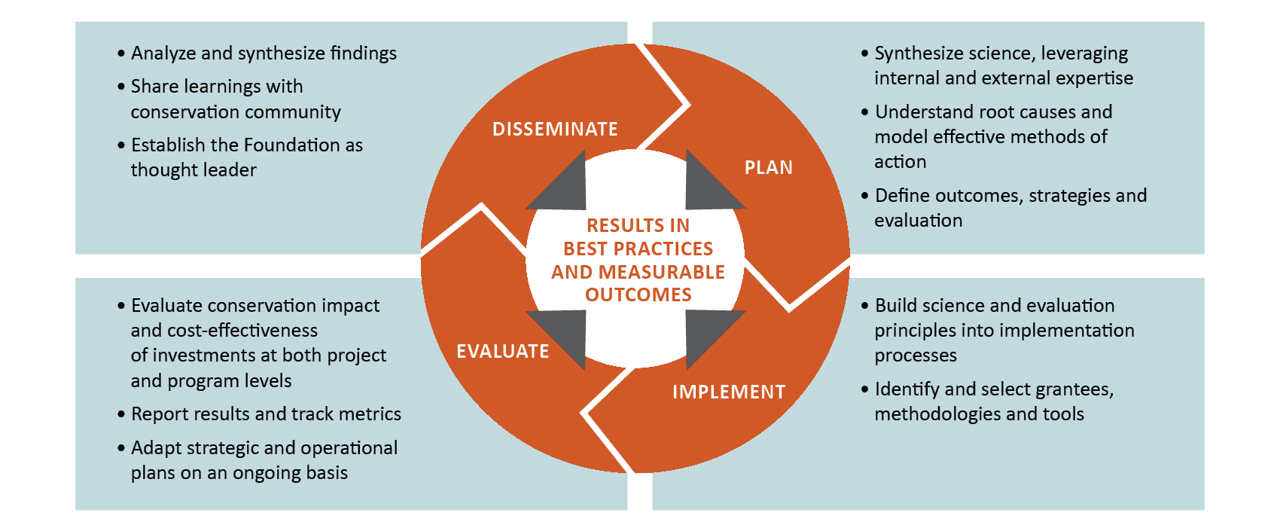
Science, Evaluation and Thought Leadership

Slide 5
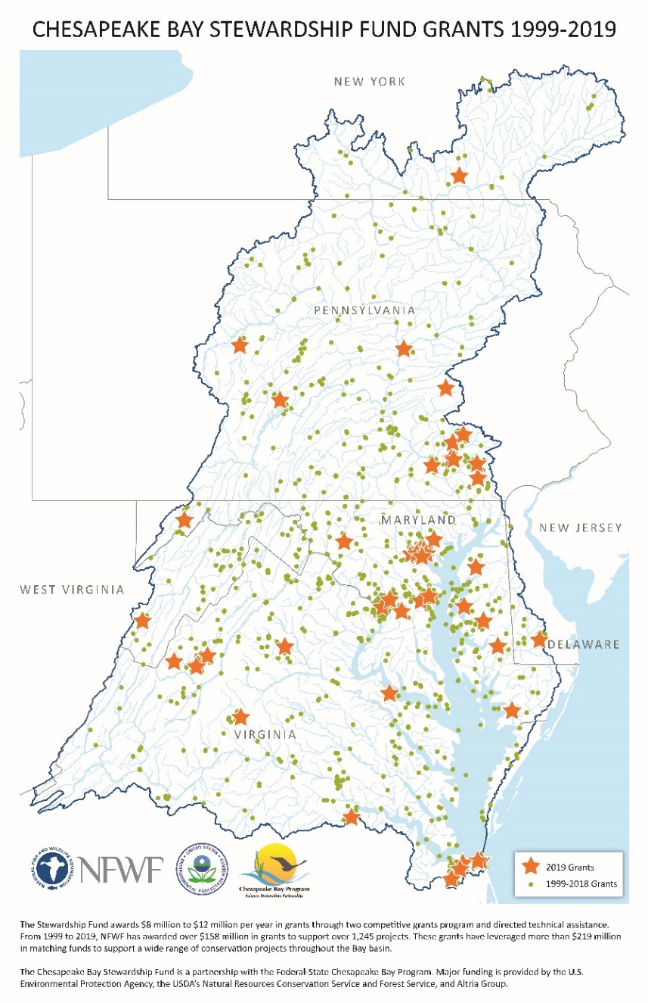
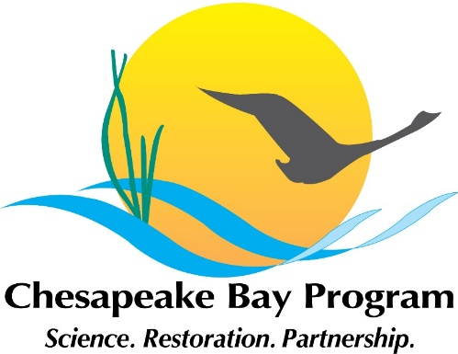
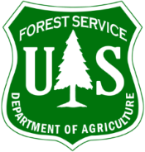
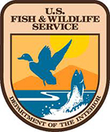
NFWF’s Chesapeake Bay Stewardship Fund
Our Goal: Accelerate local restoration actions and spur innovation in watershed restoration
Our Partnerships:
Our Impact:
1,200+ grants awarded
$400M in total impact
$160M awarded
$240M in local match
Our Outcomes:
25M lbs of annual nutrient pollutant loads prevented
830,000+ acres of BMPs

Slide 6
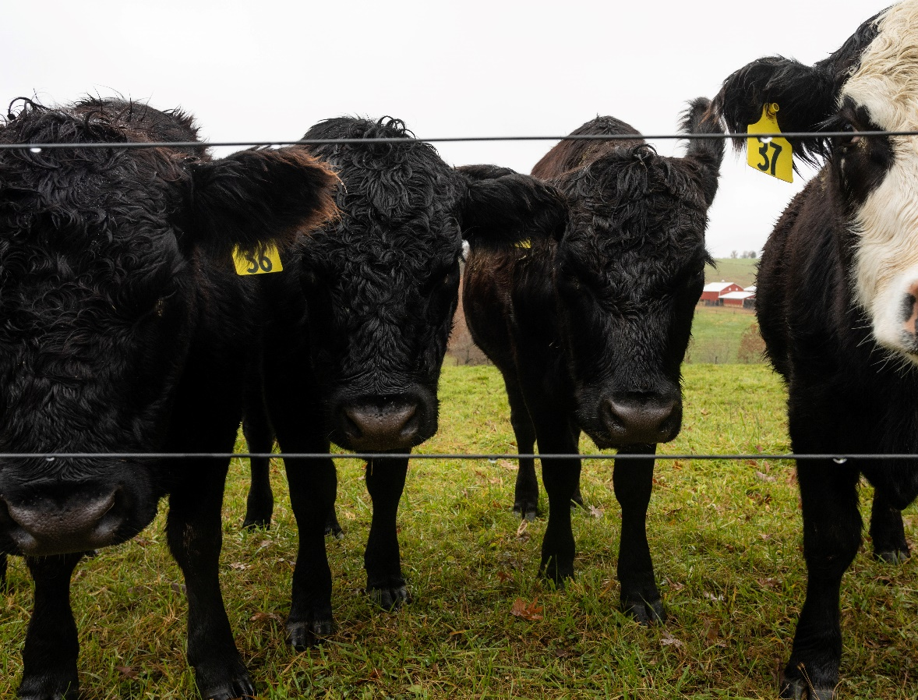
The Imperative to Advance Outreach Effectiveness
Major Challenges
Limited technical assistance and outreach funding
Bandwidth for engagement among cooperators
Collective needs to scale adoption by orders of magnitude
Building A Community of Practice
Increasing engagement with the social sciences
New data, tools, and approaches to focused outreach
Our Opportunity
Integrating partnerships to pair outreach delivery with effective evaluation

