Slide 1
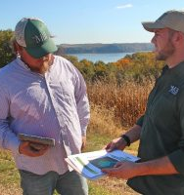
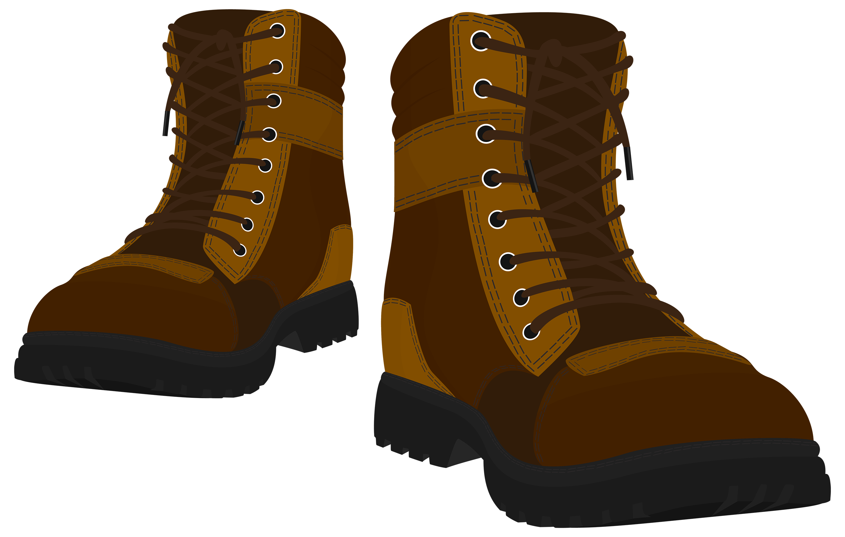
Advancing Outreach Effectiveness to Improve Conservation Practice Adoption
Workshop Objectives:
Share insights, knowledge & experience
Explore alignment between outreach strategies and farmer concerns related to conservation practice adoption.
Identify knowledge gaps and collaborative opportunities to advance soil and watershed health.
Photo Credit: Gates Rhodes for
The Nature Conservancy

Slide 2
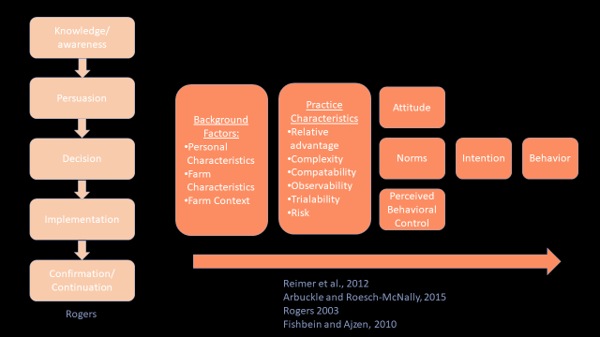

Slide 3
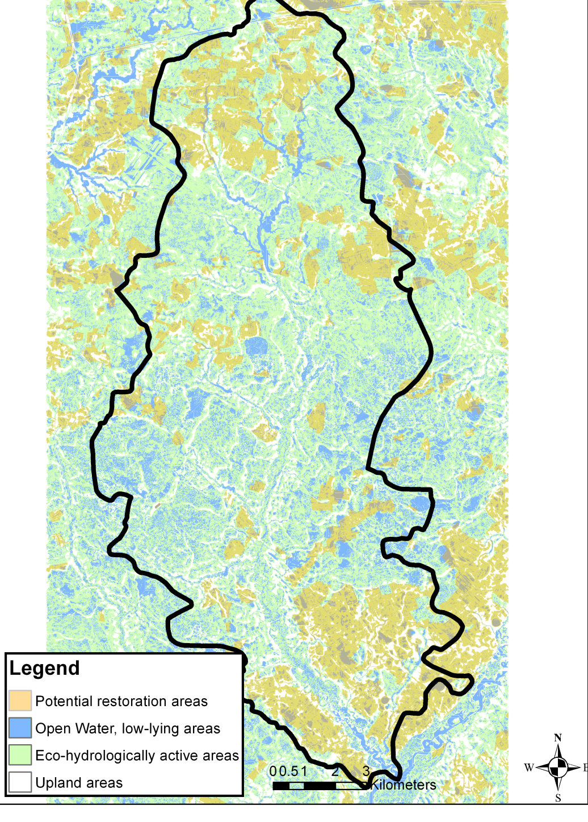
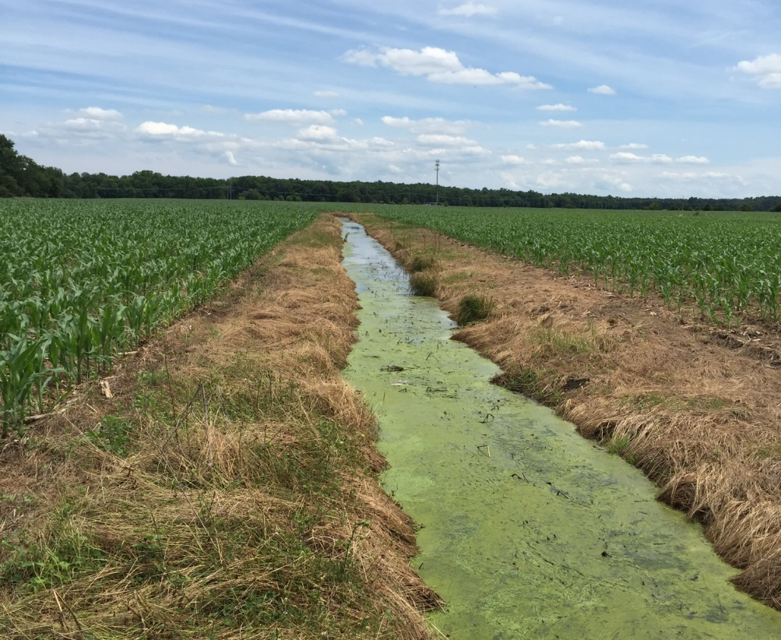
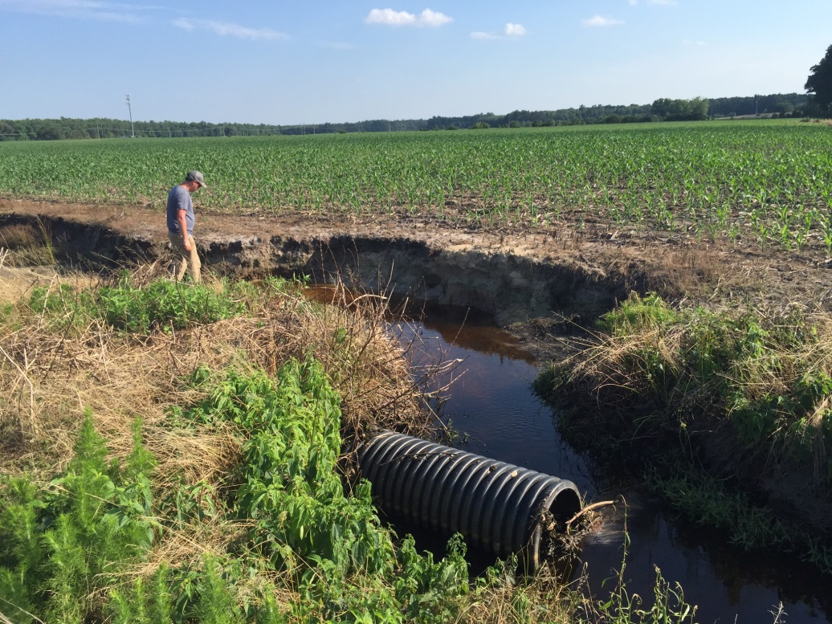
Agreeing on the Decision Context:
Hypothetical High-Priority Opportunity:
700 acre farmer tract
(Coastal Lowlands)
Option 1
Option 2
Option n
How do we convince a farmer to adopt ag BMPs?
How do we invest time and resources?
Can we predict farmer behavior and select/adapt outreach strategies, accordingly?
What defines success?
High Priority Area
Open Water
Low Priority Area
Upland Area

Slide 4
- Outreach Strategy Development -
Constraints
Beliefs
Outreach Strategies
Farmer/Landowner Decision
Values
P(Success)?
P(Influence)?
Knowledge
Social Indicators of Behavior ¹
¹ from Hindsley 2002

Slide 5
Advancing Outreach Effectiveness to Improve Conservation Practice Adoption
SESSION III: Assessing Potential to Influence Operator Decisions
Trust
Trust
Attitude
Trust
Norms
P(Influence)?
TSP
Trust
TSP
t₀
Trust
Awareness
Knowledge
Commitment
Adoption
Knowledge
TSP
TSP
TSP
TSP
P(Convincing)?
P(Success)?
Legend:
Trust
Constraints
TSP Action
Trust
Remember, we can rearrange or redefine components and linkages!
Beliefs
Decision Factor
Outcome

Slide 6
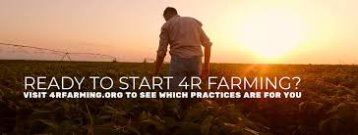
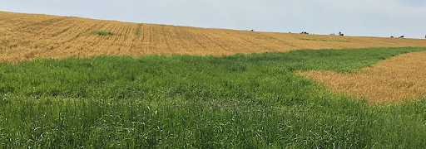
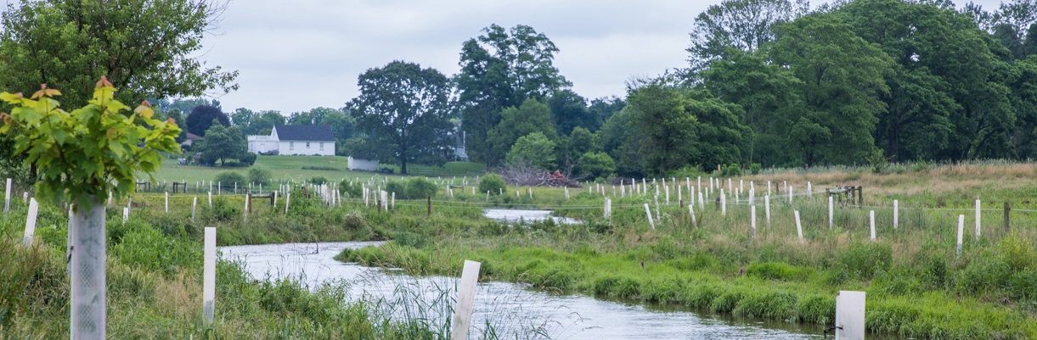
Decision Context: Which Conservation Practice?
In-Field Practices
Edge-of-Field Practices
Edge-of-Stream Practices

Slide 7
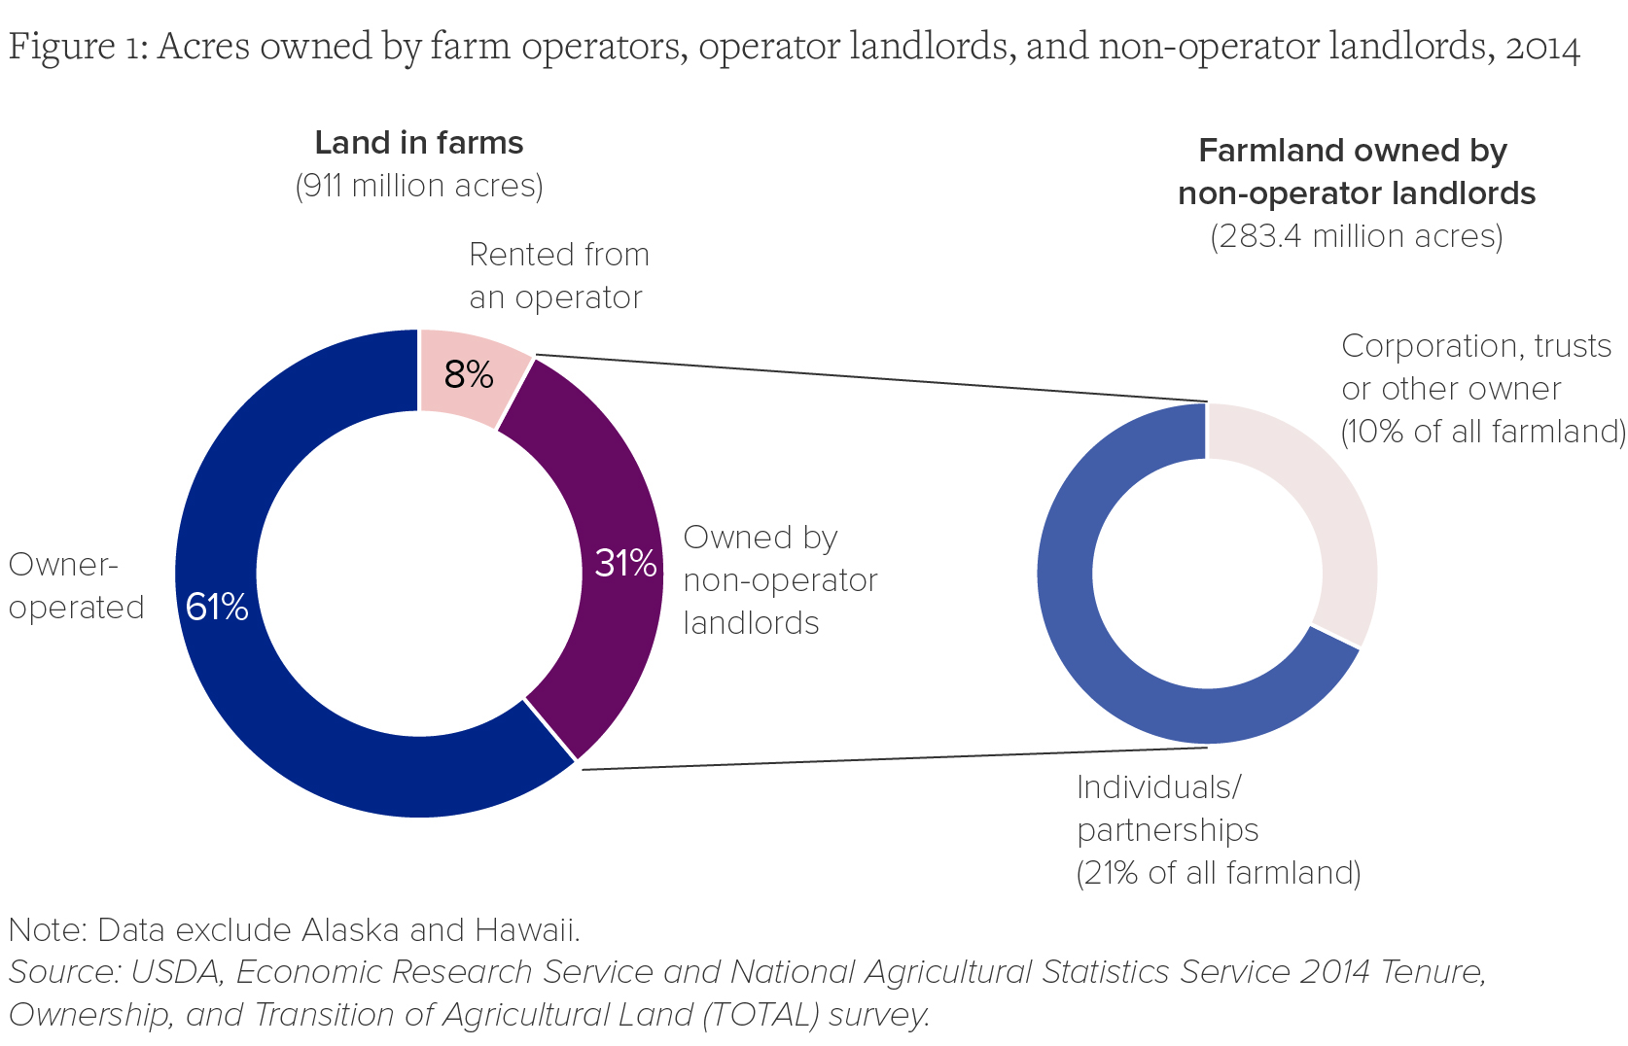
Decision Context: Which Farmers?

Slide 8
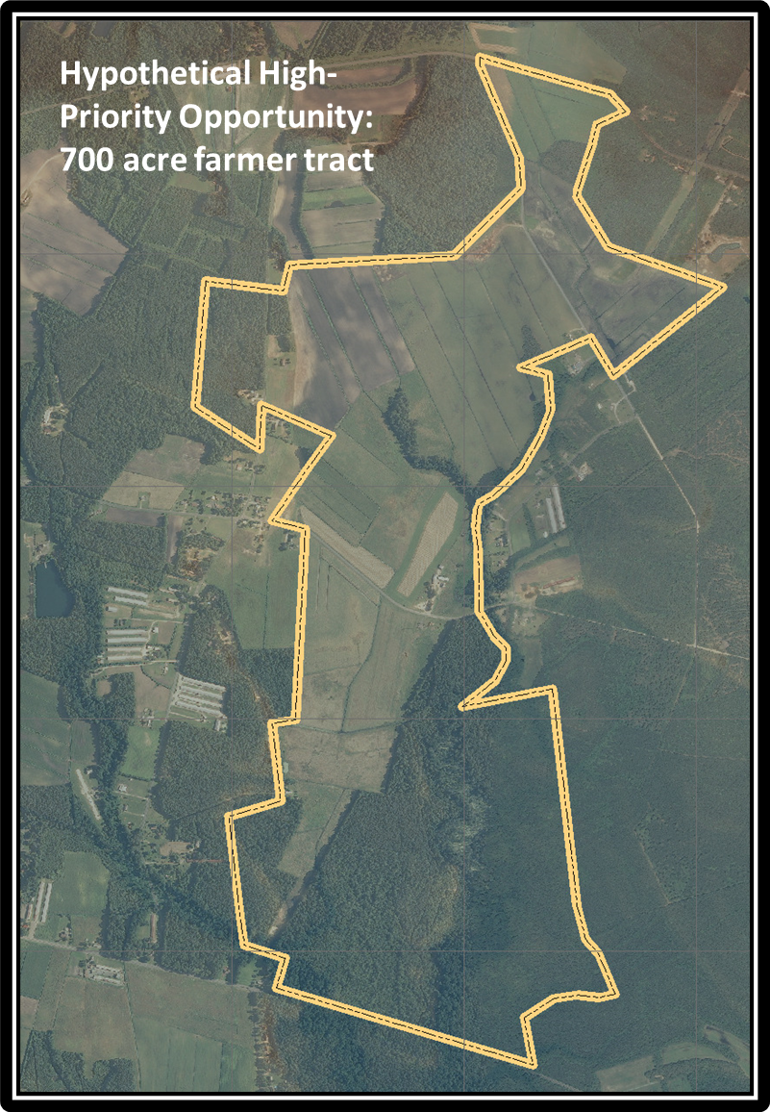
Advancing Outreach Effectiveness to Improve Conservation Practice Adoption
Prioritized TSP Challenges to Advance Restoration:
1) Owner-operator adoption of EOF/EOS natural filter practices
2) Non-Operator Landowner adoption of EOF/EOS filter practices
3) Farmer adoption of infield practices
4) Owner-operator adoption of infield practices
5) Tenant adoption of EOF/EOS practices

Slide 9
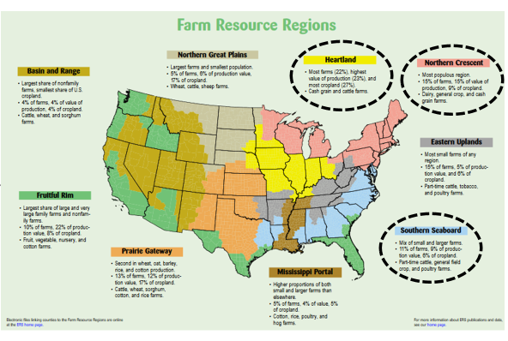
Decision Context: Which Outreach Practitioners?
NRCS
University Extension
Soil Water Conservation District staff
State Department of Agriculture staff
State Departments of Natural Resources/Environmental Quality
Retail Agronomists/Crop Advisors/Consultants/Corporate Agriculture Representatives
Other Farmers (including farm bureau, SCD officers, commodity groups etc.)
Non-profits – ?need to articulate the diversity of NGO’s (e.g., farming, environmental)?
Federal Agent
State Agent
For Profit Agent
Network Agent
Non-Profit Agent
3 regions, 8 to 10 groups/region, 2-4 reps/group = 48 to ~120 participants

Slide 10
Advancing Outreach Effectiveness to Improve Conservation Practice Adoption: Workshop Strategy
Workshop Objectives:
Share insights, knowledge & experience
Explore alignment between outreach strategies and farmer concerns related to conservation practice adoption.
Identify knowledge gaps and collaborative opportunities to advance soil and watershed health.
SESSION I: Welcome & Introductions
SESSION II: Understanding Concerns and Priorities
SESSION III: Assessing Potential to Influence Operator Decisions
SESSION IV: Outreach Exchange
SESSION V: Cross-walking Perspectives and Tying It Together
SESSION VI: Key Take-Aways
1/26
1/27
1/28

Slide 11
Advancing Outreach Effectiveness to Improve Conservation Practice Adoption
Workshop Objectives:
Share insights, knowledge & experience to advance conservation practice adoption.
Explore alignment between outreach strategies and farmer concerns related to conservation practice adoption.
Identify knowledge gaps and collaborative opportunities to advance soil and watershed health.
Photo Credit: Gates Rhodes for
The Nature Conservancy

Slide 12
Workshop Guidelines:
Recognize everyone has expertise to contribute! This workshop seeks to explore the diversity of our beliefs based on experience as well as knowledge.
Answer questions as an ambassador of your sector.
Be ready to wear another’s hat: If you believe a question is not relevant, either 1) provide feedback as if you were a member of that sector; or 2) share why you can’t answer the question.
Remember the decision context:
Targeting high priority parcels deemed to provide exceptional benefits to soil or watershed health.
Deciding how best to spend the finite time and resources available to engage farmers (e.g., one year of an outreach practitioner’s available work time (or a team of outreach practitioners).
Use this workshop to explore how well your beliefs align with others.
Be sensitive to different ideas, perspectives, and terminologies.
Help think about how to foster connections… maybe one of the key workshop outcomes!

