Slide 1
Foundation for Food & Agriculture Research Overview
Dr. Sally Rockey, FFAR Executive Director
January 26, 2021

Slide 2
Our Mission
We build unique partnerships to support innovative science addressing today’s food and agriculture challenges.

Slide 3
Our Vision
We envision a world in which ever-innovating and collaborative science provides every person access to affordable, nutritious food grown on thriving farms.

Slide 4
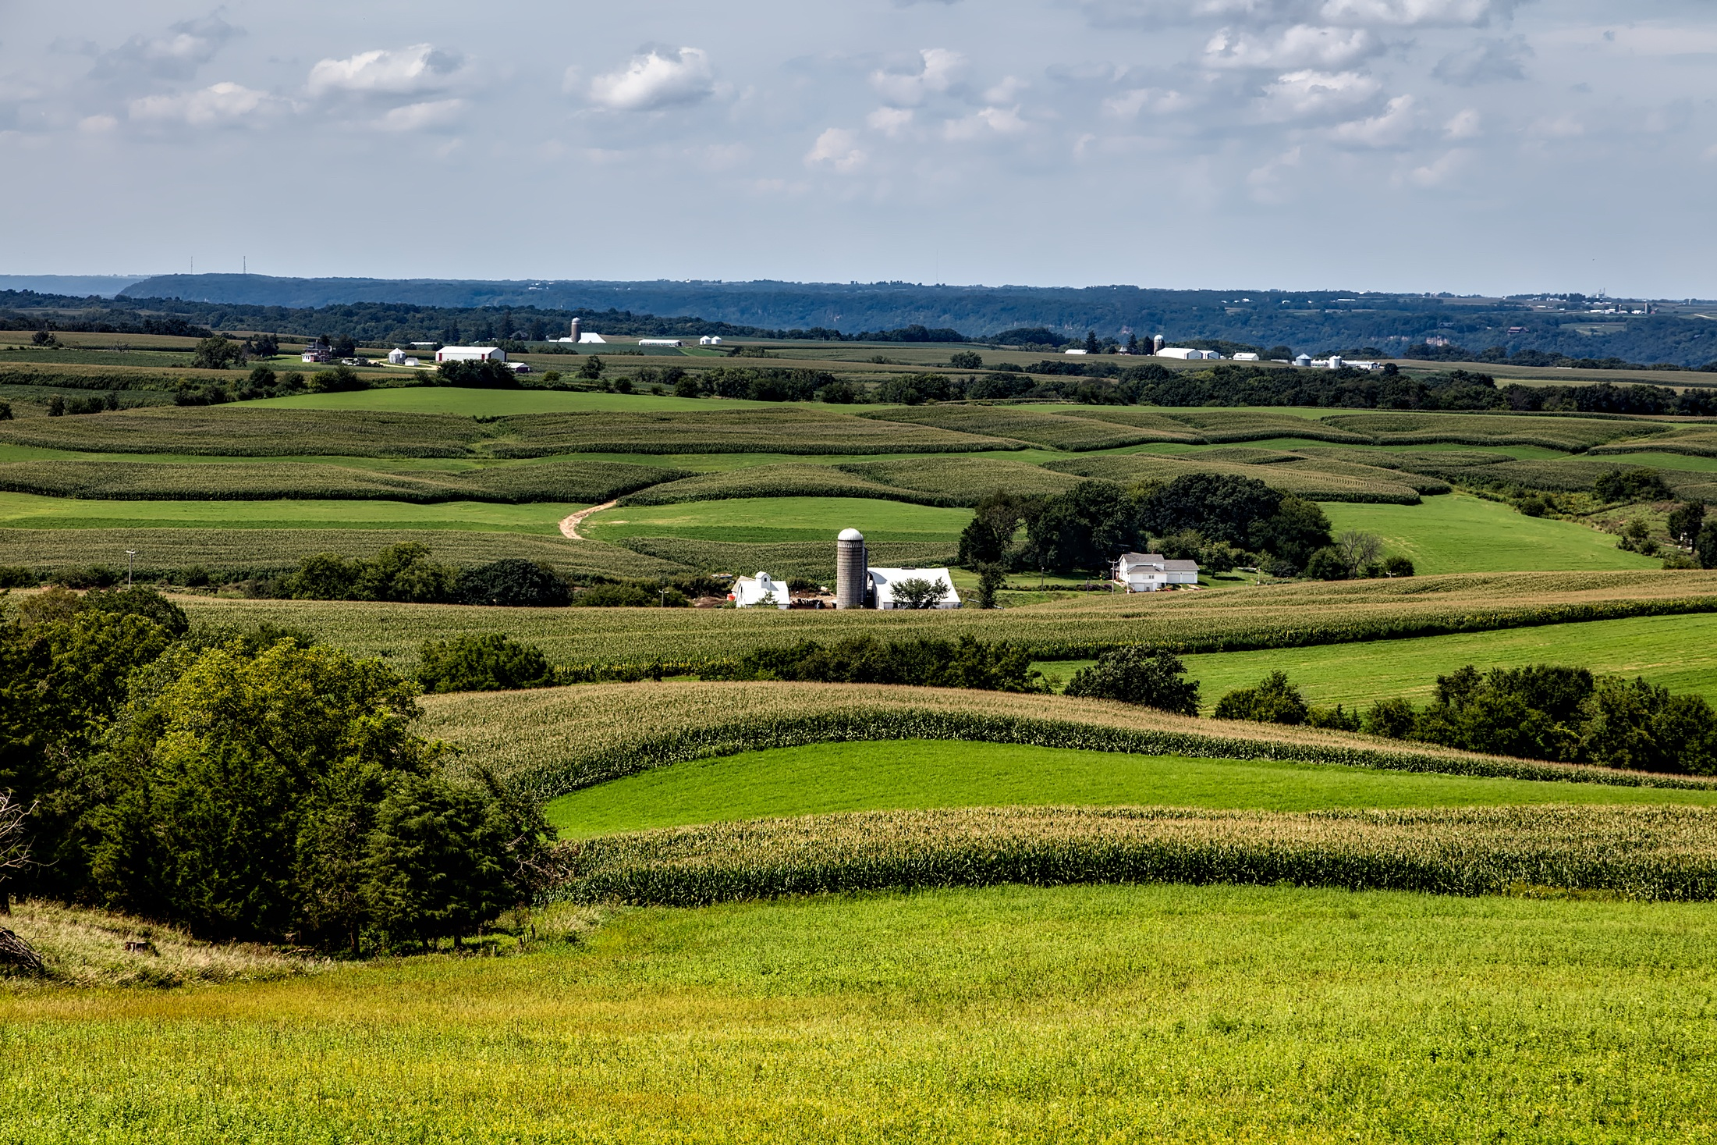
How We Work
Private-Public Partnerships
$385M
+
$385M
FFAR
Investment
Non-Federal Match
We build unique partnerships to support
innovative science addressing today’s food and agriculture challenges.
“FFAR also brings together diverse groups that might not otherwise collaborate to solve big challenges
...the FFAR model delivers - and doubles the taxpayer's investment.”
-Bob Stallman
Past President, American Farm Bureau Federation
Current FFAR Board Member

Slide 5
The FFAR Paradigm
Creates novel research partnerships across the food and agriculture sector.
Works nimbly to efficiently address emerging issues in food and agriculture.
Leverages public dollars with private dollars to expand research impact.
Fills research gaps to ensure great science supports farms, reduces food insecurity, and supports better health.

Slide 6
FFAR is a connector in the agriculture research space
Notes:
FFAR connects with researchers with members of industry to deliver the best strategies, technologies and information to farmers and the agriculture community.

Slide 7
We Fund Pioneering Research
BY FOCUSING ON THESE KEY CHALLENGE AREAS:
Next Generation Crops
Advanced Animal Systems
Sustainable Water Management
Health-Agriculture Nexus
Urban Food Systems
Soil Health

Slide 8
FFAR Grants By The Numbers
187
Grants awarded
1:1.41
Matching ratio
$273M
Funding awarded or in the pipeline

Slide 9
Industry & Foundation Partners
Over 400 distinct funding partners!

Slide 10
We Invest in the Scientific Workforce
BY FOSTERING THESE PROGRAMS:
NAS Prize in Agriculture Science
New Innovators in Food and Agriculture
FFAR Fellows
Vet Fellows

Slide 11
FFAR Makes Awards in 4 Ways:
Competitive Grants Direct Awards
Prizes Consortia

Slide 12
FFAR Consortia
Consortium for Innovation in Post-Harvest Loss and Food Waste Reduction
IRRIGATION INNOVATION
CONSORTIUM
Ecosystem Services Market Research Consortium

Slide 13
Competitive Programs
New Innovators
Seeding Solutions
ROAR
Egg-Tech Prize

Slide 14
Ag Climate Partnership
Vision: We envision a world where every farmer and rancher deploys climate-smart solutions on every acre.
Goal: U.S. agriculture is net negative for greenhouse emissions by the year 2030.
Strategy: Mobilize scientists and farmers to unlock the climate-solving potential of our farmlands.

Slide 16
The key to success is collaboration

Slide 17
“Take it to the farmer”

Slide 18
Welcome to our “Advancing Outreach Effectiveness to Improve Conservation Practice Adoption” convening event
FOUNDATIONFFAR.ORG
202.624.0700

