Slide 1

09/24/2018
Application of Phase 6 Watershed Model to Climate Change Assessment
STAC Workshop: Climate Change Modeling 2.0
September 24, 2018
Gopal Bhatt¹ and Lewis Linker²
¹ Penn State, ² US EPA

Slide 2
Presentation outline
Estimated impacts of 2025 and 2050 climate change on the watershed delivery of nutrients and sediment.
Decadal series of climate change assessment for the years 2025, 2035, and 2045.
2017 climate change assessment
2025
2050
2019 climate change assessment
2025
2035
2045
2055
2065

Slide 3
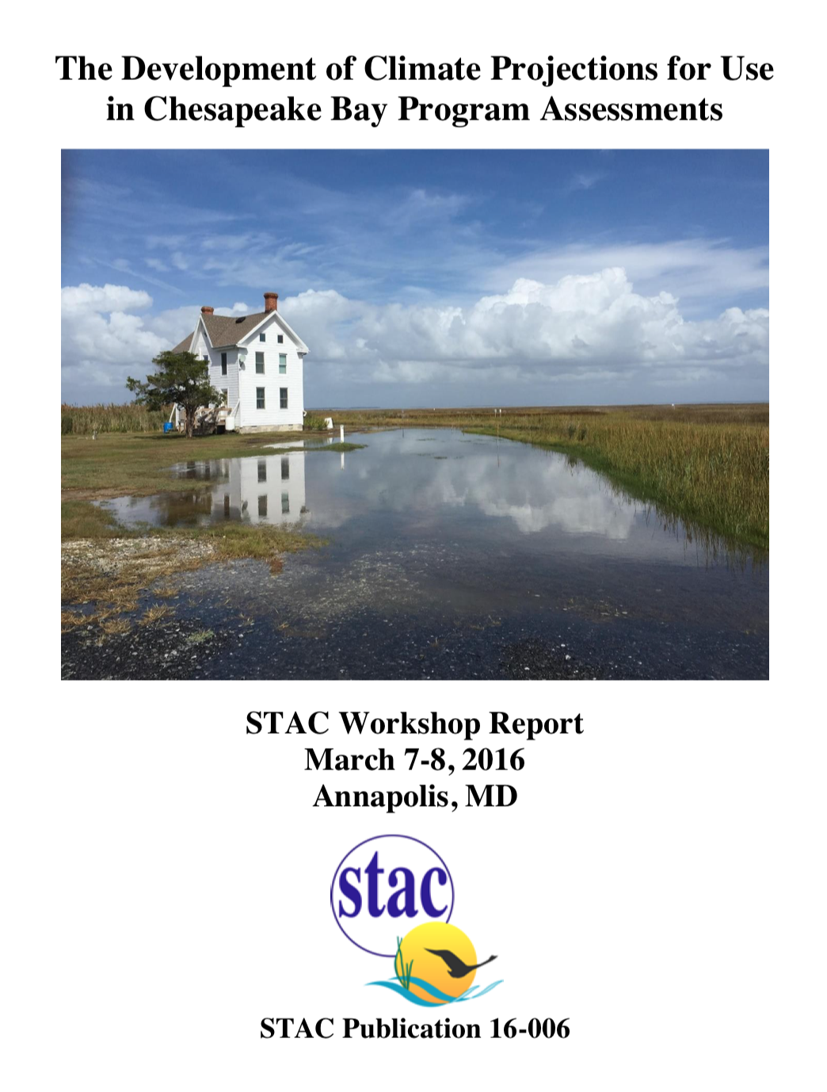
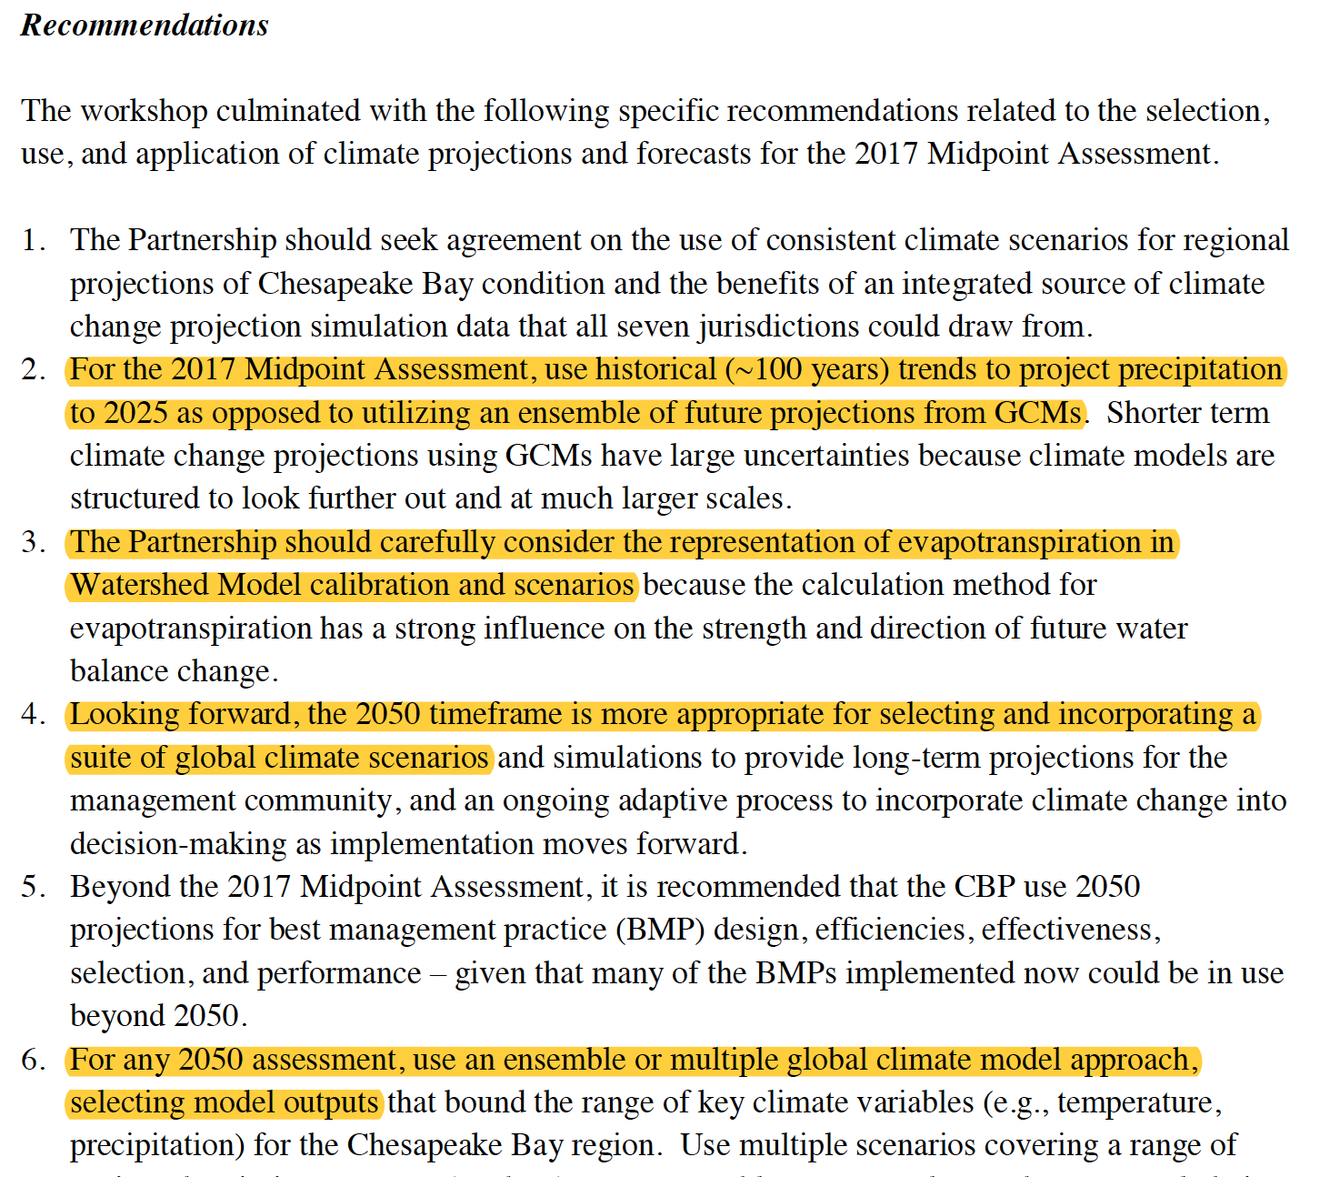
2017 Assessment
STAC recommendations ^{[1]}
[1] Page 8 http://www.chesapeake.org/pubs/360_Johnson2016.pdf

Slide 4
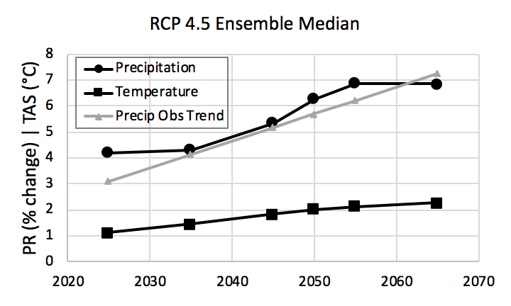
2017 Assessment
Summary of precipitation and temperature
Precipitation (% change) Temperature (°C change)
change is shown in reference to 1995
Years
Trend: extrapolation of long-term (88-year) trends
Ensemble: 31-member ensemble of RCP4.5 GCMs

Slide 5
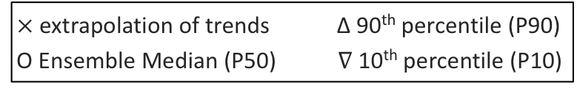
2017 Assessment
Summary of precipitation change
$×$ extrapolation of trends Δ 90th percentile (P90)
O Ensemble Median (P50) $∇$ 10th percentile (P10)
Precipitation Change (percent)
YEAR 2025
YEAR 2050

Slide 6
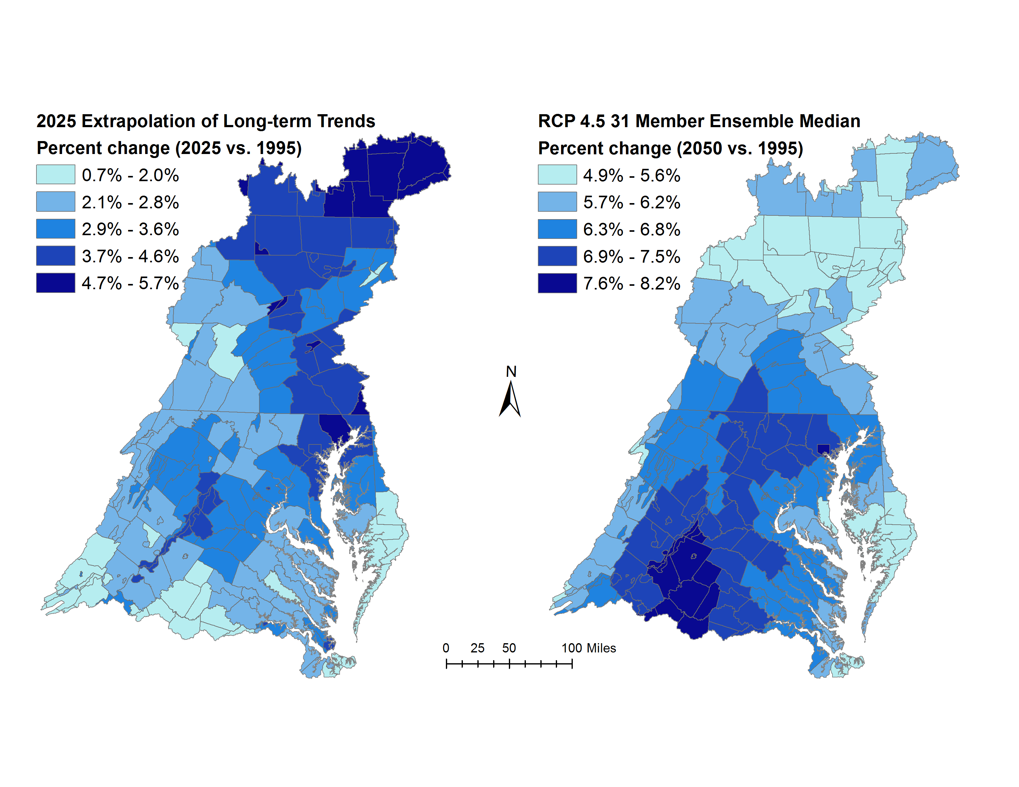
2017 Assessment
YEAR 2025
YEAR 2050
3.11% increase in average annual rainfall volume
6.28% increase in average annual rainfall volume

Slide 7
2017 Assessment
Summary of temperature change
$×$ extrapolation of trends Δ 90th percentile (P90)
O Ensemble Median (P50) $∇$ 10th percentile (P10)
Temperature Change (Celsius)
YEAR 2025
YEAR 2050

Slide 8
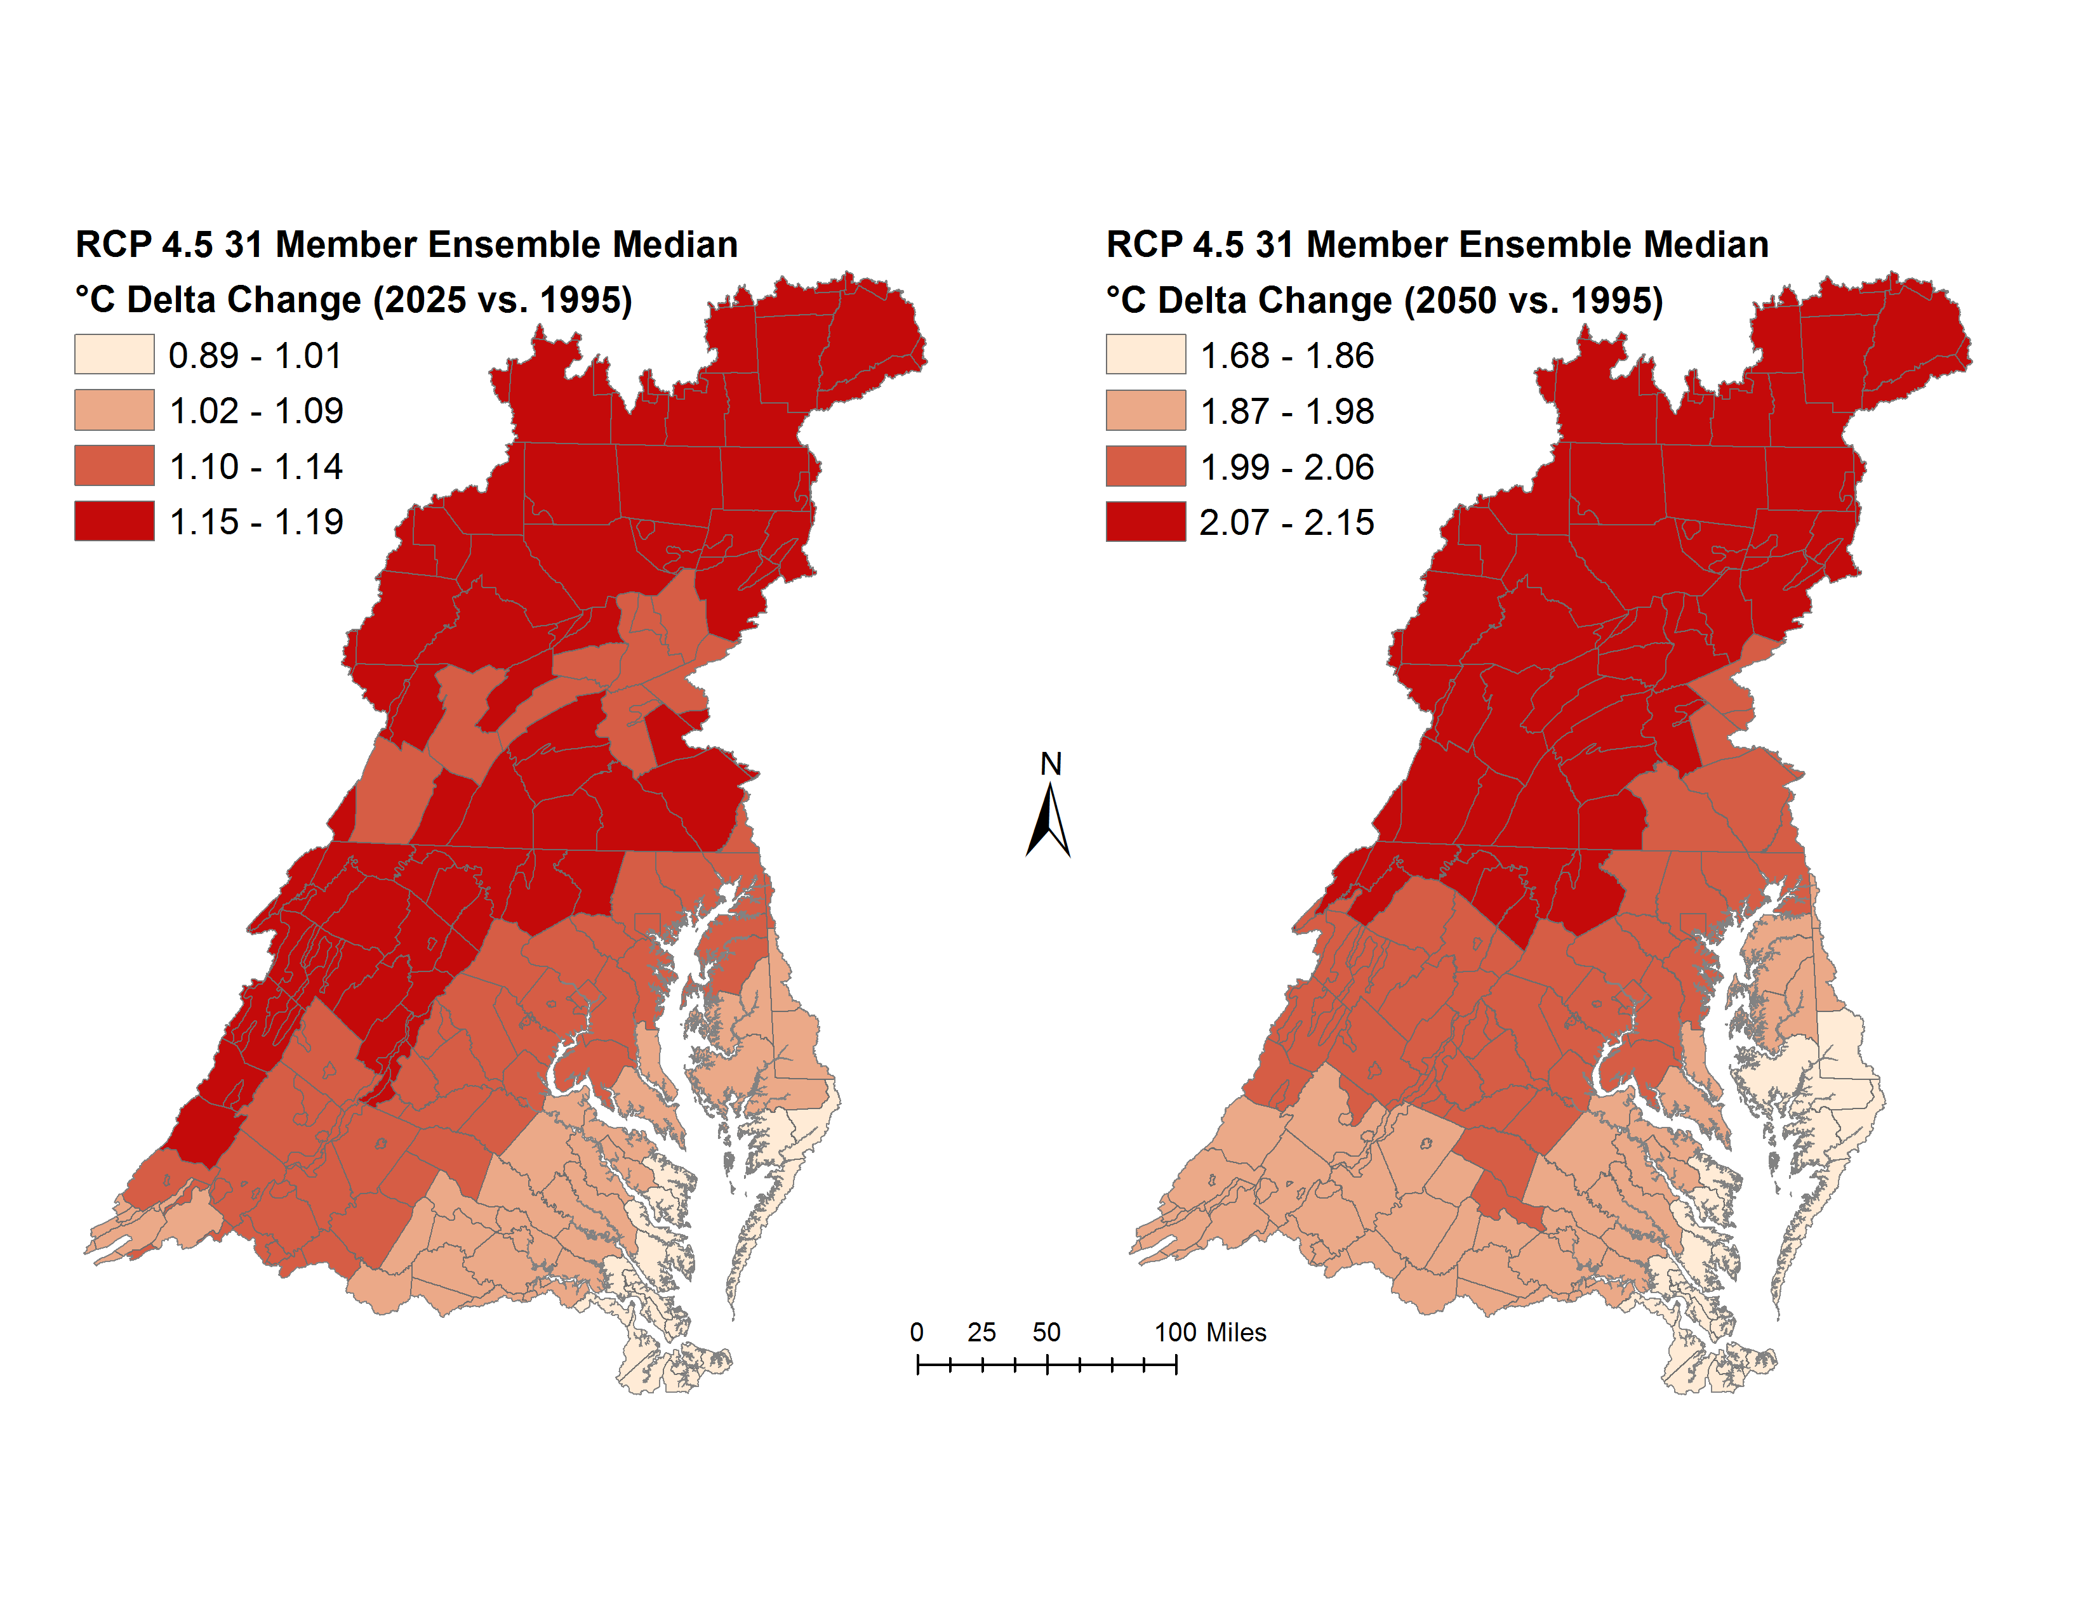
2017 Assessment
YEAR 2025
YEAR 2050
1.12°C increase in average annual temperature
2.03°C increase in average annual temperature

Slide 9
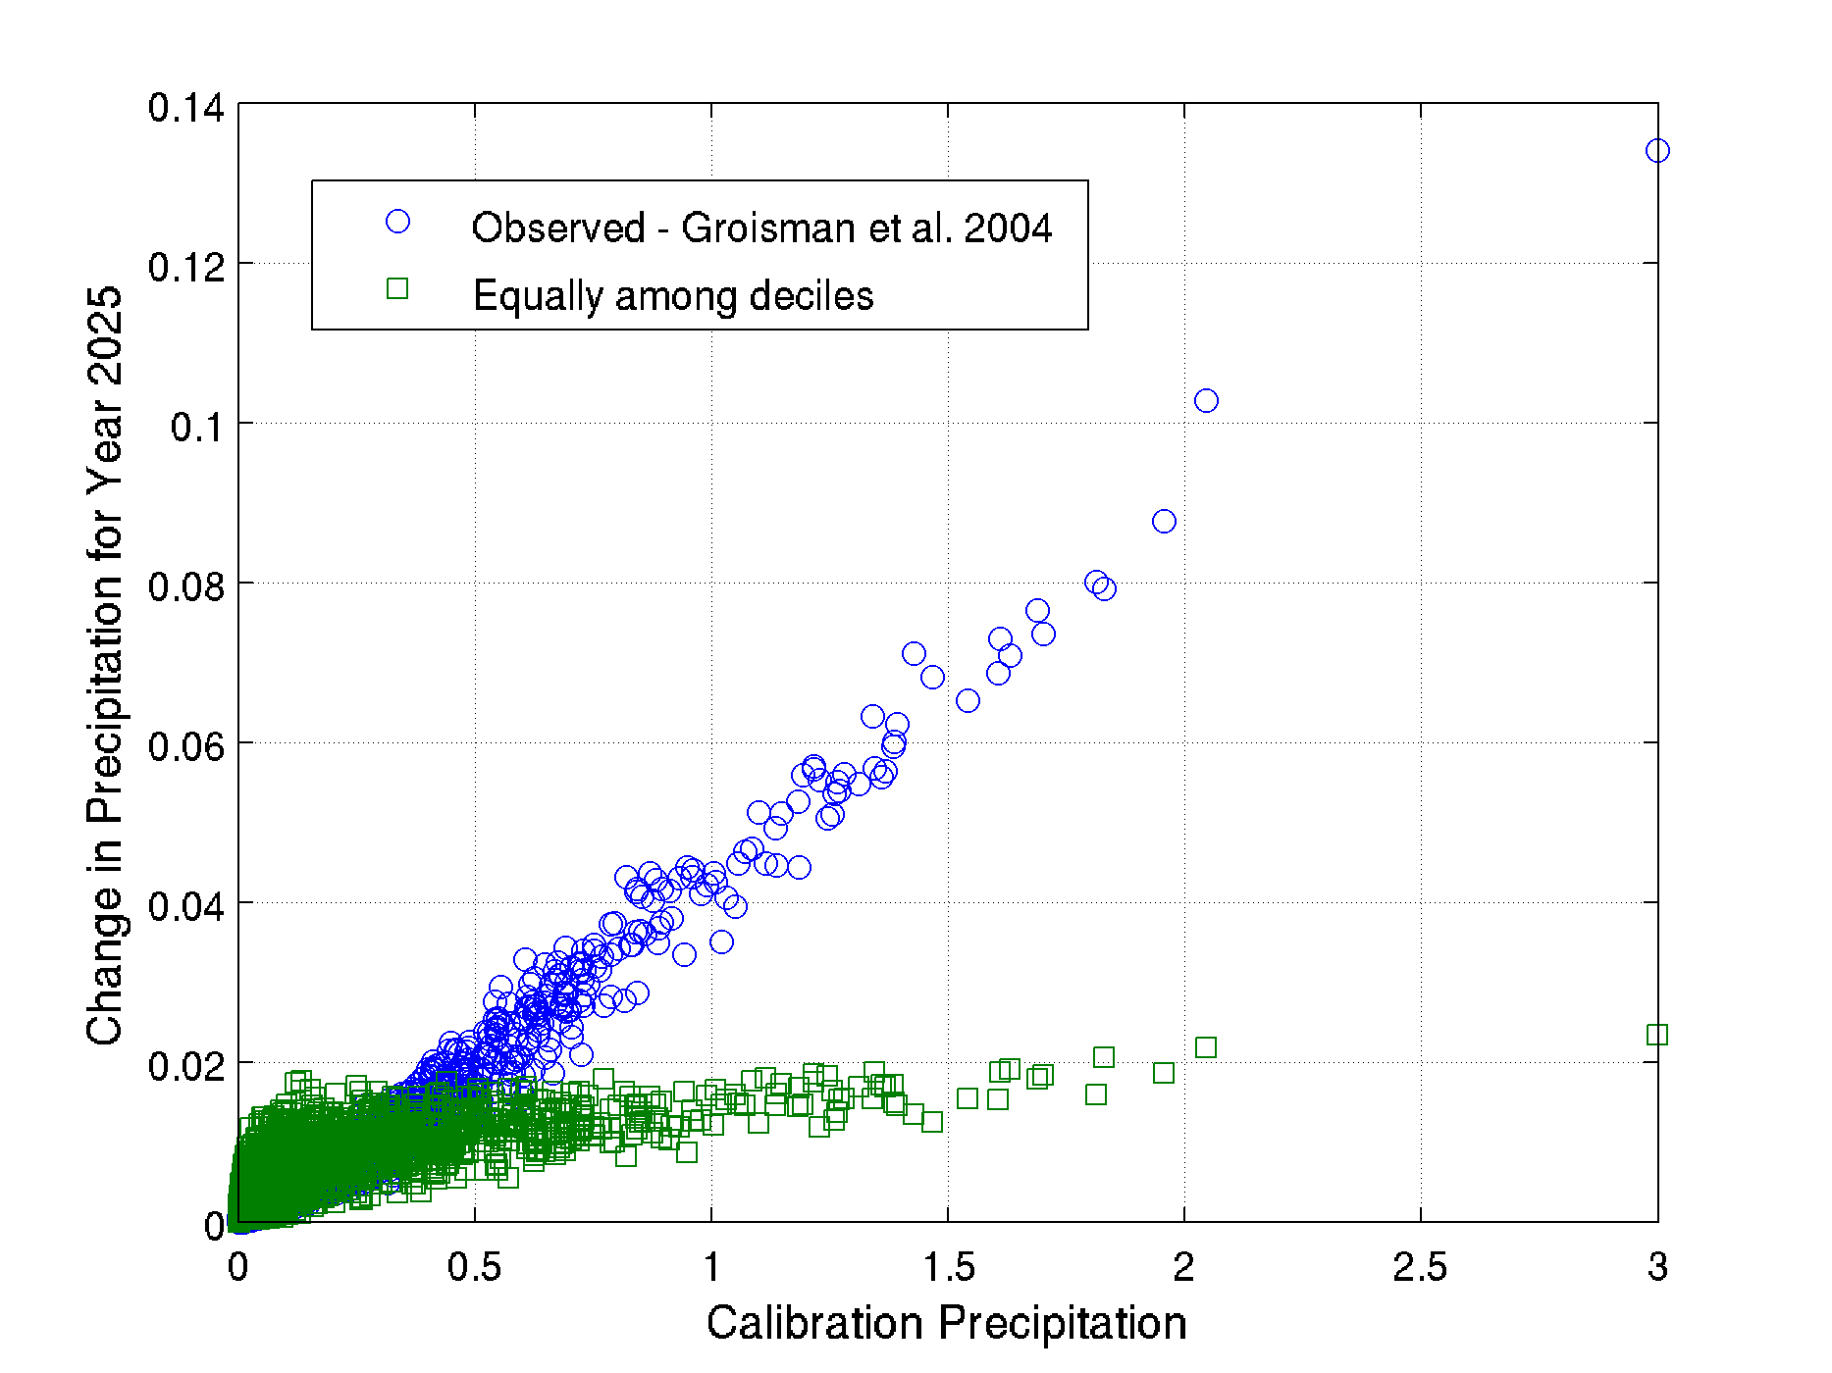
2017 Assessment
Monthly delta change to hourly events
Downscaling monthly change to deciles
(a) Observed changes in rainfall intensity over the last century (based on Groisman et al. 2004, Figure 10).
(b) Equal distribution
Summary of daily rainfall data
Deciles vs. Percent volume (Potter, PA)
Change in daily volume (inches/day)
About 50% of the rainfall volume lies in top 10% intensity events
Calibration rainfall (inches/day)

Slide 10
2017 Assessment
Flow
Nitrogen
Equal
decile split
Preferential
decile split
Equal
decile split
Preferential
decile split
Equal
decile split
Preferential
decile split
Equal
decile split
Preferential
decile split
2025
2050
2025
2050
Phosphorus
Sediment
Equal
decile split
Preferential
decile split
Equal
decile split
Preferential
decile split
Equal
decile split
Preferential
decile split
Equal
decile split
Preferential
decile split
2025
2050
2025
2050
Differences in the watershed delivery of flow, nitrogen, phosphorus, and sediment are shown for the two methods for downscaling changes in monthly rainfall volume for the year 2025 and 2050 to hourly rainfall events.

Slide 11
2017 Assessment
Estimation of potential evapotranspiration (PET)
Percent change in PET
The difference in PET using the Hamon and Hargreaves-Samani methods are shown. For 2025, the Hamon method estimated an increase in PET that was 3.36% greater than that from Hargreaves-Samani method. The change was even more pronounced for 2050, where the Hamon method estimated 6.26 percent additional increase in PET as compared to Hargreaves-Samani. Estimated change in PET using Penman Monteith (short reference) show better alignment with Hargreaves-Samani.

Slide 12
2017 Assessment
Flow
Nitrogen
Hargreaves
Samani
Hamon
Hargreaves
Samani
Hamon
Hargreaves
Samani
Hamon
Hargreaves
Samani
Hamon
2025
2050
2025
2050
Phosphorus
Sediment
Hargreaves
Samani
Hamon
Hargreaves
Samani
Hamon
Hargreaves
Samani
Hamon
Hargreaves
Samani
Hamon
2025
2050
2025
2050
Differences in estimated delivery due to methods for estimating potential evapotranspiration for 2025 and 2050 are shown. The differences are higher with increase in temperature.

Slide 13
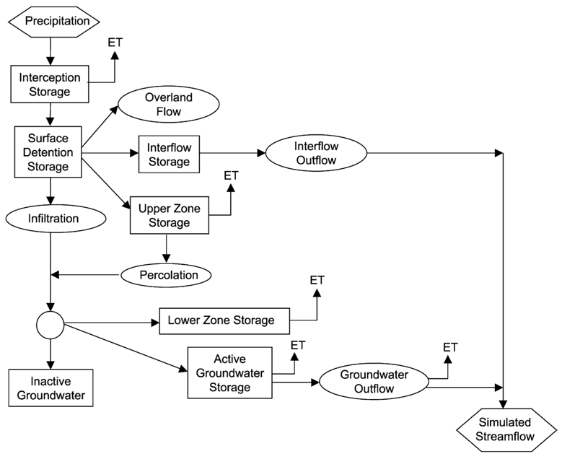
2017 Assessment
Summary of changes in delivery
Hydrologic response:
rainfall volume & intensity
snow and melt due to temperature
evapotranspiration
Flow
Year 2025
Trend rainfall and Ensemble median temperature
Year 2050
Ensemble median rainfall & temperature
Johnson et al. 2003
Sediment
Sediment response:
rainfall intensity
surface runoff
riverine scour and deposition
Year 2025
Trend rainfall and Ensemble median temperature
Year 2050
Ensemble median rainfall & temperature
Trend: projection of extrapolation of long-term trends
Ensemble: 31-member ensemble of RCP4.5 GCMs
Bicknell et al. 2005

Slide 14
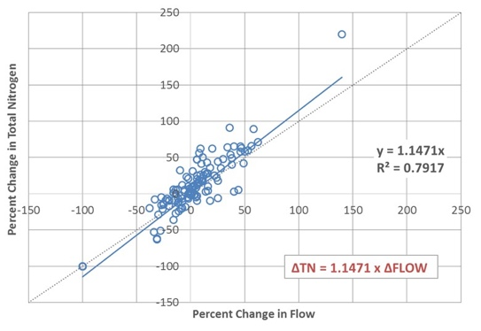
2017 Assessment
Summary of changes in delivery
Nitrogen response:
sensitivity to flow
stream bank erosion
denitrification, organic scour
Nitrogen
Year 2025
Trend rainfall and Ensemble median temperature
Year 2050
Ensemble median rainfall & temperature
Shenk G.
Phosphorus
Phosphorus response:
sensitivities to flow and sediment (APLE)
stream bank erosion
scour/deposition of inorganic and organic (HSPF)
Year 2025
Trend rainfall and Ensemble median temperature
Year 2050
Ensemble median rainfall & temperature
Trend: projection of extrapolation of long-term trends
Ensemble: 31-member ensemble of RCP4.5 GCMs

Slide 15
2017 Assessment
Nitrogen and phosphorus species
Simulated changes in nitrogen delivery
Simulated changes in phosphorus delivery
Year 2025
Trend rainfall and Ensemble median temperature
Year 2050
Ensemble median rainfall & temperature
Year 2025
Trend rainfall and Ensemble median temperature
Year 2050
Ensemble median rainfall & temperature
Arrows show relatively more increase in organic nitrogen as compared to inorganic.
Arrows show relatively more increase in inorganic (particulate) phosphorus as compared to organic.
Trend: projection of extrapolation of long-term trends
Ensemble: 31-member ensemble of RCP4.5 GCMs

Slide 16
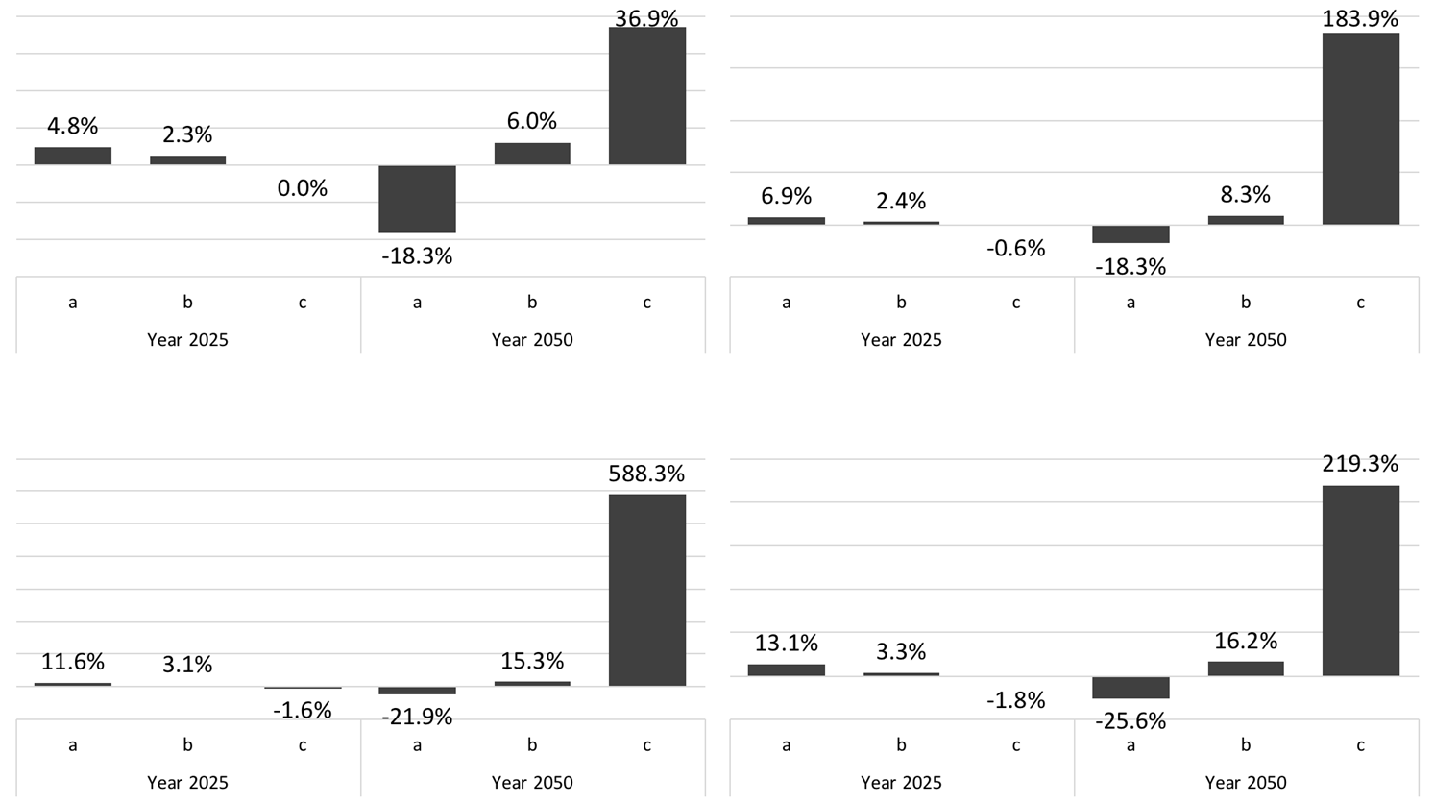
2017 Assessment
Uncertainty due to climatic inputs
Flow
Nitrogen
Year 2025
Year 2050
Year 2025
Year 2050
Trend rainfall, Ensemble 10%. temperature
Trend rainfall, Ensemble median temperature
Trend rainfall, Ensemble 90%. temperature
Ensemble 10%. rainfall & temperature
Ensemble median rainfall & temperature
Ensemble 90%. rainfall & temperature
Trend rainfall, Ensemble 10%. temperature
Trend rainfall, Ensemble median temperature
Trend rainfall, Ensemble 90%. temperature
Ensemble 10%. rainfall & temperature
Ensemble median rainfall & temperature
Ensemble 90%. rainfall & temperature
Phosphorus
Sediment
Year 2025
Year 2050
Year 2025
Year 2050
Trend rainfall, Ensemble 10%. temperature
Trend rainfall, Ensemble median temperature
Trend rainfall, Ensemble 90%. temperature
Ensemble 10%. rainfall & temperature
Ensemble median rainfall & temperature
Ensemble 90%. rainfall & temperature
Trend rainfall, Ensemble 10%. temperature
Trend rainfall, Ensemble median temperature
Trend rainfall, Ensemble 90%. temperature
Ensemble 10%. rainfall & temperature
Ensemble median rainfall & temperature
Ensemble 90%. rainfall & temperature

Slide 17
2019 Assessment
Year
2025
2035
2045
2050
Precipitation
Trend | Ensemble
x | –
? | ?
? | ?
– | x
Temperature
Trend | Ensemble
– | x
? | ?
? | ?
– | x
Selections highlighted in yellow are the STAC and CBP climate resiliency workgroup recommendations and CBP approved approaches for the 2017 Climate Change assessment.
For 2035 and 2045 the Modeling Workgroup (September 2018) recommended (a) combining the two sources using weighted means for rainfall, (b) using the ensemble for temperature. Both approaches are consistent with the STAC 2016 Climate Change Workshop recommendations of observed precipitation trends for 2025 and ensemble precipitation estimates for 2050.

Slide 18
2019 Assessment
Flow response
Trend rainfall, Ensemble median temperature
Ensemble median rainfall & temperature
Trend rainfall, Ensemble median temperature
Hybrid rainfall, Ensemble temperature
Ensemble median rainfall & temperature
Trend rainfall, Ensemble median temperature
Hybrid rainfall, Ensemble temperature
Ensemble median rainfall & temperature
2025
2035
2045
Trend: projection of extrapolation of long-term trends
Ensemble: 31-member ensemble of RCP4.5 GCMs
Hybrid: weighted average of trend and ensemble

Slide 19
2019 Assessment
Sediment response
Trend rainfall, Ensemble median temperature
Ensemble median rainfall & temperature
Trend rainfall, Ensemble median temperature
Hybrid rainfall, Ensemble temperature
Ensemble median rainfall & temperature
Trend rainfall, Ensemble median temperature
Hybrid rainfall, Ensemble temperature
Ensemble median rainfall & temperature
2025
2035
2045
Trend: projection of extrapolation of long-term trends
Ensemble: 31-member ensemble of RCP4.5 GCMs
Hybrid: weighted average of trend and ensemble

Slide 20
2019 Assessment
Nitrogen response
Trend rainfall, Ensemble median temperature
Ensemble median rainfall & temperature
Trend rainfall, Ensemble median temperature
Hybrid rainfall, Ensemble temperature
Ensemble median rainfall & temperature
Trend rainfall, Ensemble median temperature
Hybrid rainfall, Ensemble temperature
Ensemble median rainfall & temperature
2025
2035
2045
Trend: projection of extrapolation of long-term trends
Ensemble: 31-member ensemble of RCP4.5 GCMs
Hybrid: weighted average of trend and ensemble

Slide 21
2019 Assessment
[1]
[3]
[2]
[4]

Slide 22
2019 Assessment
Phosphorus response
Trend rainfall, Ensemble median temperature
Ensemble median rainfall & temperature
Trend rainfall, Ensemble median temperature
Hybrid rainfall, Ensemble temperature
Ensemble median rainfall & temperature
Trend rainfall, Ensemble median temperature
Hybrid rainfall, Ensemble temperature
Ensemble median rainfall & temperature
2025
2035
2045
Trend: projection of extrapolation of long-term trends
Ensemble: 31-member ensemble of RCP4.5 GCMs
Hybrid: weighted average of trend and ensemble

Slide 23
2019 Assessment
[1]
[2]
[3]
[4]

Slide 24
Summary and Conclusions
Estimated impacts of 2025 and 2050 climate change on the watershed delivery of nutrients and sediment were shown.
Estimated changes in the delivery of flow, nutrients, and sediment were shown for decadal series of climate change assessments for the years 2025, 2035, and 2045.
Synthesis of inputs and model results provided insights into the overall behavior of the model response.
Analysis did not include changes in land-use, crop yields, atmospheric deposition, and best management practices (BMPs).
Trend-based rainfall projection (estimated from annual data) did not have any monthly/seasonal component.

Slide 26
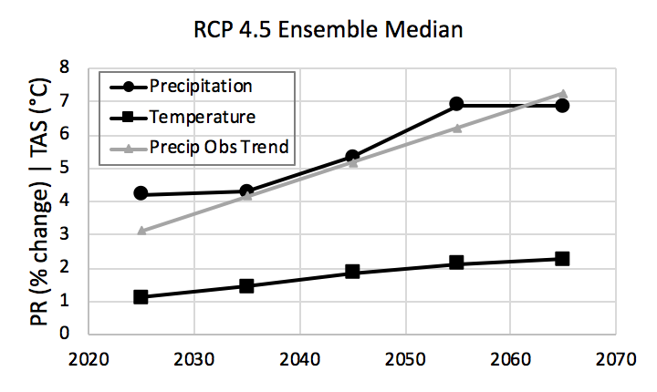

Slide 27
Simulated change in hydrology
(HSPF)
Simulated change in export from land
(Phase 6 sensitivities)
Simulated change in sediment washoff
(HSPF)
Small streams response
(imperviousness + stream bed/bank)
Sparling | Simulation of nutrient species
(nitrate vs. nitrogen)
Riverine response
(scour/deposition + biogeochemical)

Slide 28
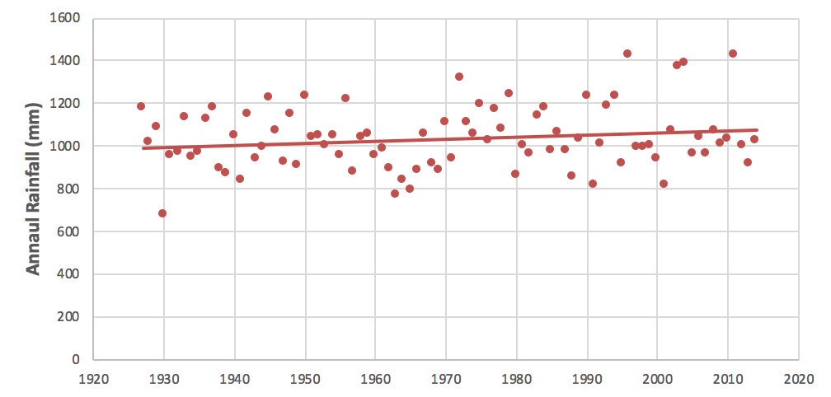
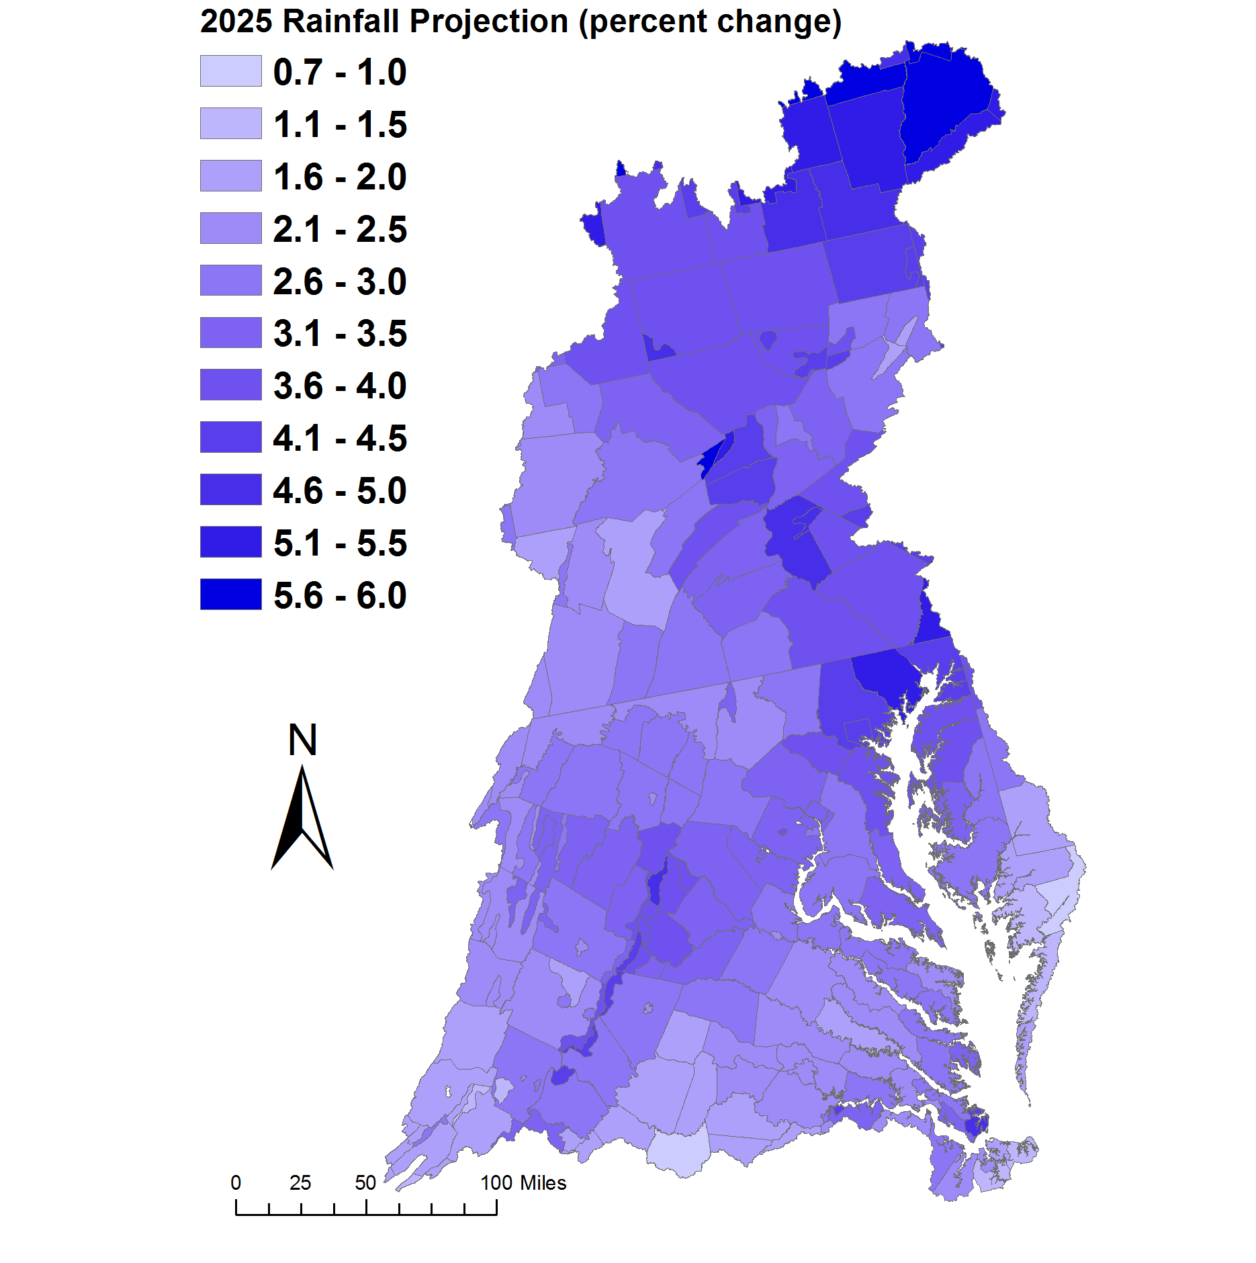
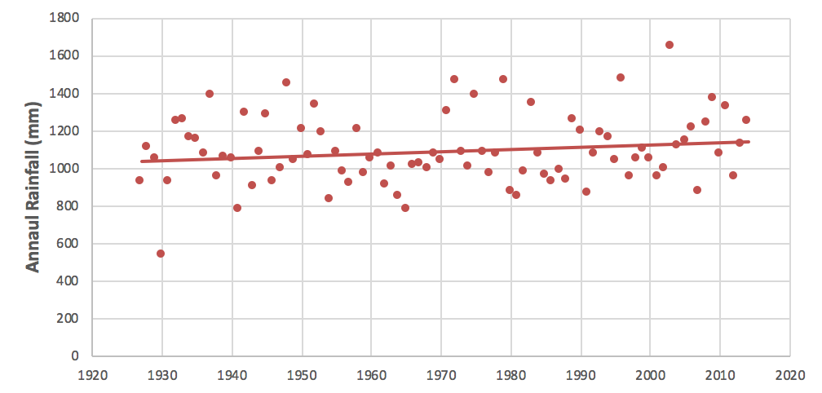
2017 Assessment
Rainfall projections using 88-years of annual PRISM^{[1]} data trends
Centre, PA
Change in Rainfall Volume 2021-2030 vs. 1991-2000
Major Basins | PRISM Trend
Youghiogheny River | 2.1%
Patuxent River Basin | 3.3%
Western Shore | 4.1%
Rappahannock River Basin | 3.2%
York River Basin | 2.6%
Eastern Shore | 2.5%
James River Basin | 2.2%
Potomac River Basin | 2.8%
Susquehanna River Basin | 3.7%
Chesapeake Bay Watershed | 3.1%
+2.67% (28.10 mm)
District of Columbia
[1] Parameter-elevation Relationships on Independent Slopes Model
+3.14% (34.46 mm)

Slide 29
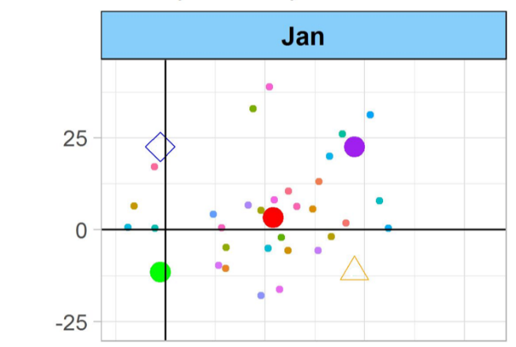
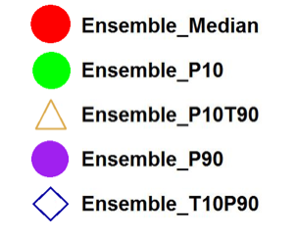
2017 Assessment
Ensemble analysis of GCM projections – RCP 4.5
An ensemble analysis of statistically downscaled projections were used from BCSD CMIP5^{[1]} dataset.
Change were calculated as differences in 30-year averages.
P90 – 90th percentile
P50 – median ensemble
P10 – 10th percentile
25
0
-25
Precipitation Change (%)
0 1 2 3
Temperature Change (°C)
31 member ensemble
[1] Reclamation, 2013. 'Downscaled CMIP3 and CMIP5 Climate and Hydrology Projections: Release of Downscaled CMIP5 Climate Projections, Comparison with preceding Information, and Summary of User Needs', prepared by the U.S. Department of the Interior, Bureau of Reclamation, Technical Services Center, Denver, Colorado. 47pp.
[1] BCSD – Bias Correction Spatial Disaggregation;
[1] CMIP5 – Coupled Model Intercomparison Project 5
Kyle Hinson, CRC | VIMS

Slide 30
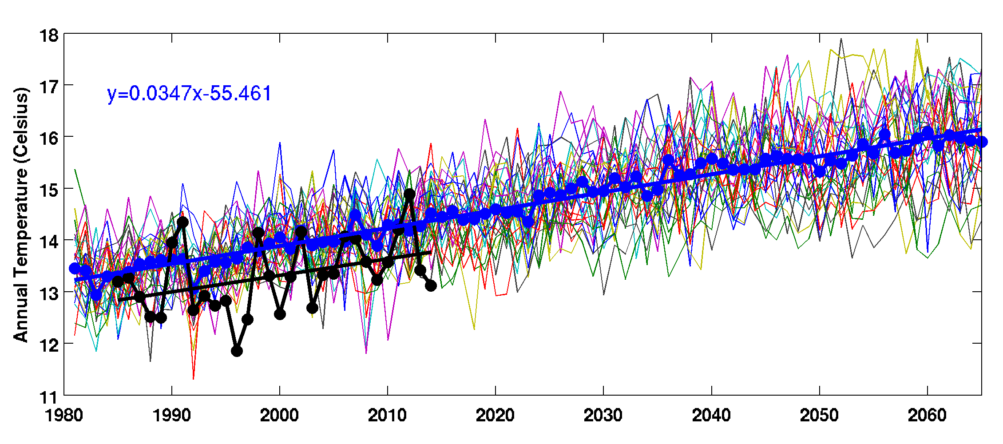
2017 Assessment
Temperature
Precipitation
Data shown for the District of Columbia for illustration.
2050
Average annual precipitation and temperature from the 31 bias-corrected downscaled global circulation models are shown for a land segment (N11001). Shown in blue line is the ensemble median. Data used in model calibration from NLDAS-2 are shown in black

Slide 31
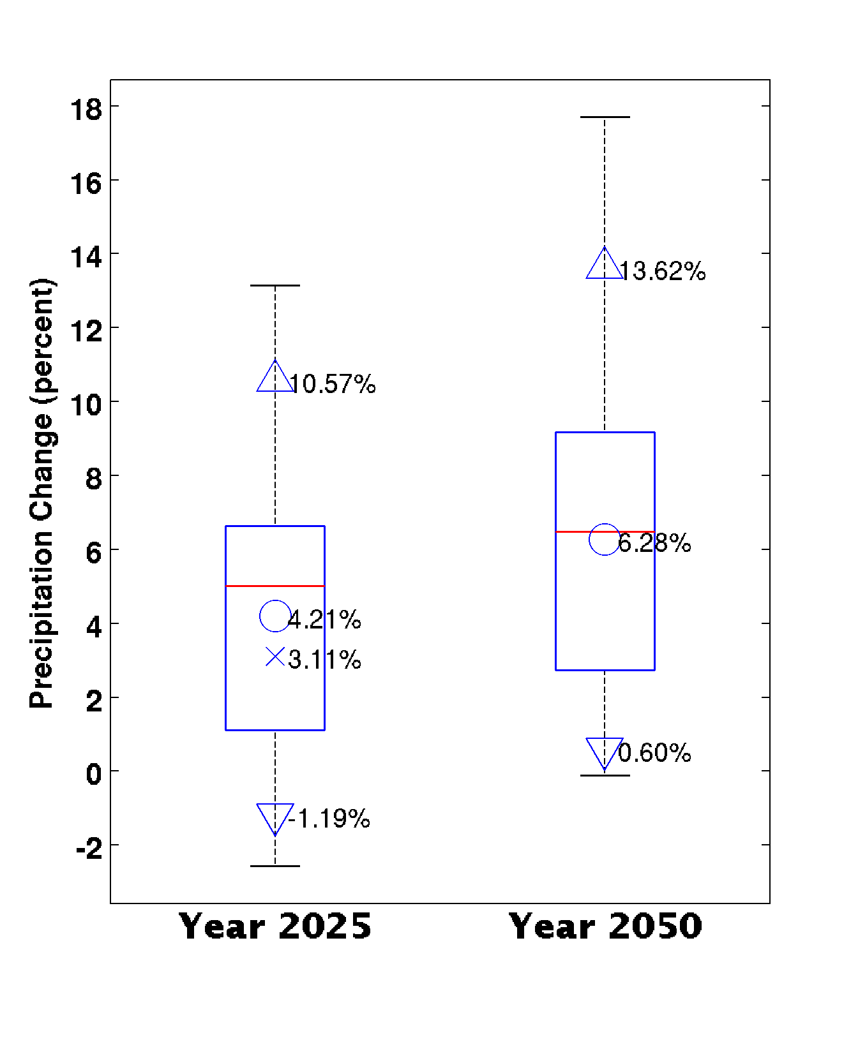
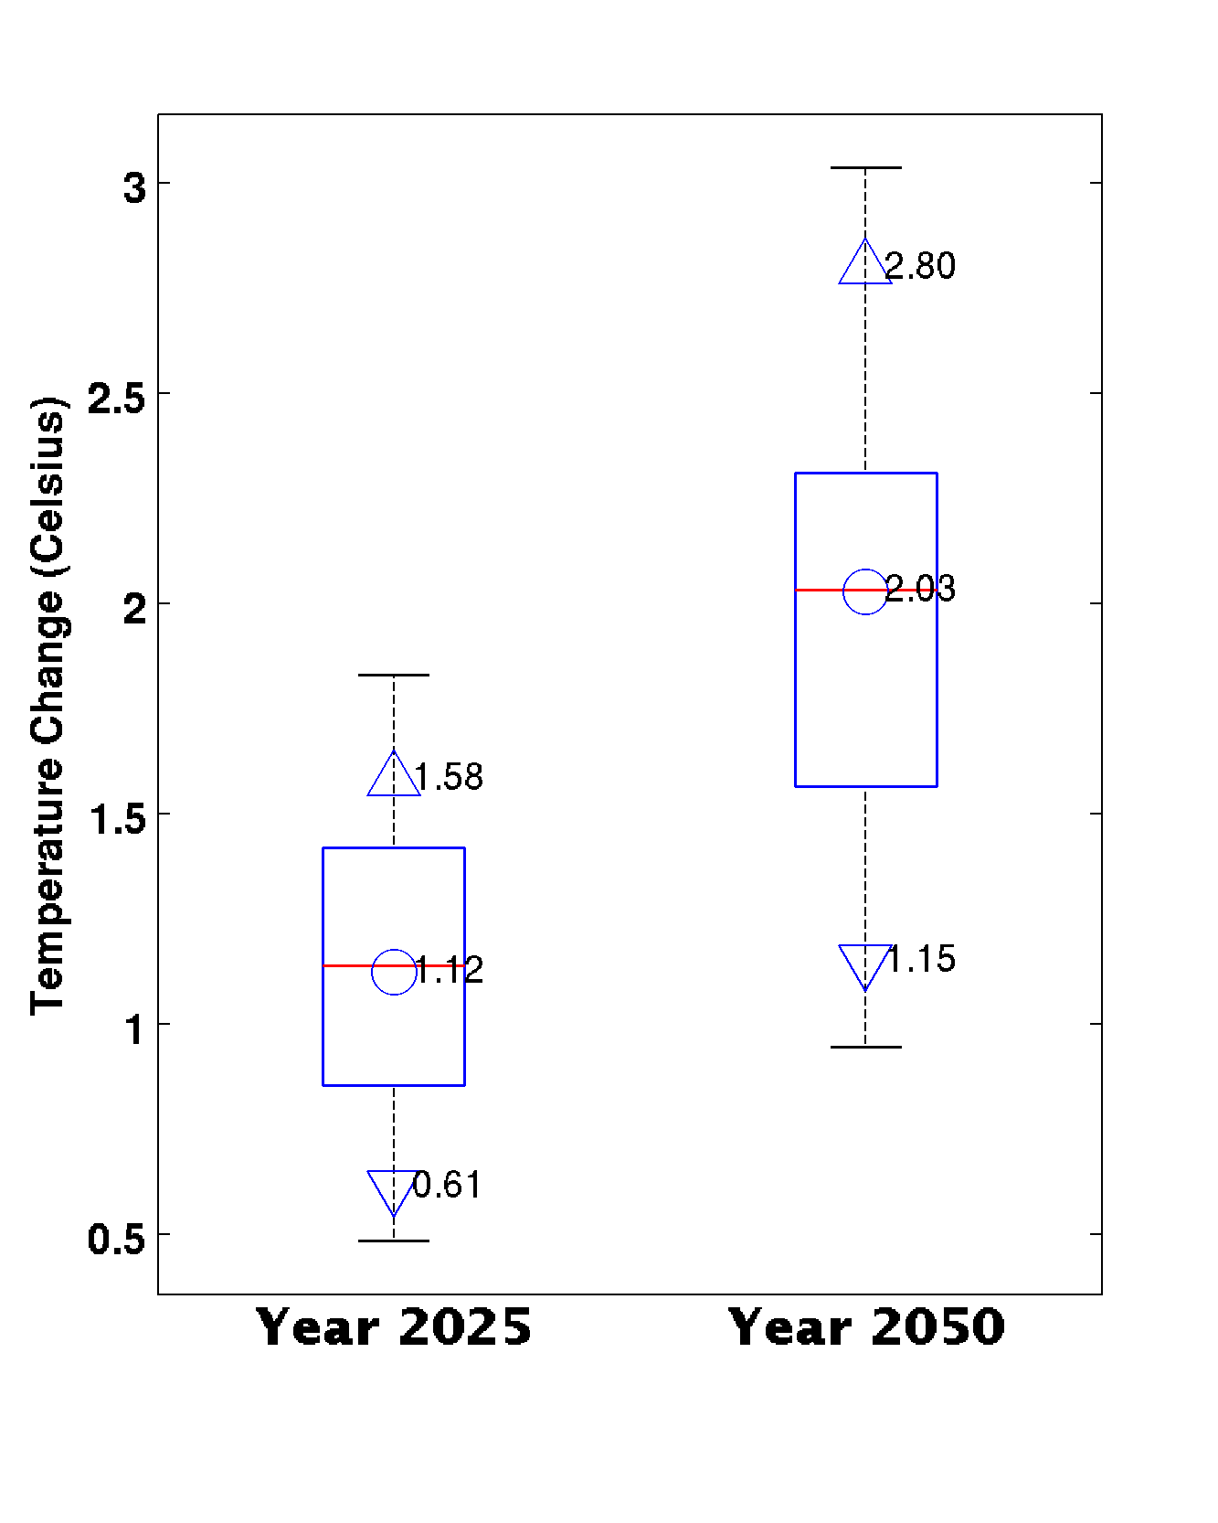
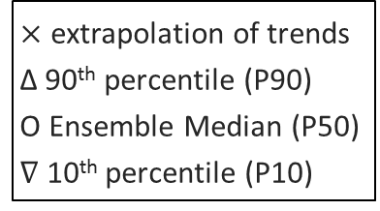
2017 Assessment
Projected changes in precipitation and temperature (RCP 4.5) – Average Annual
$×$ extrapolation of trends
Δ 90th percentile (P90)
O Ensemble Median (P50)
$∇$ 10th percentile (P10)
Summary of RCP4.5 average annual rainfall and temperature change for the Chesapeake Bay watershed are shown. Then range for 10th percentile (P10), ensemble median (P50), and 90th percentile (P90) are shown. The estimated change in rainfall volume based on the extrapolation of long-term trends are also shown (with marker symbol x)

Slide 32
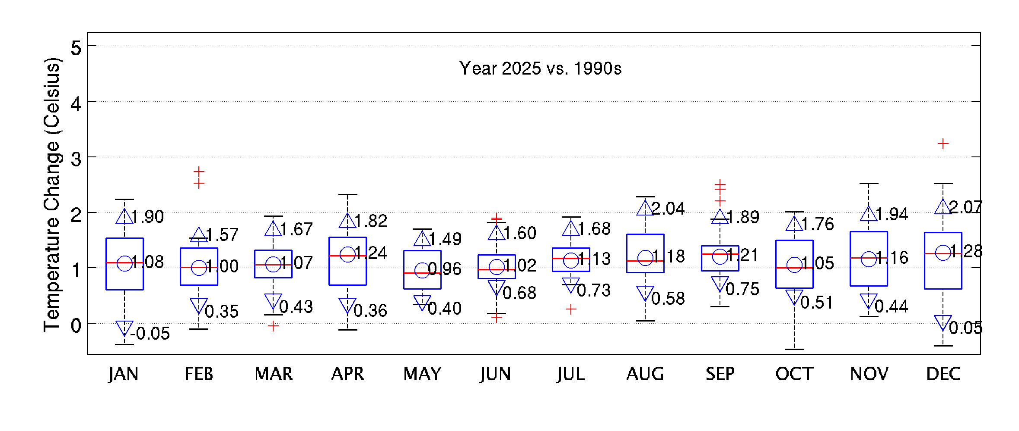
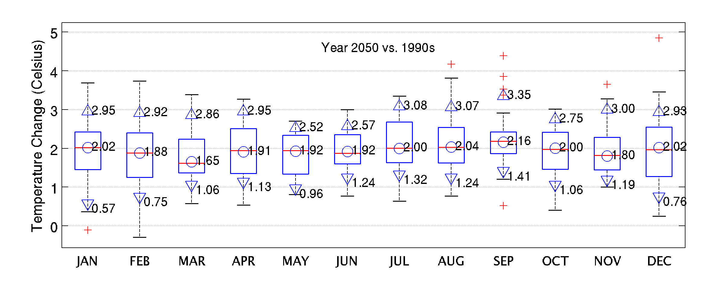
2017 Assessment
Projected changes in temperature (RCP 4.5)
Watershed average of ensemble median is +1.12 ⁰C
Watershed average of ensemble median is +2.02 ⁰C
Monthly change in temperature for the Chesapeake Bay Watershed is shown. Box plot shows distribution of projected change based on 31-member ensemble of RCP 4.5 for the years 2025 and 2050. Additional three marker keys show 10th percentile (P10), ensemble median (P50), and 90th percentile (P90) bounds.

Slide 33
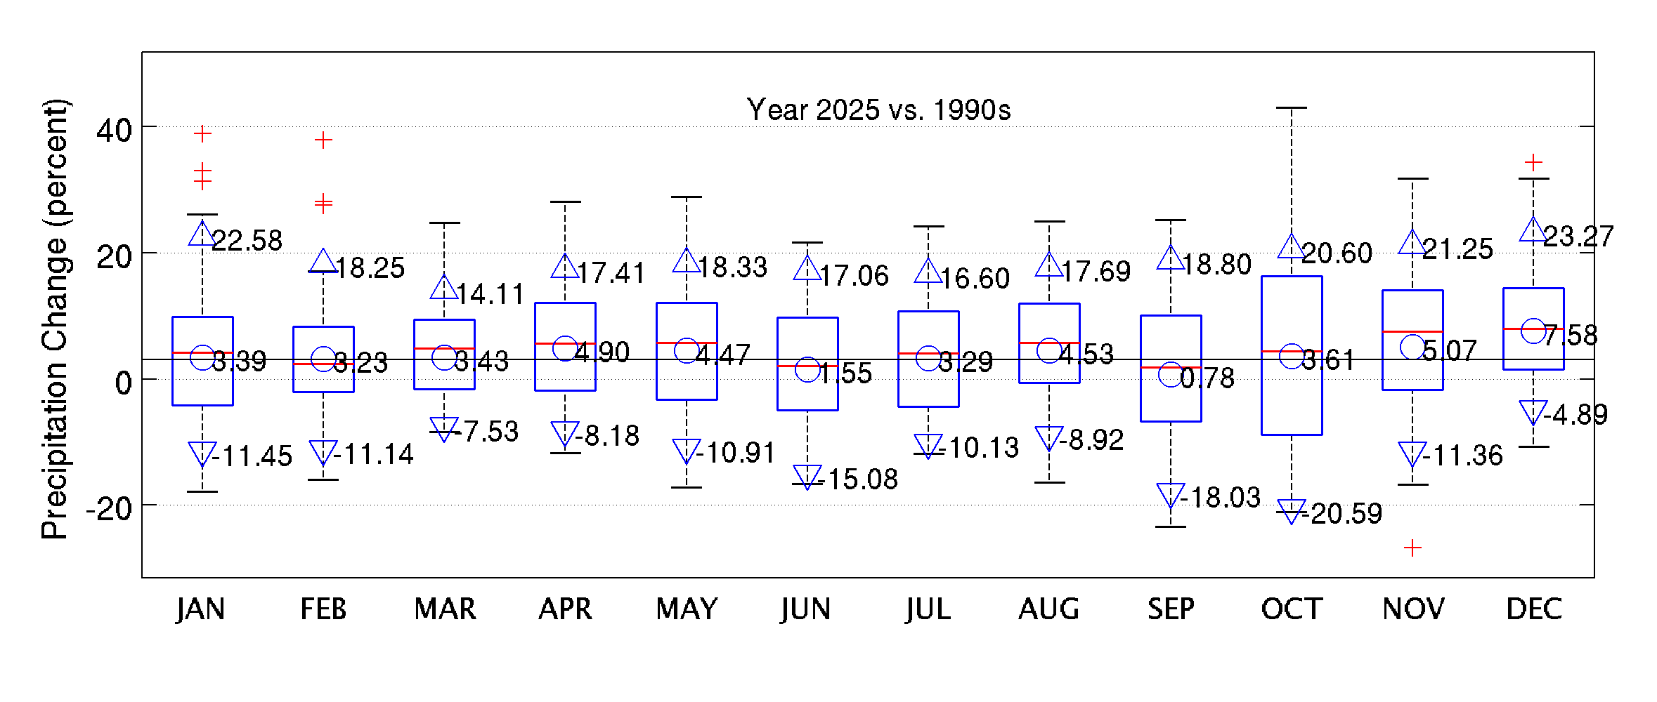
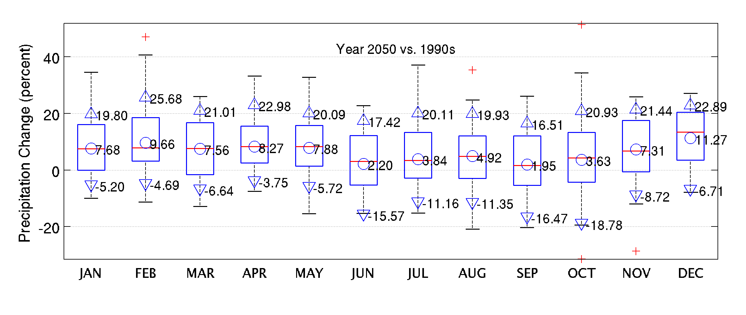
2017 Assessment
Projected changes in precipitation (RCP 4.5)
Watershed average of ensemble median is +4.21% (+3.11% estimated using extrapolation of long term trend)
Watershed average of ensemble median is +6.28%
Monthly change in precipitation volume for the Chesapeake Bay Watershed is shown. Box plot shows distribution of projected change based on 31-member ensemble of RCP 4.5 for the years 2025 and 2050. For the year 2025 projected change based on long term trend is shown in black line. Additional three marker keys show 10th percentile (P10), ensemble median (P50), and the 90th percentile (P90) bounds.

Slide 34
2017 Assessment
Monthly delta change to hourly events
(Inches)
Observed changes in rainfall intensity over the last century (based on Figure 10 in Groisman et al. 2004). The equal allocation distribution (blue) is contrasted with the distribution obtained based on observed changes (red).
(Inches)
Additional rainfall added to the baseline daily rainfall over the 10-year period for a Phase 6 land segment (Potter, PA) is shown. In the method based on observed intensity trends, (Groisman et al. 2004) more volume is added to 10th decile resulting in higher intensity events become stronger.

Slide 35
2017 Assessment
Summary of changes in delivery
Simulated changes in the delivery of flow, nutrients, and sediment to the Chesapeake Bay for year 2025 and 2050 climate change scenarios are shown.

Slide 36
2017 Assessment
Uncertainty due to climatic inputs
Trend: projection of extrapolation of long-term trends
Ensemble: 31-member ensemble of RCP4.5 GCMs

