Slide 1
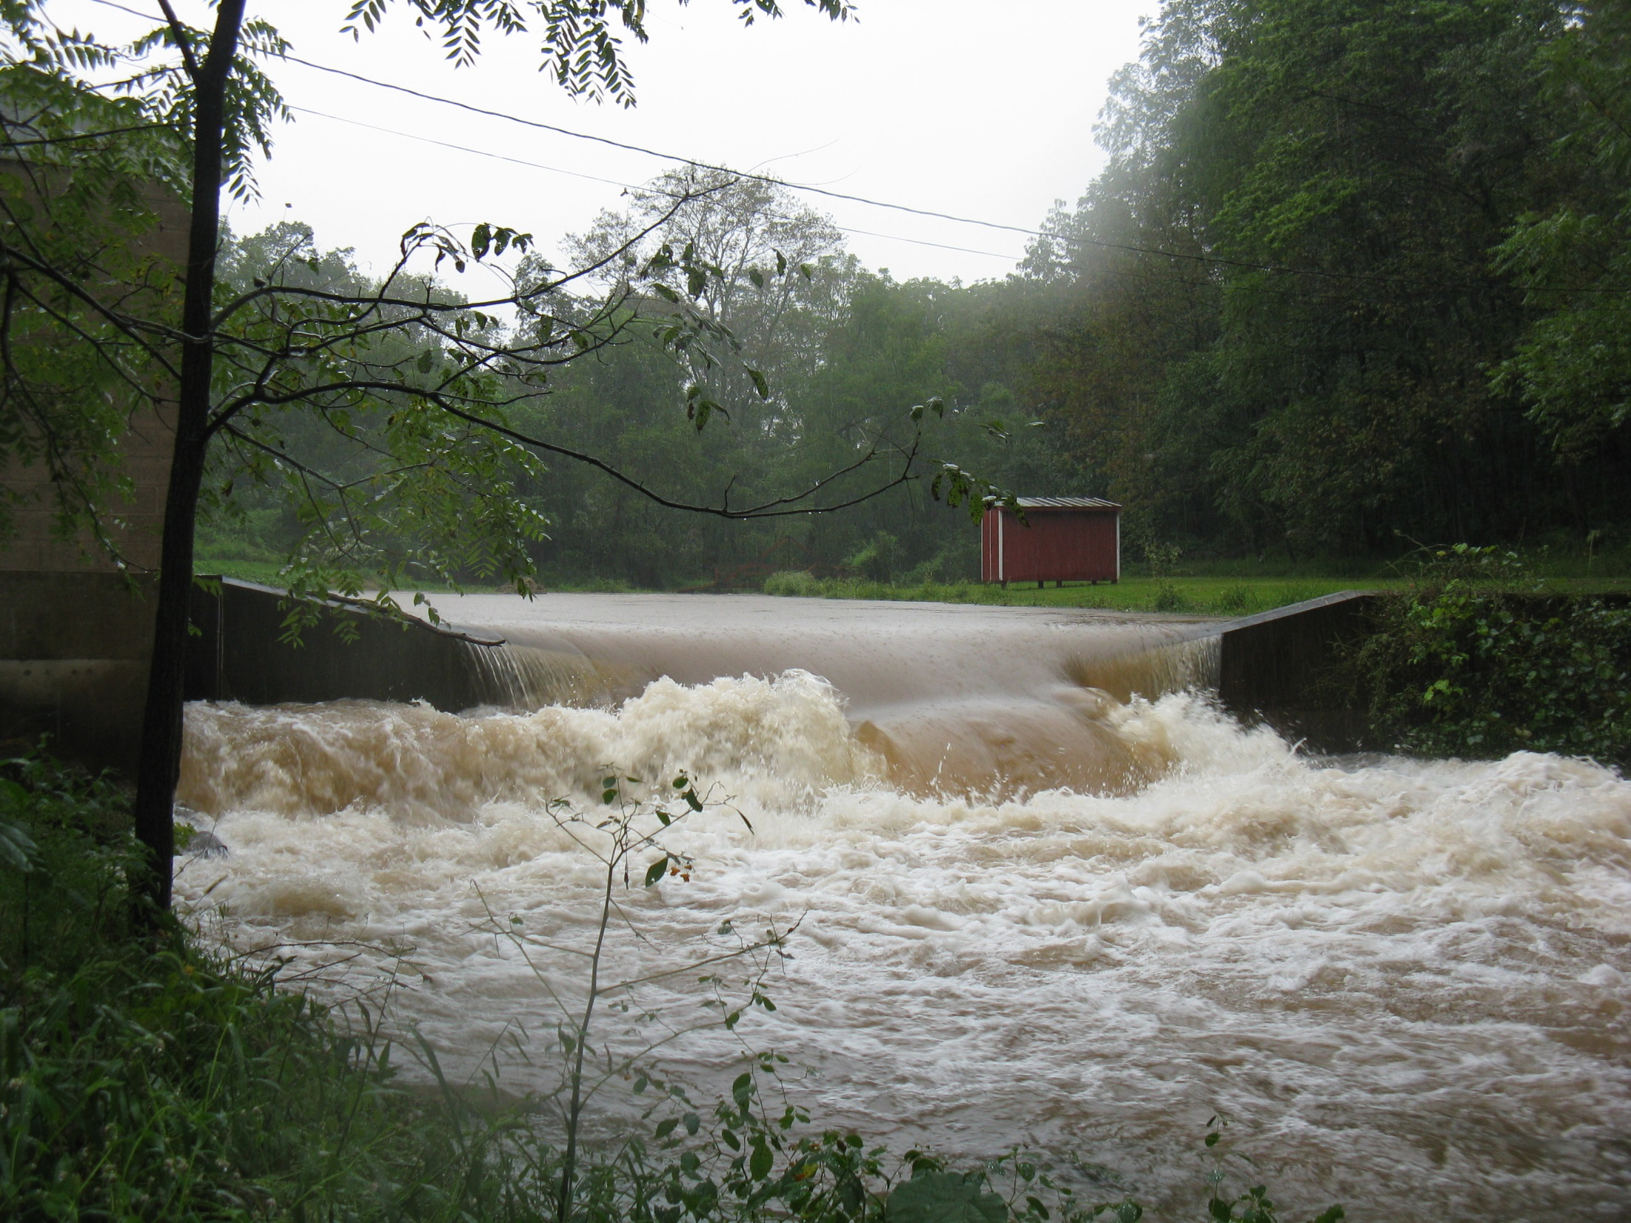
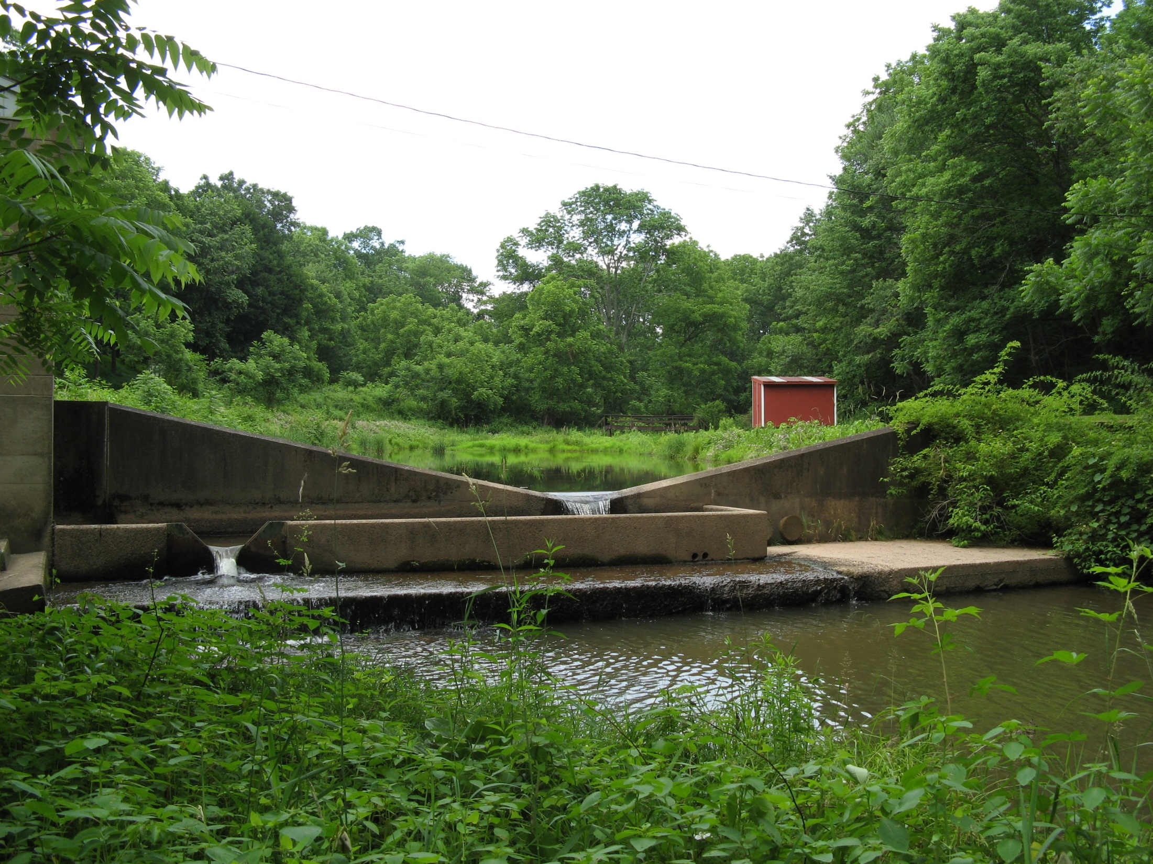

Consider the role of extreme rainfall events in nutrient loss from agricultural watersheds
Anthony Buda
USDA Agricultural Research Service
University Park, PA
STAC Workshop: Climate Change Modeling 2.0
September 24-25, 2018
Crowne Plaza Hotel
Annapolis, MD

Slide 2
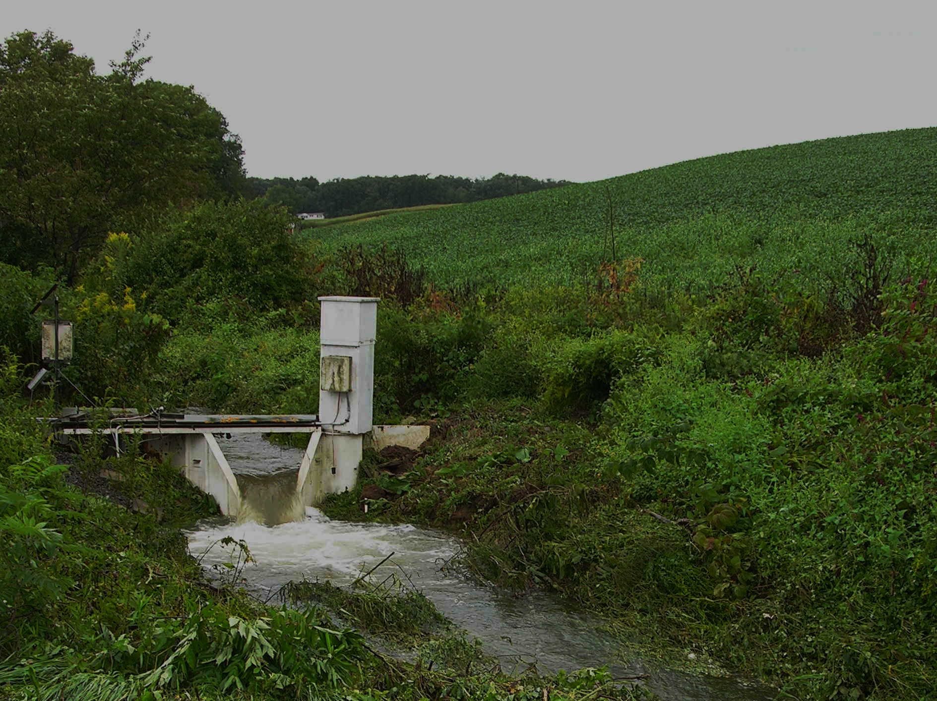
Case in point: Tropical Storm Lee in 2011
Lee contributed significantly to 2011 and decadal P loss
30.0
29.5
Tropical Storm Lee accounted for 21% of the P loss over the past decade.
2007-2016
P loss (kg)
15.0
9.8
Tropical Storm Lee accounted for 63% of the P loss in 2011.
2011
6.1
Lee
0.0

Slide 3
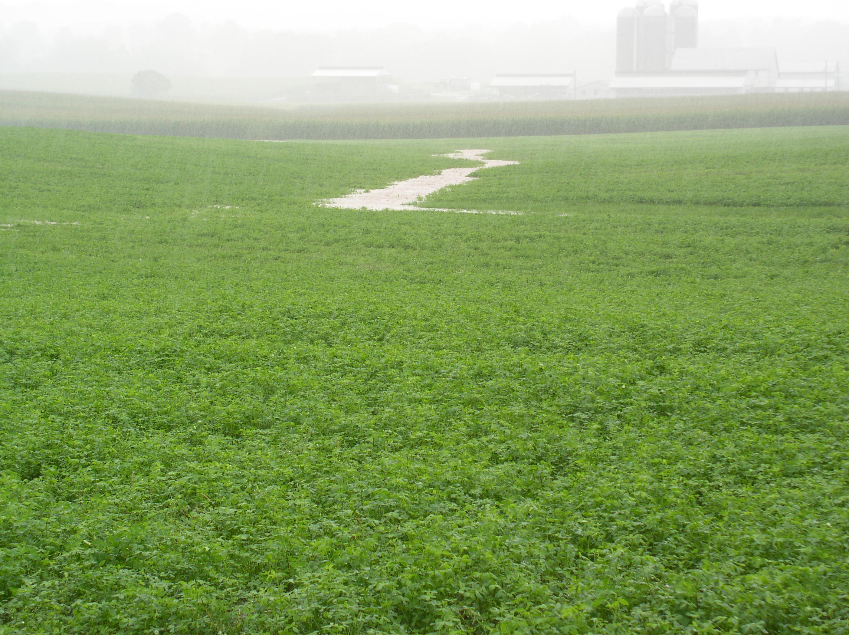




Extreme rainfall greatly affects N and P loss
BMPs need to be assessed in the context of weather extremes
Extreme precipitation and phosphorus loads from
two agricultural watersheds

Slide 4
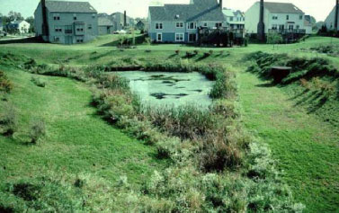
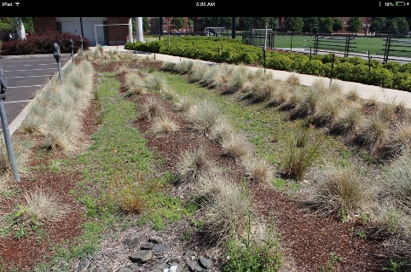
Resilient BMPs for a Changing Climate
Jon Butcher
BMPs work by a variety of physical and biological mechanisms
These mechanisms determine how BMPs are sensitive to climate drivers (e.g., rainfall volume and intensity, temperature, soil moisture
Evaluate climate response:
  Simulation models
  Space for time substitution
  Field experiments (rare to date)
Sensitivity - Is the practice and its performance sensitive to the range of potential change?
Adaptability – Can the practice be modified to be resilient to potential changes as they emerge?
Timeliness – How short is the time line to adapt to changes?
Research sponsored by EPA ORD over the last four years

Slide 5
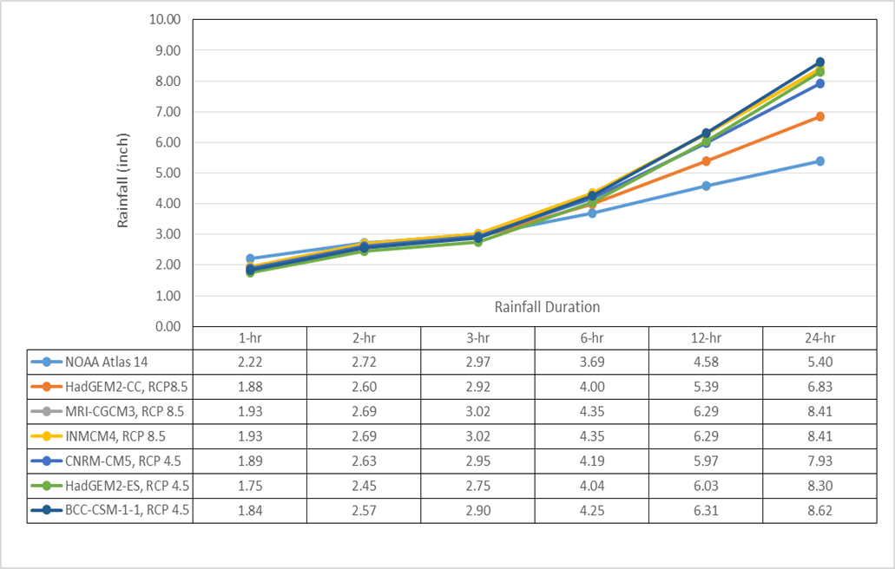
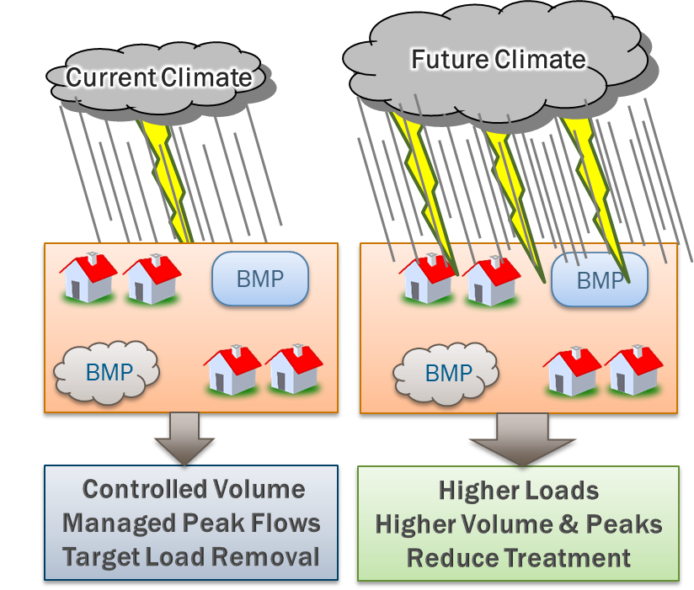
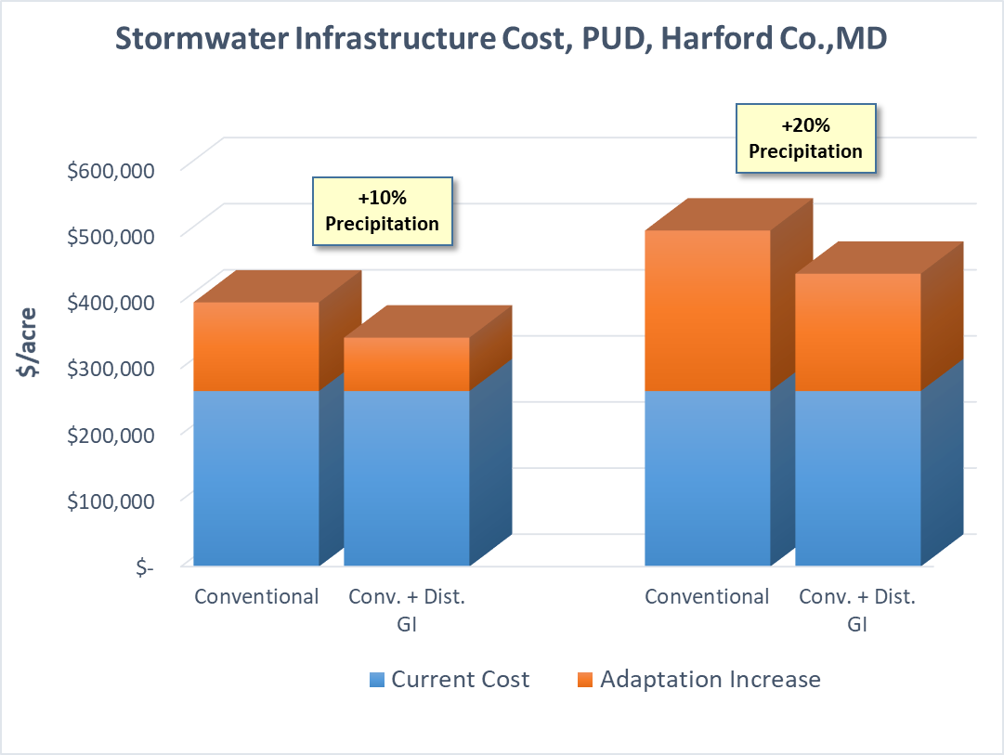
Urban BMPs
Dauphin Co. PA 2085, 25-yr event
Notes:
Emphasis on sizing; Dependence on both physical and biological components
HSPF, SUSTAIN, RHESSys tools

Slide 6
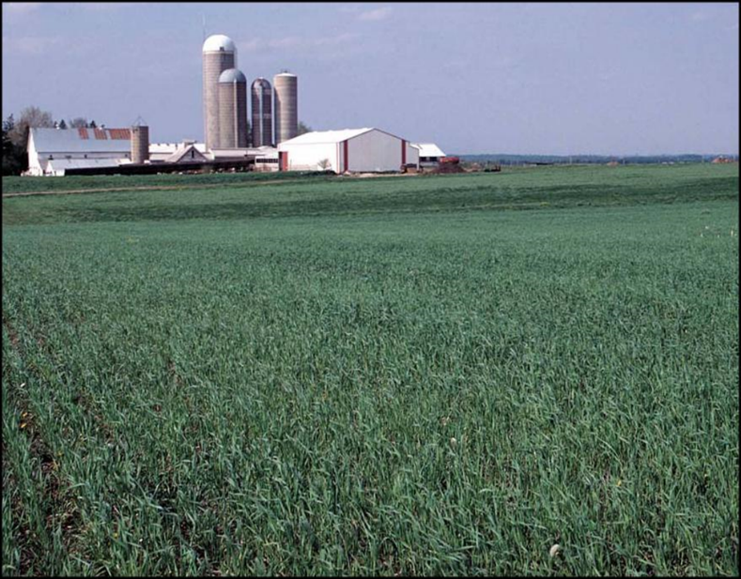
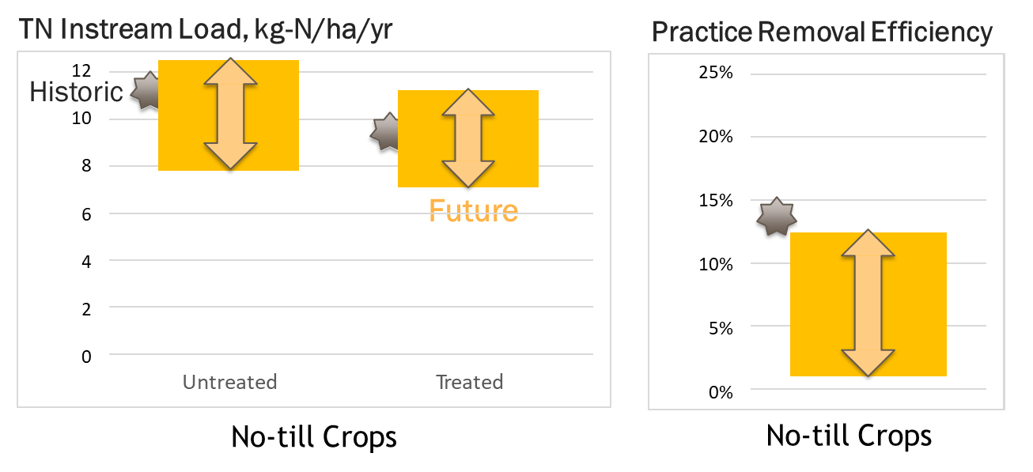
Rural BMPs
Example: No-till on GA coastal plain: SWAT suggests little change in future TN load, but practice effectiveness decreases due to changes in water balance
Climate resilience summary for riparian buffers
Notes:
Emphasis on biological processes for ag and forestry
SWAT and APEX modeling

Slide 7
Ag Management Actions In Response to Climate Change
Curtis Dell, Soil Scientist,
USDA-ARS, University Park, PA
and
Agriculture Workgroup’s Agriculture Modelling Subcommittee Chair

Slide 8
Anticipated changes in Bay watershed agricultural systems in response to changing climate
Expanding use of winter cover crops
  Better window for establishment after summer crop harvest
More double cropping
  Soybeans after small grains
  Harvesting winter covers crops, like rye, for dairy forage
Greater diversity of crops grown
  Limited based on markets for crops or feed need for livestock/poultry
Expanded use of irrigation

Slide 9
Possible impacts on current BMP efficiencies
Annual management practices (largest group of ag BMPs) most flexible for adaptation to climate change.
  For example: Nutrient management BMP give credit for adaptive approaches that improve timing and efficiency of nutrient inputs
Efficiencies of structural BMPs (such as grassed waterways, barnyard runoff control) and vegetative buffers may be altered by changing rainfall intensities and temperature cycles.
  Maybe biggest challenge for modeling ag BMPs

Slide 10


Watershed Diagnostics for Improved Adoption of Management Practices:
Integrating Biophysical and Social Factors
Adel ShirmohammadI (Co-PI)- (ENST-UMD)
Professor, Assoc. Dean for Research AND Assoc. Director of MAES
Paul Leisnham (Project PI)-(ENST-UMD)
college of Agriculture & Natural Resources, University of Maryland
Other Co-Pis:
Hubert Montas (BIOE-UMD), David Lansing(UMBC), Thomas Hutson (UME-AGNR), and several collaborators
NIWQP: 2012-51130-20209; $631,500
Notes:
It was funded by the NIWQP in 2012 and ended in 2017 to complete, and has a total budget of just over $600K.

Slide 11


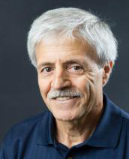


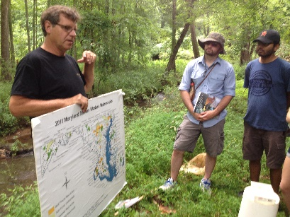


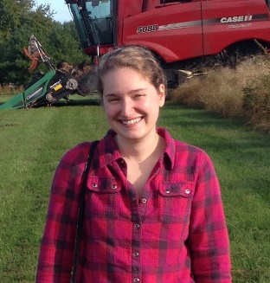
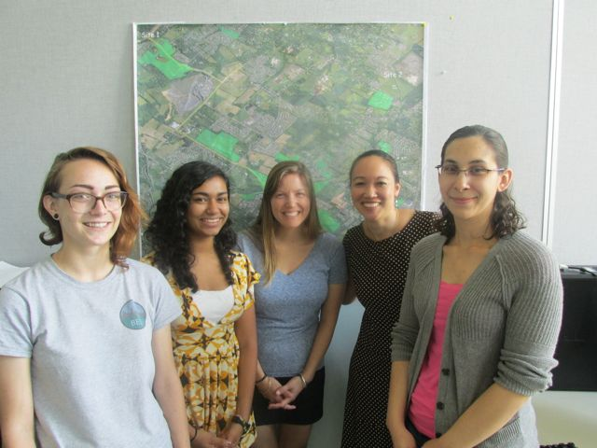



Dan Boward, MD-DNR
Ecology
Paul Leisnham,
Socio-Ecology
Hubert Montas, Diagnostic Tools
Adel Shirmohammadi, Hydrology
Jaison Rekenberger, Diagnostic Tools
Zhongrun Xiang, Modeling
Daniel Schall,
UMBC Sociology
David Lansing, UMBC
Sociology
Victoria Chanse, Amanda Rockler & numerous students
Extension & Sociology
Julianna Brightman & Kanoko Maeda, Sociology
Tom Hutson & Nicole Barth,
Extension
Notes:
As you may have gleaned from the outline, this is a integrated research-extension-education project and cross-disciplinary in nature.
My expertise is as a socio-ecologist, but we have personnel with expertise in hydrology and the development of diagnostic tools, sociology and education and extension.
I have highlighted Jasion and Daniel who are you Masters students supported by the project and who did much of the work, along with numerous undergraduates.

Slide 12
Talk Outline
Background
Impacts of climate change on pollution Critical Source Areas (CSAs)
Impacts of climate change on Best Management Practice (BMP) effectiveness
Competing views on water pollution and BMPs among stakeholders
Notes:
In my talk, I am going to address three main highlights so far, after a very brief background to the project.
CSAs are watershed areas that export target pollutants at rates significantly higher than others.
BMPs are best management practices that can refer to various activities that reduce non-point source pollution from running off into our waterways, including….

Slide 13
DDSS Development
Excess Export
Causes
DDSS will rank environmental causes to pollution and prescribe a BMP allocation plan
Geo-referenced biophysical and land management data
Simulate watershed responses to selected stressors
Identify CSAs & prescribe appropriate BMPs
More “bang for the buck”
Bio-
Dynamic
Models
Pollutant Hot Spots
Components: GIS, Models, Expert Systems
Models: SWAT (SUSTAIN, AQUATOX, FIBI, EPA BASINS)
Expert Systems: MATLAB (predicate calculus to decision trees)
Notes:
Our approach to addressing such water degradation is to build a diagnostic decision support system tools to help watershed managers develop BMP allocations plans.
The diagnostic tool will…There are three main sub-components to the : 1. Geo-referenced… of the study area. 2. Bio-dynamic models that…. 3. Set of two expert systems that will…
With this approach we can get the most bang for the buck.
Details:
Why is a hotspot a hotspot? Is it because of topography, is it because of soil depth? Is it because of type of agricultural practice?
ID appropriate practice for each hotspot.
Data: Hydrology, water quality, ecosystem health
Source: ARS, MBSS, student-led surveys (Leisnham)
Methods: compare values, trends, orders of magnitude, timing.
Nash-Sutcliffe and Pearson coefficients.
Sensitivity analysis.
Field inspection for hot-spot verification.
Correlate predicted water quality with BIBI from field observations.

Slide 14
Climate Change Forecasts for the Northeastern United States
Elevated concentrations of atmospheric CO₂
Elevated mean temperature
Increased mean rainfall
Shift in seasonal rainfall patterns
    Wetter spring
    Drier late summer
Increases in extreme weather events
Notes:
However, when considering BMP implementation a complicating factor is climate change. The Northeast has experienced and will continue to experience a range of impacts…and of particular importance to this talk the greatest is quite possibly increases in extreme weather events.

Slide 15
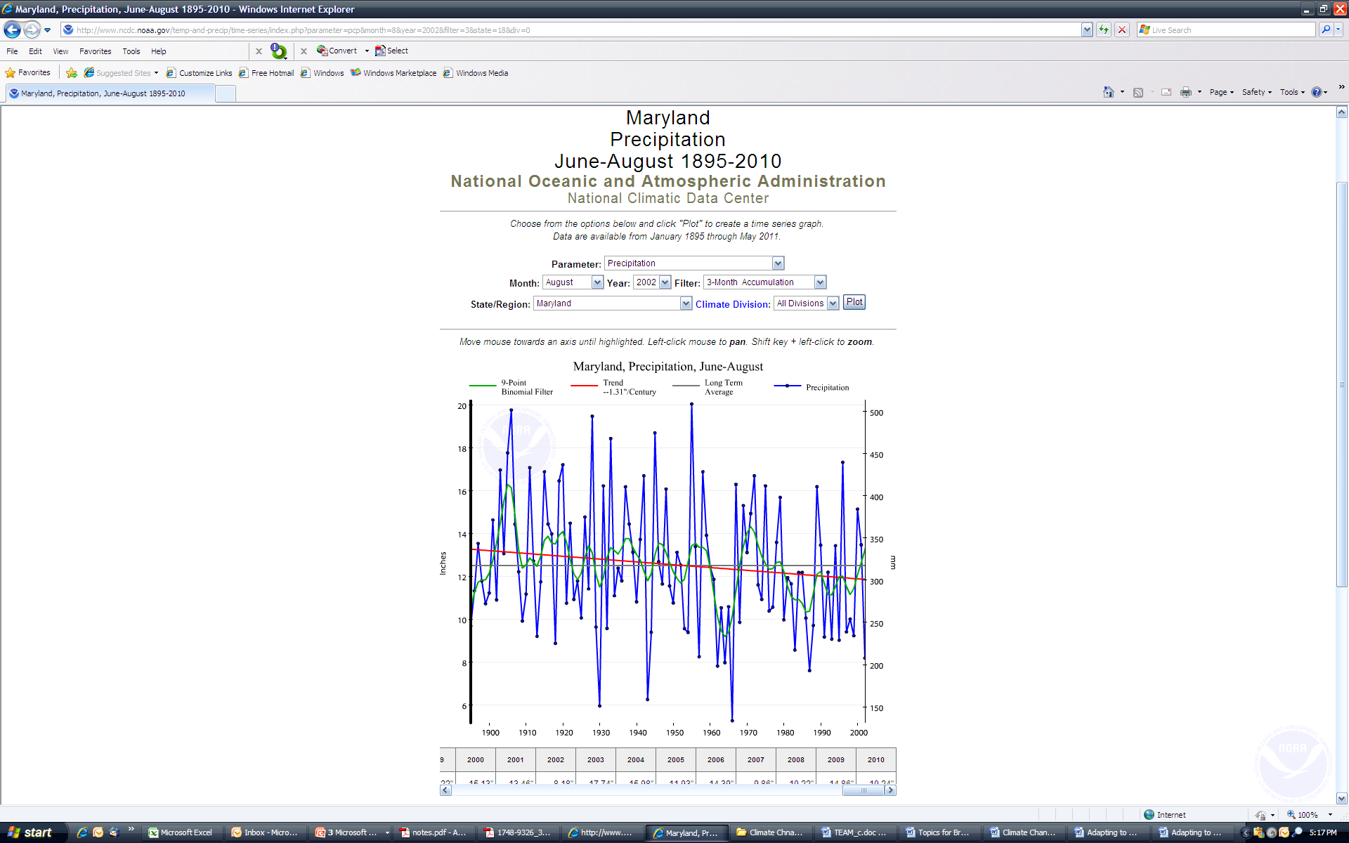
NOAA – National Climate Date Center
Cum. Change in Precipitation for June-August= -1.31” [June (-0.18), July (-0.49), August (-0.65)] per Century
http://www.ncdc.noaa.gov/temp-and-precip/time-series/index.php?parameter=pcp&month=8&year=2002&filter=3&state=18&div=0

Slide 16
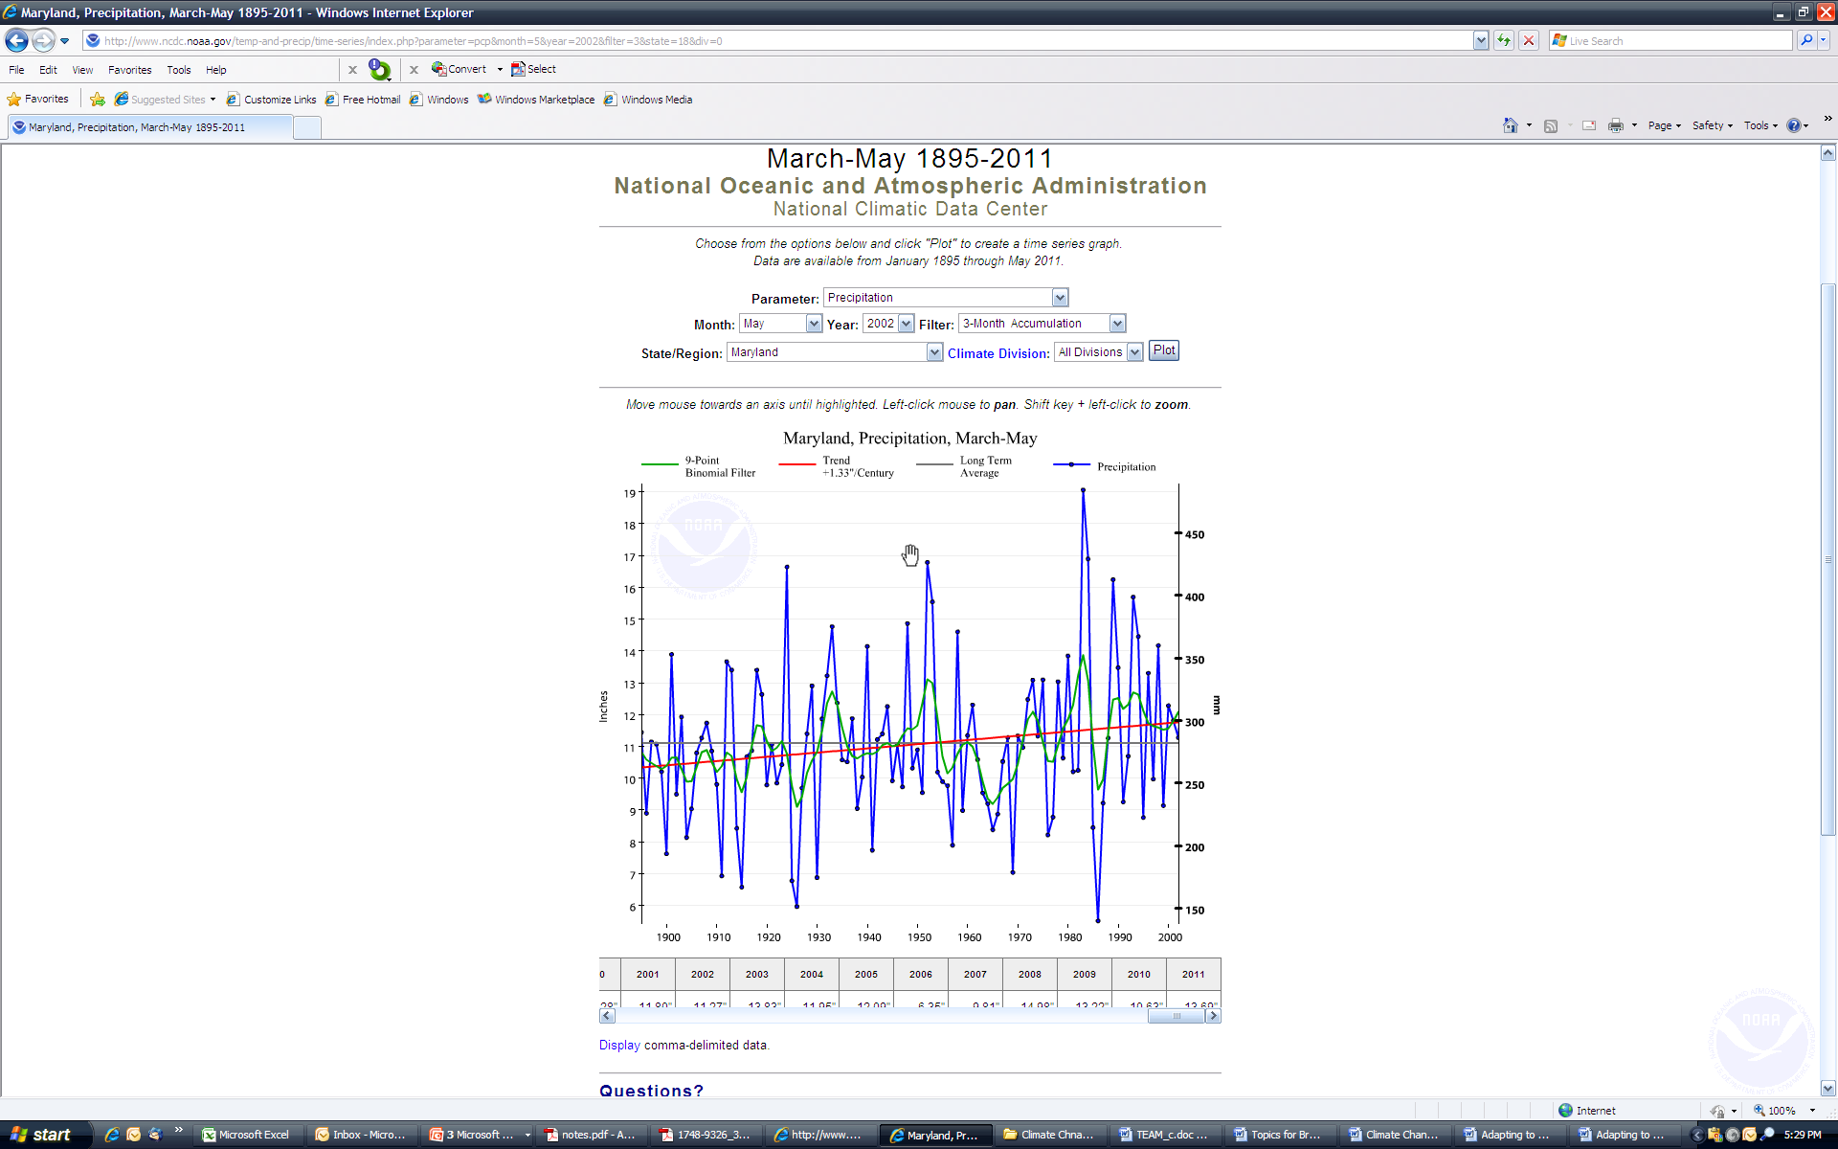
NOAA – National Climate Date Center
Cum. Change in Precipitation for March-May = 1.33” [March (0.47), April (0.18), May (0.67)] per Century
http://www.ncdc.noaa.gov/temp-and-precip/time-series/index.php?parameter=pcp&month=8&year=2002&filter=3&state=18&div=0

Slide 17
Model Construction and Analysis
Data Type | Characteristics
Topography/DEM | 10 meter
Landuse/Land Cover | NLCD 2006 HRU
Soils | NRCS SSURGO
Weather (Calibration) | 3 stations NCEP CFSR
Flow, Nutrients and Sediment | 1 USGS Gauging Station Greensboro
Climate Change GFDL-CM2.1 | CMIP3 (B1, A1B, A2) (Mid and End Century)
Software | Purpose and Progression
ArcGIS | Spatial Data Analysis (Graphics and Database)
ArcSWAT | Model development SWAT input file Generation
SWAT-CUP | Model calibration (SUFI-2 Method)
SWAT | Experimental engine (SWAT.exe)
Downscaled climate predictions from global model based around 3 IPCC scenarios that lead to low, medium, and high future levels of CO₂
Model Calibration
Warm-up (3 yrs): 1/1/1990 to 12/31/1992
Calibration Period (15 yrs): 1/1/1990 to 12/31/2004
Model Validation
Warm-up (2 yrs): 1/1/2005 to 12/31/2006
Validation Period (6 yrs): 1/1/2005 to 12/31/2010
Notes:
This slide simply has some details of the data and model construction, calibration, validation based on observations at the gauging station.
This study used downscaled climate predictions from global GFDL CM2.1 based around the 3 socio-economic development scenarios of the IPCC Special Report on Emission Scenarios (SRES) that lead to low, medium and high future levels of atmospheric CO₂.
To note, the Greensboro watershed consisted of a total of 7705 distinct HRUs based on the combinations environmental data.
Detail:
Used past weather to calibrated so that output in watershed model looked at watershed output in real life.
The B1 storyline is characterized by a world that tends toward a service based economy and technologies that are resource efficient. The A1B scenario reflects a balance between fossil and non-fossil fuel sources, in combination with rapid economic and technological growth worldwide. The A2 storyline is one where economies and social boundaries remain heterogeneous into the future and economic and technological growth are slower than for B1 and A1B.
Changes in land use not taken into account. PPT does change and

Slide 18

Impacts of Climate Change on Pollution CSAs
Renkenberger et al., 2016. Climate change impact on critical source area identification in a Maryland watershed. Transactions of ASABE, Vol 59 (6): 1803-1819.

Slide 19
Definition of a Critical Source Area (CSA)
An area that exports a target pollutant at concentrations significantly above average
Rank | SurQ (mm H20) | TSS (tonnes/ha/yr) | TN (kg/ha/yr) | TP (kg/ha/yr)
Top 10% | >406 | >1.03 | >24 | >1.9
Top 20% | >359 | >0.73 | >16 | >1.6
Top 10%: Value for which the top ~770 HRUs is separated from the other 7705 HRUs
Top 20%: Value for which the top ~1540 HRUs is separated from the other 7705 HRUs
Always defined a watershed area (or HRU) a CSA if it exported a given pollutant at or above these fixed thresholds
Notes:
And we defined a CSA as…..
Our breakpoint was the top 10% or 20% of watershed areas, or HRUs, that exported a given constituent, and then always defined areas a CSA if they exported pollutants at these fixed excessive levels
This is important to identify for focusing our BMP implementation. We want to do this as effectively and efficiently as possible. I should note here that the point of defining CSAs is to reduce the amount of land area targeted by less-strategic placement of BMPs.
Not based on TMDLs or water quality. Ranking is only relative to present day model.

Slide 20
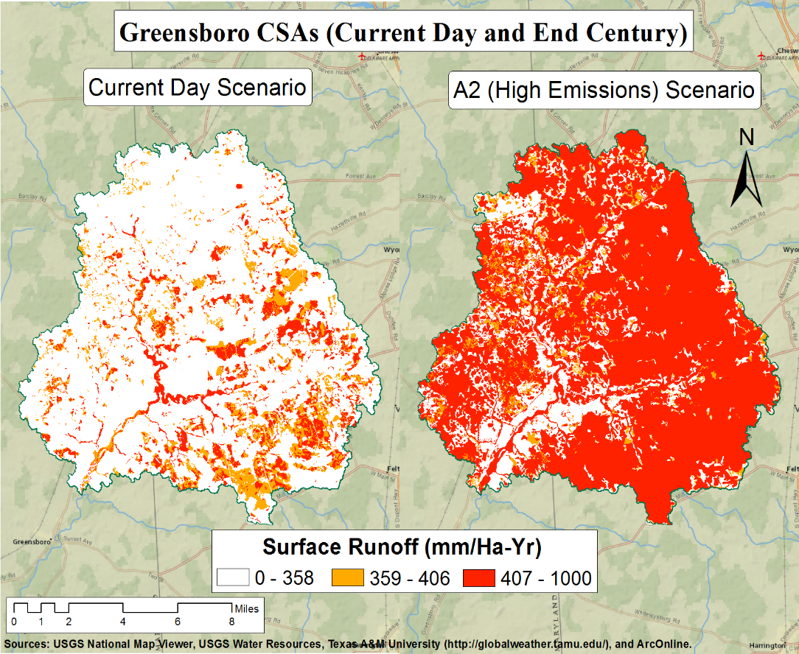
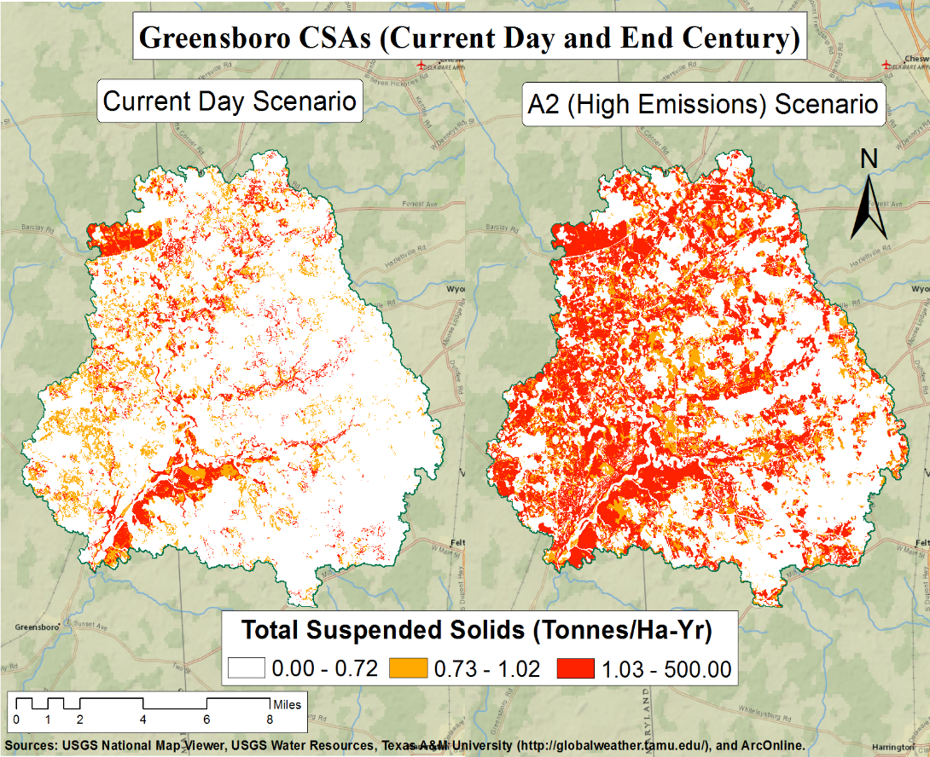
Surface Runoff & Total Suspended Solids
% Change in Area: SurQ: 21%-81% (3.9x), TSS: 18%-45% (2.5x)
% Change on Export: SurQ: 31%-89% (3x), TSS: 46%-81% (1.5x)
Present Day CSAs
SRES A2
End Century CSAs
25-30% ↑ rainfall
3.9X ↑
3.0X ↑
Notes:
Over the next two slides I am going to show you the worst-case increase in land area considered a CSA based on our fixed thresholds.
We expect to see a 25-30% increase in rainfall under the A2 emissions scenario and this leads to massive increases excessive surface runoff and sediment.
Keep in mind that I’m showing large increases with the worst case scenario by increases under milder emissions scenarios at mid-century also see large increases.
Details:
Average annual concentration and total export
Percent Change in Area
SurQ: 21% - 81% 3.9x
TSS: 18% - 45% 2.5x
Percent Change in Export
SurQ: 31% - 89% 3x
TSS: 46% - 81% 1.5x

Slide 21
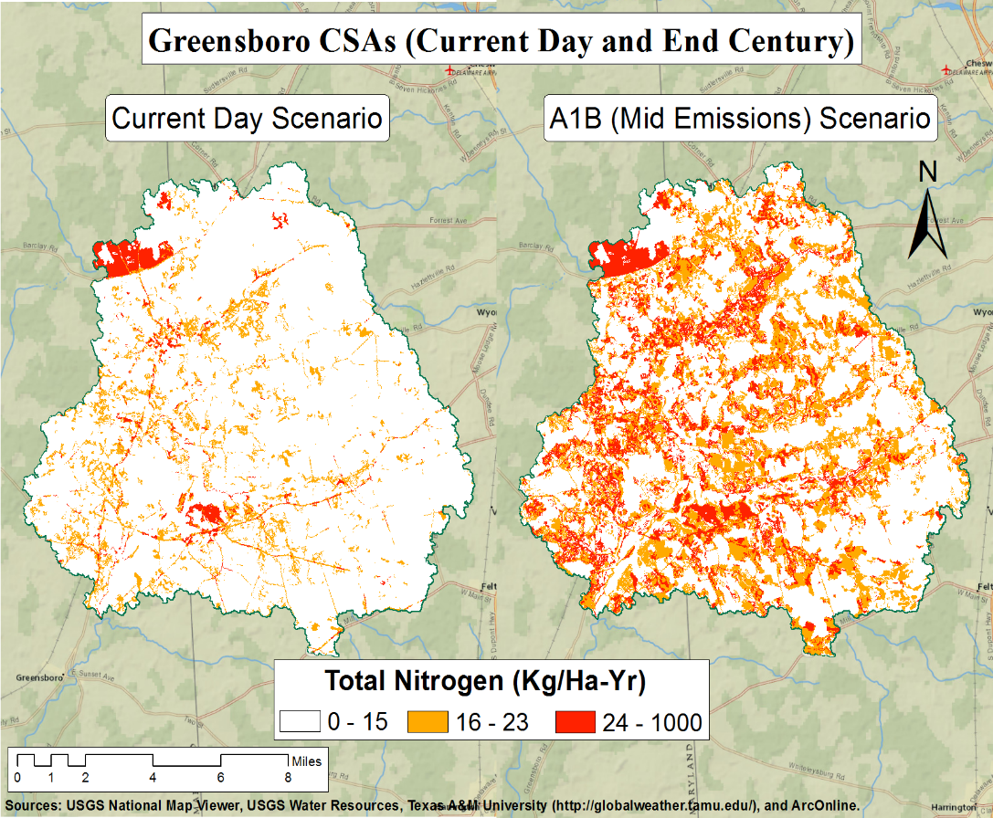
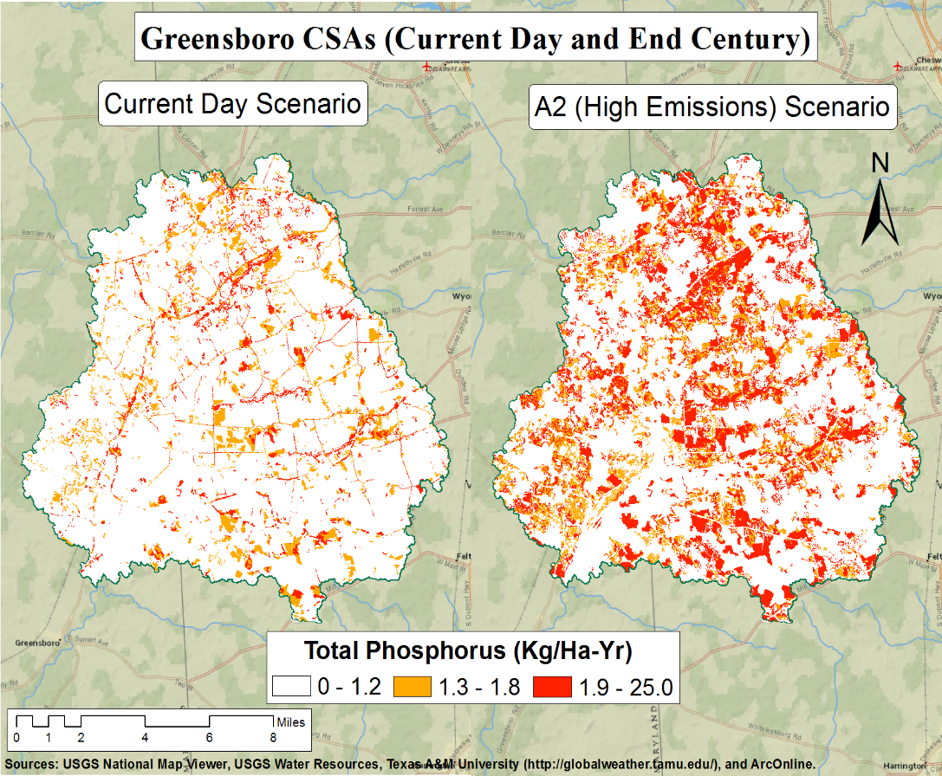
Nitrogen & Phosphorous
% Change in Area: TN: 11%-41% (3.7x), TP: 13%-32% (2.46x)
% Change in Export: TN: 31%-72% (2.3x), TP: 39%-66% (1.7x)
Present Day CSAs
SRES A2/A1B
End Century CSAs
25-30% ↑ rainfall
3.7X ↑
2.5X ↑
Notes:
Worst case emissions scenario for nitrogen pollution is A1B which just nearly as much total rainfall but less extreme events which allows more infiltration and subsurface flow which leaches more Nitrogen
Average annual concentration and total export
Percent Change in Area
TN: 11% - 41% 3.7x
TP: 13% - 32% 2.46x
Percent Change in Export
TN: 31% - 72% 2.3x
TP: 39% - 66% 1.70x

Slide 22
Impacts of Climate Change on BMP Effectiveness
Renkenberger et al., 2017. Effectiveness of BMPs with Changing Climate in a Maryland Watershed. Transactions of ASABE, Vol 60 (3):769-789.
Notes:
To assess the impacts of climate change on BMP effectiveness we first want to consider how we will prescribe BMPs when we have four constituent pollutants.

Slide 23
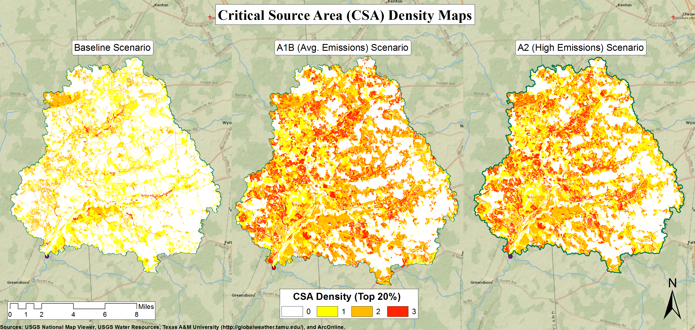
Targeting Method: Dense CSAs
$$Critically Dense Areas at the top 20\% Breakpoint Value$$
BMPs at the 20% CBV need to be applied to all CSAs
Rank | SurQ (mm H20) | TSS (tonnes/ha/yr) | TN (kg/ha/yr) | TP (kg/ha/yr)
Top 10% | >406 | >1.03 | >24 | >1.9
Top 20% | >359 | >0.73 | >16 | >1.6
Notes:
One method is to apply BMPs to watershed areas, or HRUs, with multiple CSAs. Here I am showing you maps with 3 CSAs overlaid each other, and areas are given a CSA Density. We have baseline scenario and the two higher emissions scenarios at end of century, which have more critically dense areas.
Ok So what may we expect when we allocate targeted BMPs?
A single HRU can be a CSA for more than one pollutant. These HRUs are more critically dense than other HRUs. Hence a CSA density.
Critical Break Values are the same as defined earlier. They are fixed.
BMPs at the 20% CBV need to be applied to all CSAs

Slide 24
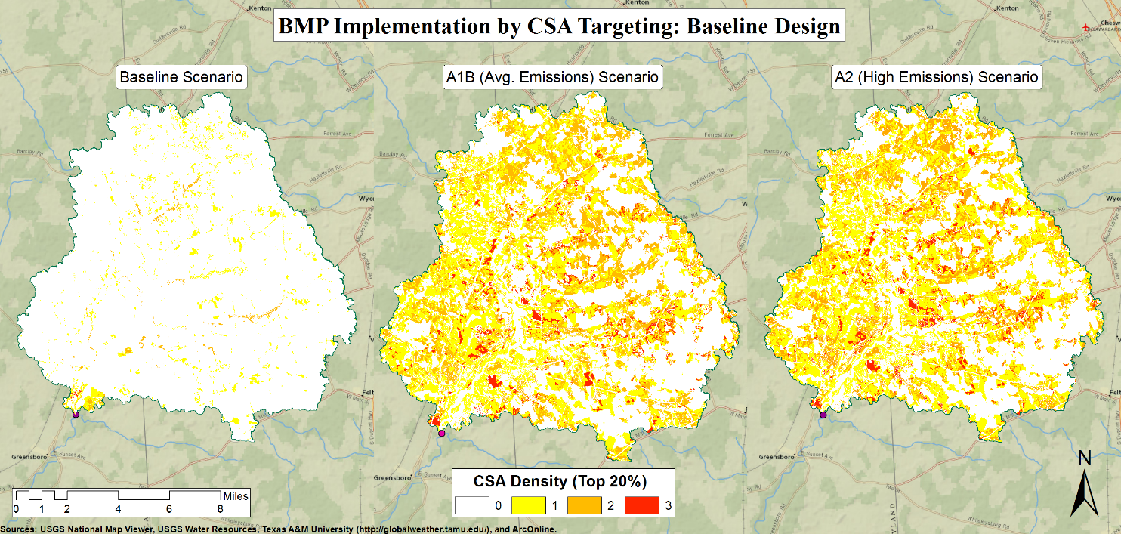
Targeting Dense CSAs of Today
We will meet TMDL targets if we ignore CC, but miss TMDL targets by 64-143% under Future Scenarios. We target 31% of area with BMP Eff% TSS = 61%; TN = 79%; TP = 43%
Residual CSA Density with Baseline BMP Design Subjected to Current, A1B and A2 Climate Conditions
TMDL targets met
Future Scenarios:
64%-143% above TMDL Targets
Notes:
What we found is that if we implement BMPs on dense CSAs of today, we may STILL end up with significant proportions of watershed that are still critically dense CSAs in the future, under climate change, and TMDL targets are missed. BMP progress is lost due to climate change.
When relating BMP effectives to TMDL targets, the take home message is that we will meet TMDL targets if we ignore climate change but miss TMDL targets by 64-143% under the worst case emissions scenario
Keep in mind, that we are just focusing on TSS, N, P b/c everywhere would be a CSA with Surface runoff.
Using this strategy we target 31% of the watershed area.
Details:
Based on Stationary design we target 31% of the watershed area
BMP Eff% TSS = 61%; TN = 79%; TP = 43%
However, Future Scenarios show that in the future we will still end up with 64%-143% above TMDL Targets
Concluding Statement for this slide: BMP progress is lost due to climate change

Slide 25
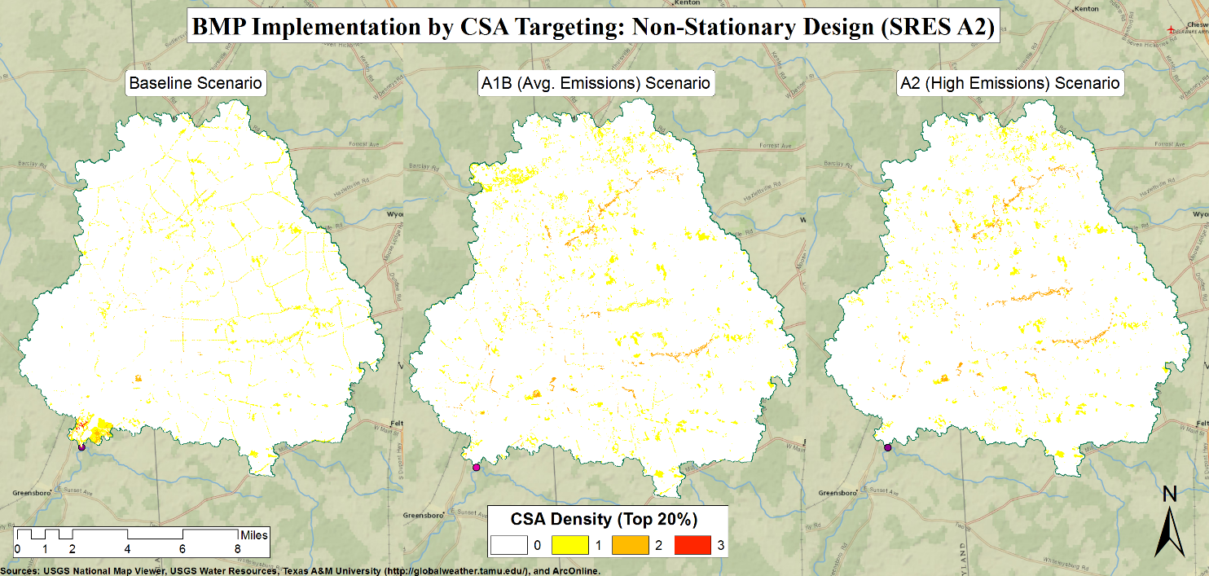
Targeting Dense CSAs of the Future
If we target CDA under high emissions, we address CSAs now and in future and meet TMDLs. Under this option we target 58% of watershed area instead of 31 %.
BMP eff. of 82%, 74% and 72% for TSS, TN and TP, respectively
Residual CSA Density with A2 BMP Design Subjected to Current, A1B and A2 Climate Conditions.
TMDL targets met
TMDL targets met
Notes:
In comparison, if we target critically dense CSAs under high emissions climate change conditions, we address CSAs now and into the future and TMDL targets are met. Under this strategy we are targeting 58% of the watershed, which is more than the 31% of the prior targeting strategy, but we achieve much better outcomes. But by needing to target are larger proportion of the watershed we demand greater stakeholder commitment.
Details:
A future design with a 20% threshold requires targeting 58% of the land area
BMP efficiencies of 82%, 74% and 72% for TSS, TN and TP respectively
TMDLs are met now and in the future (Except for TN >100%)

